Slide 1
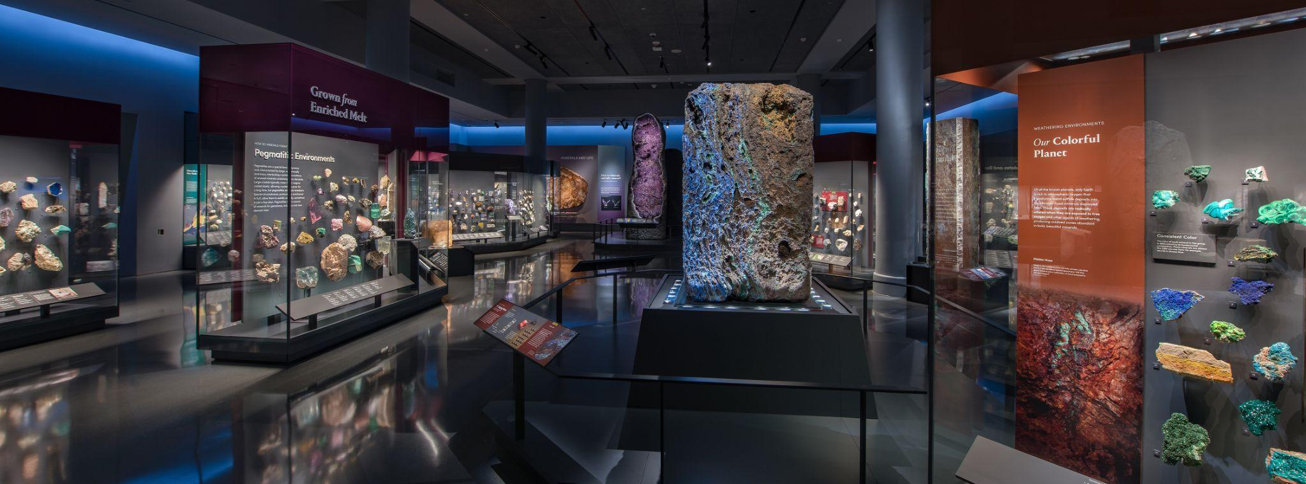
Mignone Halls of Gems and Minerals
GRADES 9–12 • EARTH SCIENCE
In this activity, you will…
Observe specimens that were formed by water
Notes:
Notes for Educator
This activity includes two parts:
Part 1: Before the Museum Visit
Part 2: After the Museum Visit

Slide 2
Part 1
Before the Museum Visit
Mignone Halls of Gems and Minerals
GRADES 9–12 • EARTH SCIENCE
Notes:
Notes for Educator
Part 1 is an engagement activity that uses the Visual Thinking Strategy (VTS) to help students practice observation, thinking, listening, and communication skills.
The concluding slide invites students to generate questions about the role of water in mineral formation. These questions can be recorded on a class or group chart, and be used as prompts for discussion after their Museum visit and/or for further research.

Slide 3
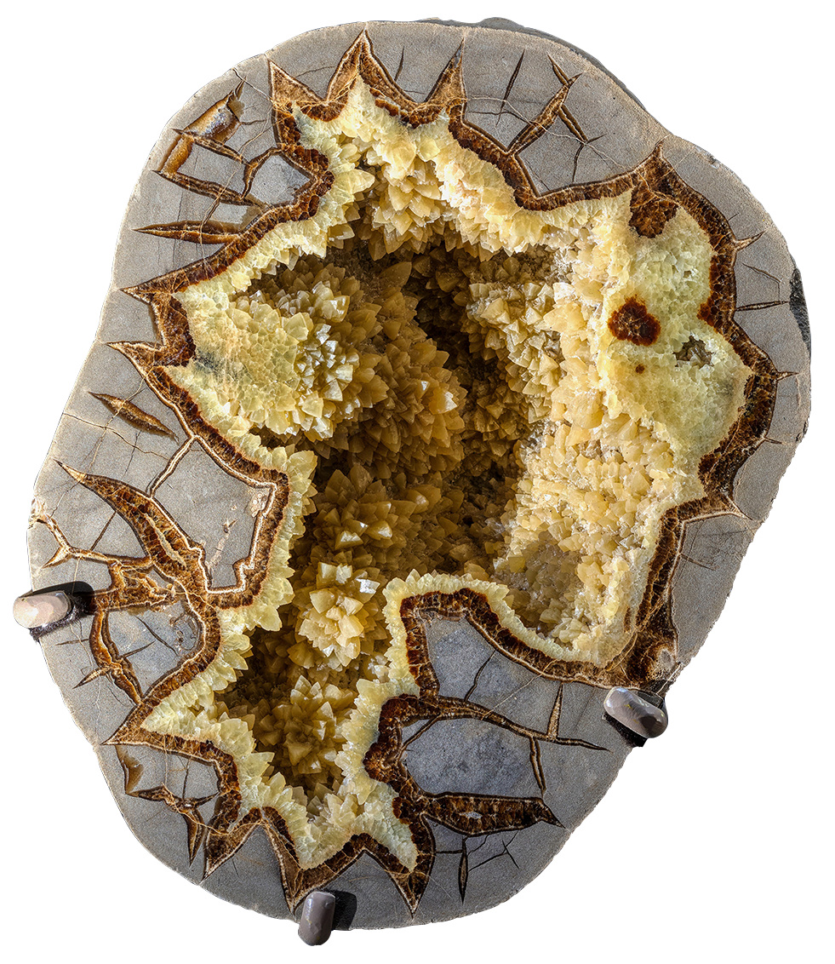
Look closely…
What do you see?

Slide 4
What do you notice about its…
Color?
Shape?
Crystal size?

Slide 5
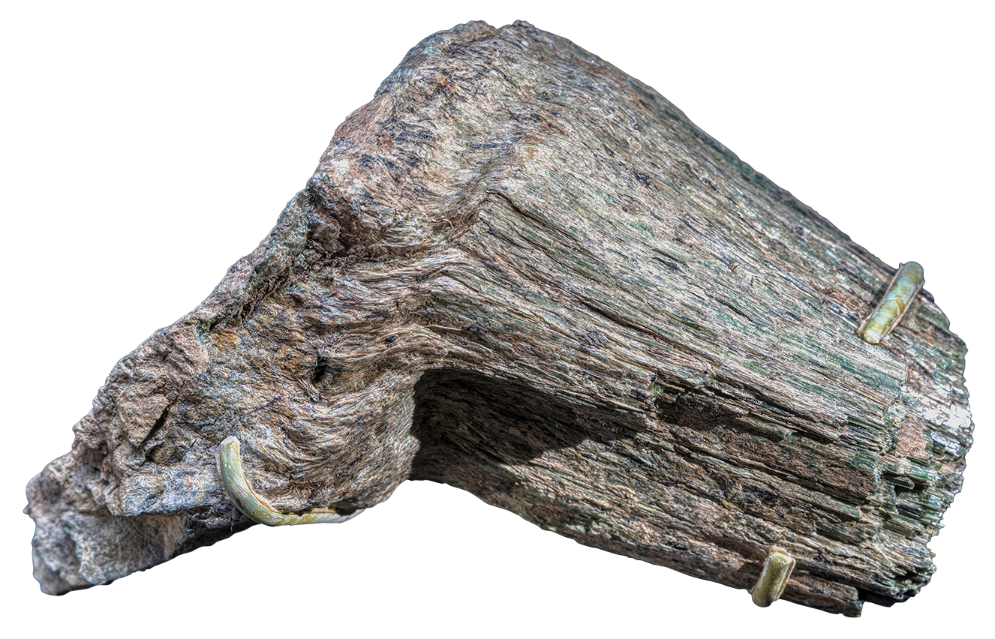
Look closely…
What do you see?

Slide 6
What do you notice about its…
Color?
Shape?
Crystal size?

Slide 7
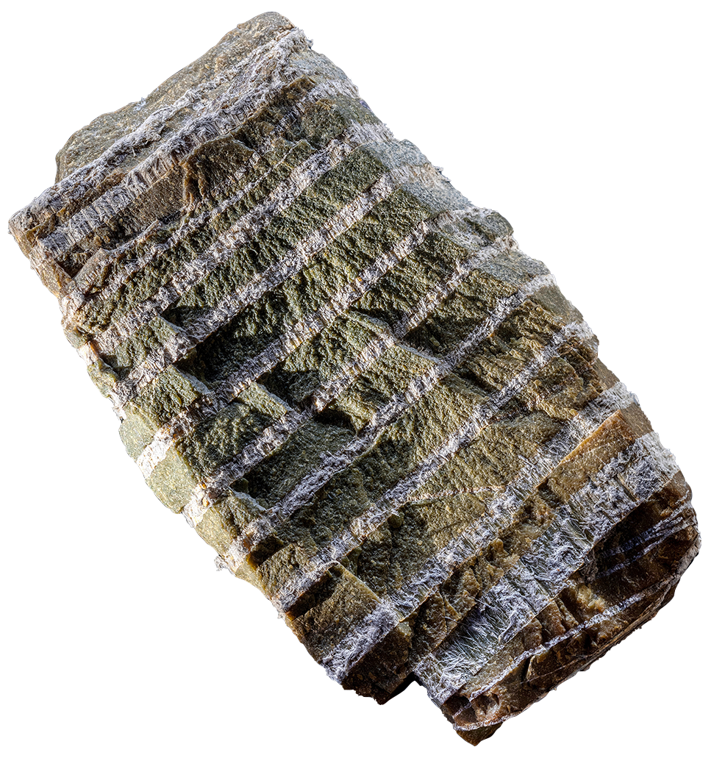
Look closely…
What do you see?

Slide 8
What do you notice about its…
Color?
Shape?
Crystal size?

Slide 9
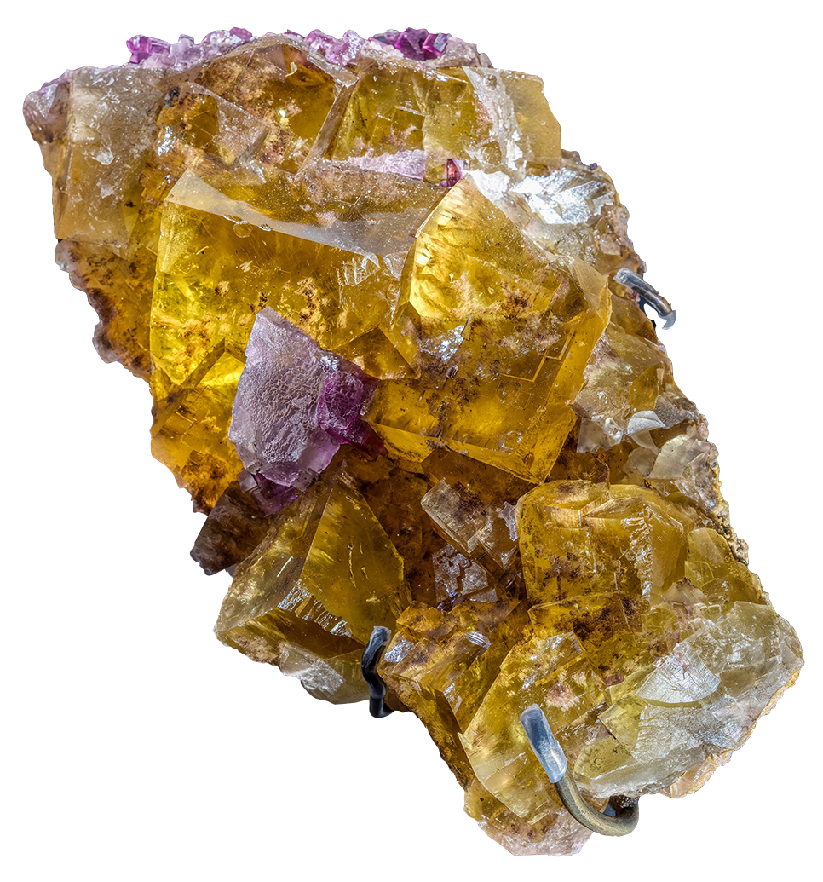
Look closely…
What do you see?

Slide 10
What do you notice about its…
Color?
Shape?
Crystal size?

Slide 11
What questions do you have about…
these minerals and the role water might have played in their formation?
Notes:
Notes for Educator
Questions can be recorded on a class or group chart so that students can revisit the questions after their trip to the Museum and/or use them as prompts for further research.
Suggested prompts:
Why do you think the minerals look this way?
What role do you think water might have played in their formation?
Tell students that when they visit the Museum, they are going to investigate the role water plays in mineral formation.

Slide 12
Part 2
After the Museum Visit
Mignone Halls of Gems and Minerals
GRADES 9–12 • EARTH SCIENCE
Notes:
Notes for Educator
Students revisit the same specimens from Part 1.
Students use their observations and what they’ve learned at the Museum and in the group discussions to figure out the role(s) water might have played in the formation of each specimen.
More information about each specimen and their formation are in the Notes section of each slide.

Slide 13
How might water have interacted with rock to form this specimen? Explain your inference.
Chemical addition adding elements
Chemical exchange swapping elements
Deposition depositing new minerals
Dissolution removing minerals
Hydration adding hydrogen and oxygen
Notes:
Notes for Educator
Specimen: Barite in a septarian nodule (Dalzell, South Dakota, USA)
Role of Water: Deposition
Description: Radial cracks that shrink from the center toward the rim characterize septarian nodules. This barite crystallized from water after matter in the center shrank, cracked or was removed by chemical reaction.

Slide 14
How might water have interacted with rock to form this specimen? Explain your inference.
Chemical addition adding elements
Chemical exchange swapping elements
Deposition depositing new minerals
Dissolution removing minerals
Hydration adding hydrogen and oxygen
Notes:
Notes for Educator
Specimen: Actinolite with clinochlore (La Palmilla, Zacapa, Guatemala)
Role of Water: Chemical Exchange
Description: This specimen grew along the boundary between a serpentinite and a jadeite albite rock. Water enabled chemical exchange between these rocks, and then crystallization of the new minerals actinolite and clinochlore.

Slide 15
How might water have interacted with rock to form this specimen? Explain your inference.
Chemical addition adding elements
Chemical exchange swapping elements
Deposition depositing new minerals
Dissolution removing minerals
Hydration adding hydrogen and oxygen
Notes:
Notes for Educator
Specimen: Lizardite and chrysotile (Hamburg, Eastern Cape, South Africa)
Role of Water: Hydration, Chemical Exchange, and Addition, followed by Deposition
Description: This lizardite formed when fluid added silica, hydrogen and oxygen to, and removed iron from, the surrounding peridotite rock. The fibrous chrysotile crystallized across fractures in the altered peridotite when the remaining fluid promoted growth of chrysotile.

Slide 16
How might water have interacted with rock to form this specimen? Explain your inference.
Chemical addition adding elements
Chemical exchange swapping elements
Deposition depositing new minerals
Dissolution removing minerals
Hydration adding hydrogen and oxygen
Notes:
Notes for Educator
Specimen: Fluorite (Elizabethtown, Illinois, USA )
Role of Water: Dissolution, followed by Deposition
Description: Water passing through fractures and pores in limestone dissolved calcite to make a cavity. Water then deposited a first layer of purple fluorite on the cavity wall, followed by yellow fluorite.

