Slide 1
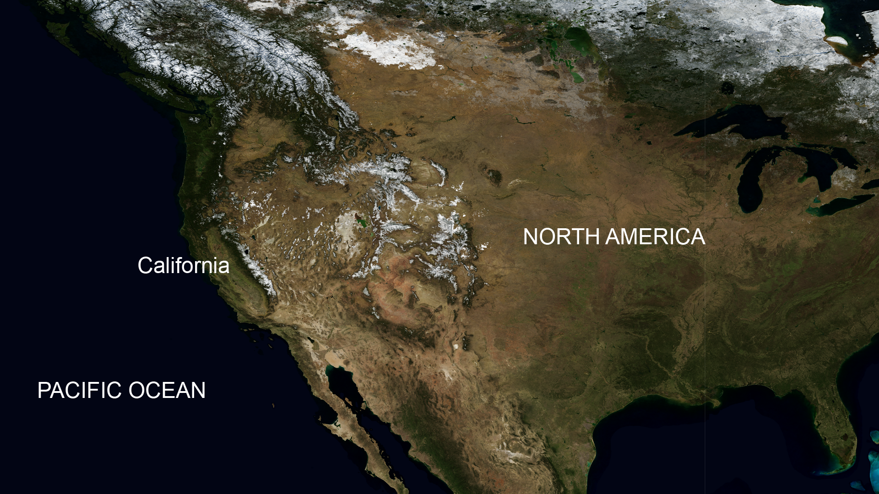
North America

Slide 2
The Mountain Deserts of California and Nevada

Slide 3
Nelson Bighorn Sheep (Ovis canadensis nelsoni)
Live in the California and Nevada mountain deserts.
They weigh ~ 300 lbs.
Their horns weigh up to 30 lbs.

Slide 4
Nelson Bighorn Sheep (Ovis canadensis nelsoni)
Live in mountaintop populations of often less than 50 individuals.
To mate, males travel through valleys to different mountaintops.

Slide 5
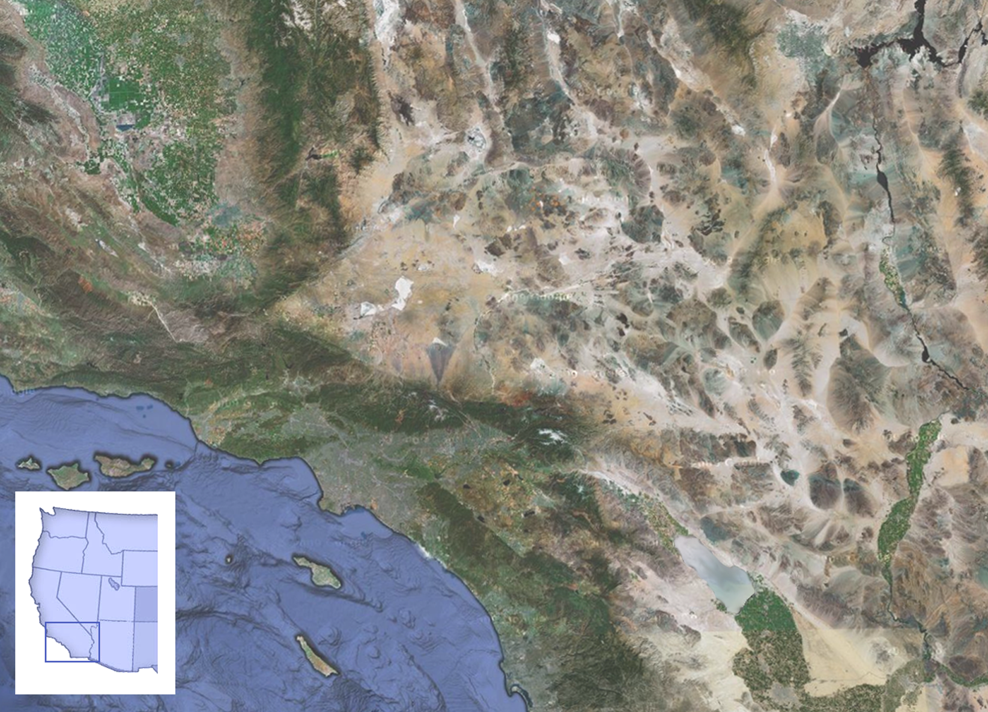

Slide 6
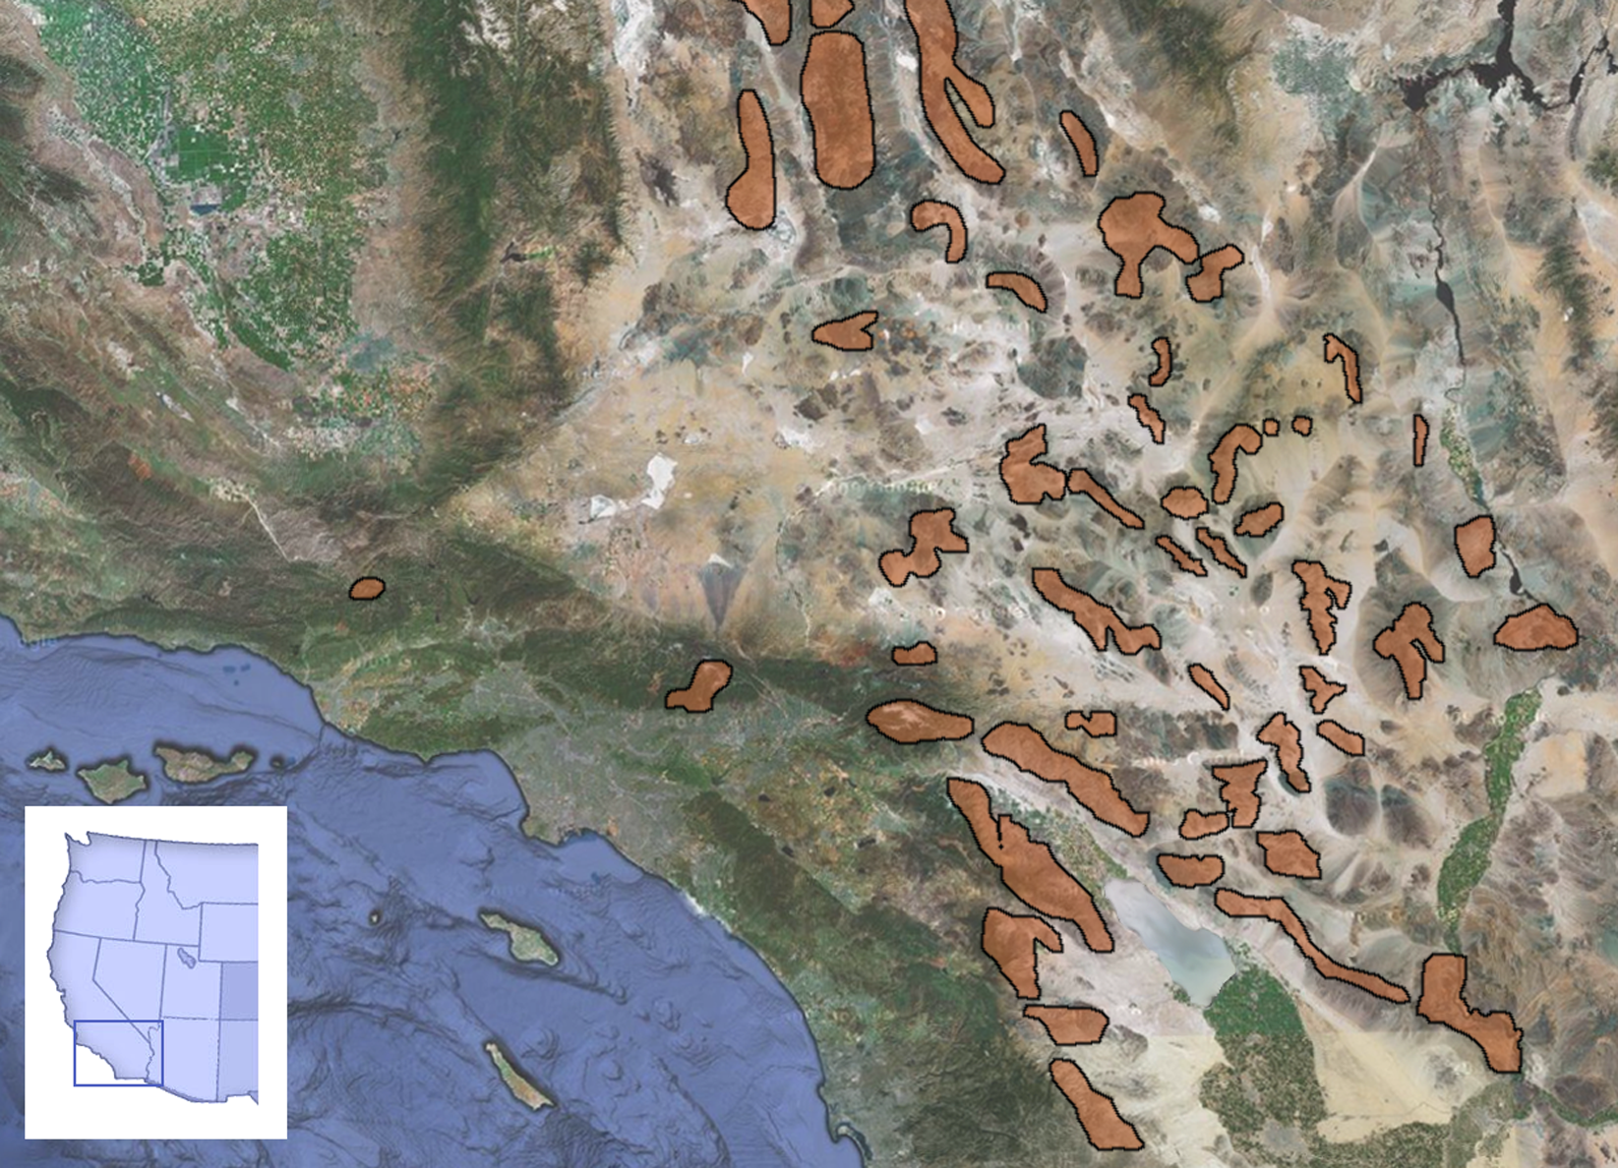

Slide 7
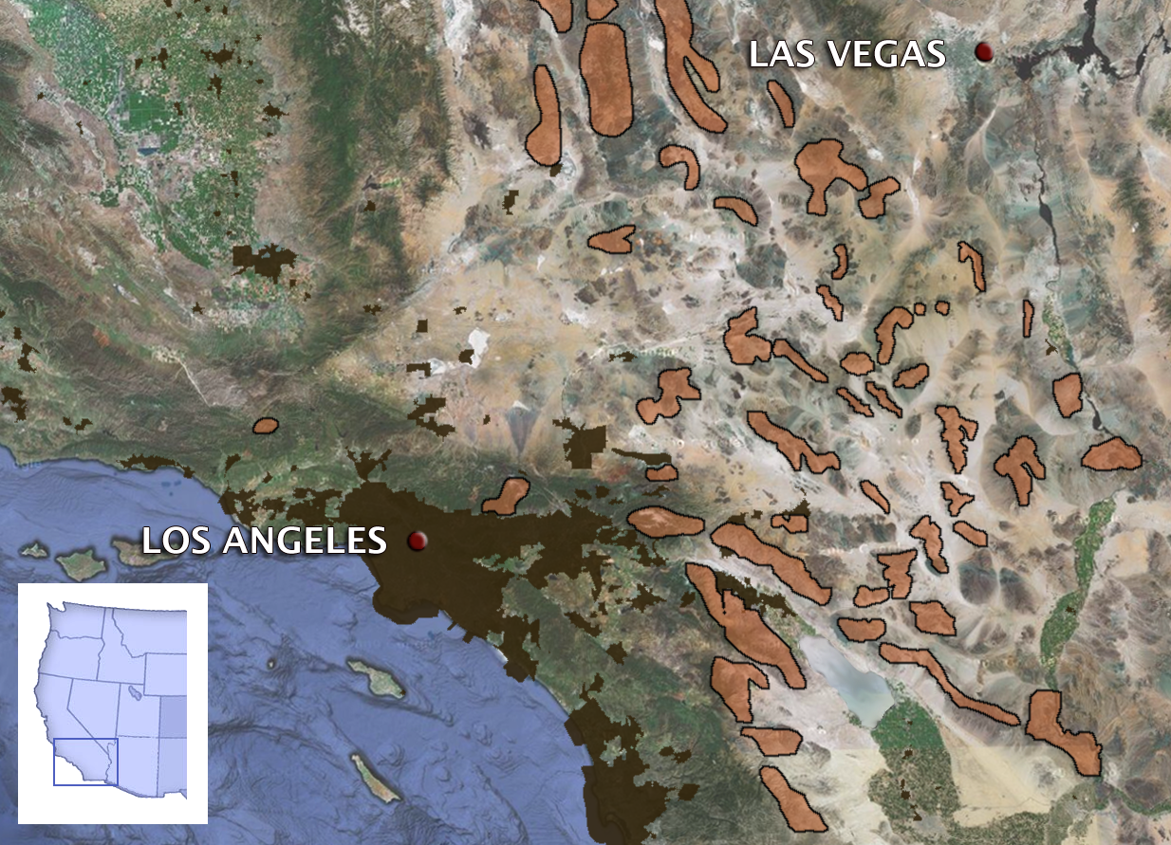

Slide 8
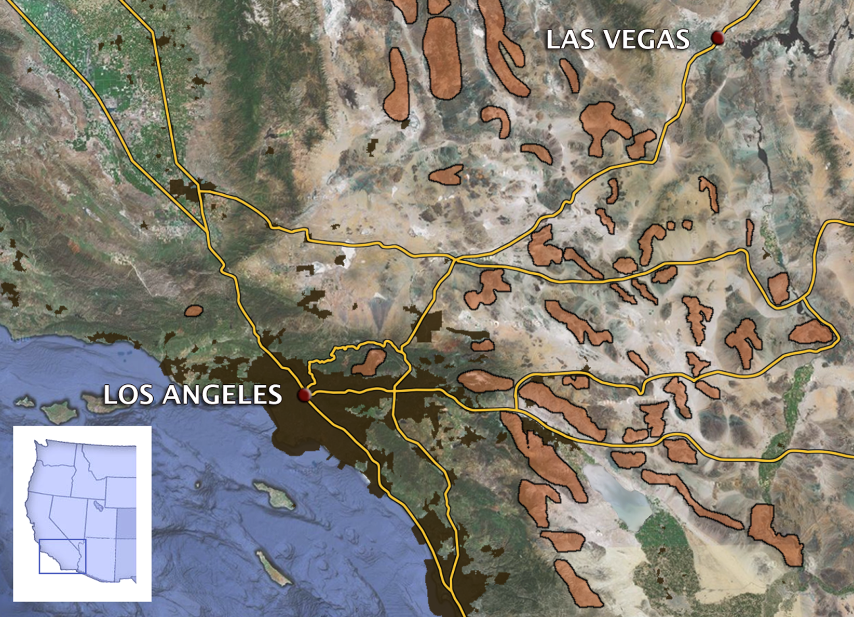

Slide 9
This map is just a slightly different representation of the same area.
What do the
patterns and
colors mean?
Notes:
9
This prints out pretty clearly in black and white.

Slide 10
Notes:
10
This prints out pretty clearly in black and white.

Slide 11
Clinton Epps and colleagues studied 27 bighorn sheep mountaintop populations
Notes:
11
This prints out pretty clearly in black and white.

Slide 12
They named each population for the mountain on which the population lives.

Slide 13
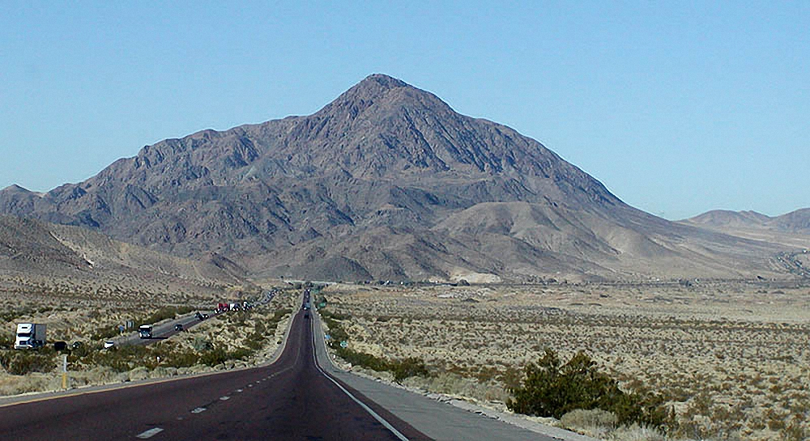
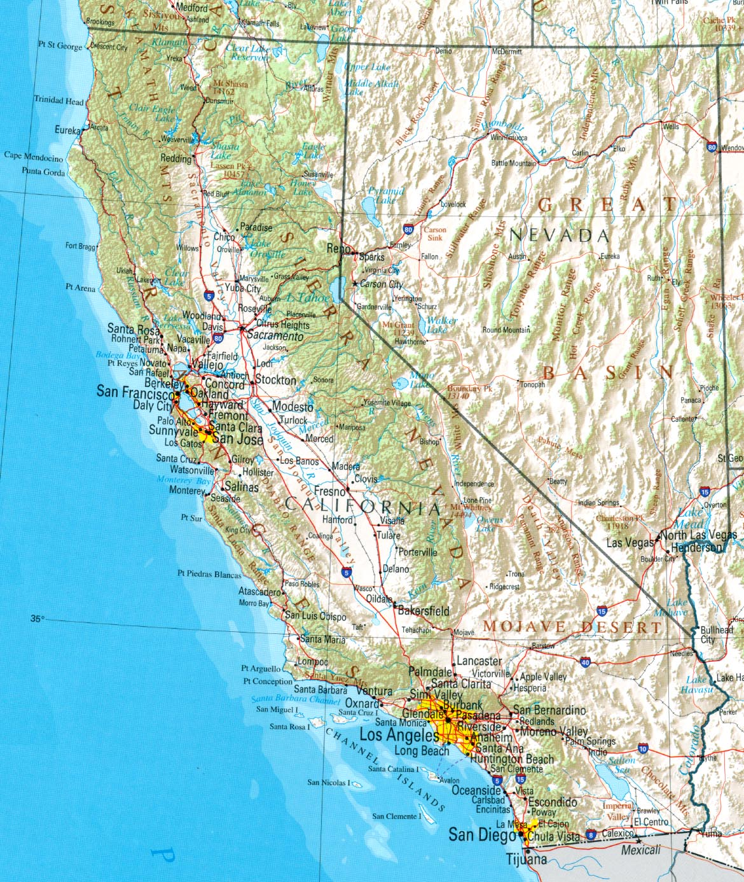
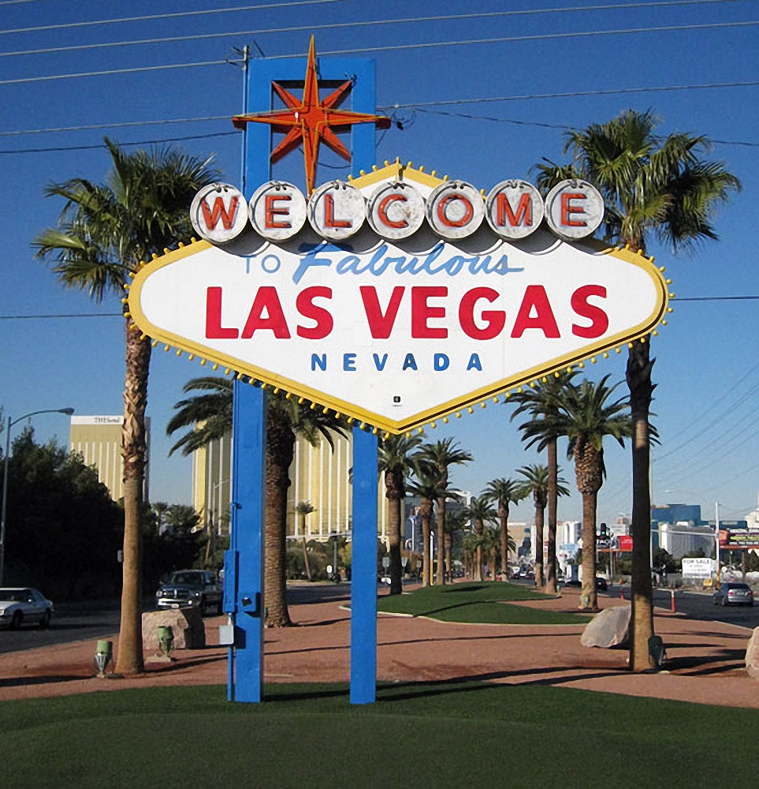
Major highways that connect Los Angeles and Las Vegas run through the bighorn sheep habitat.
Notes:
Road Map LA/Vegas: CA Department of Transportation

Slide 14
How are the highways important to Las Vegas?
Notes:
Road Map LA/Vegas: CA Department of Transportation
Desert Road: Jimmy Hoofa
Welcome to Las Vegas Sign: Las Vegas Convention & Visitors Authority

Slide 15
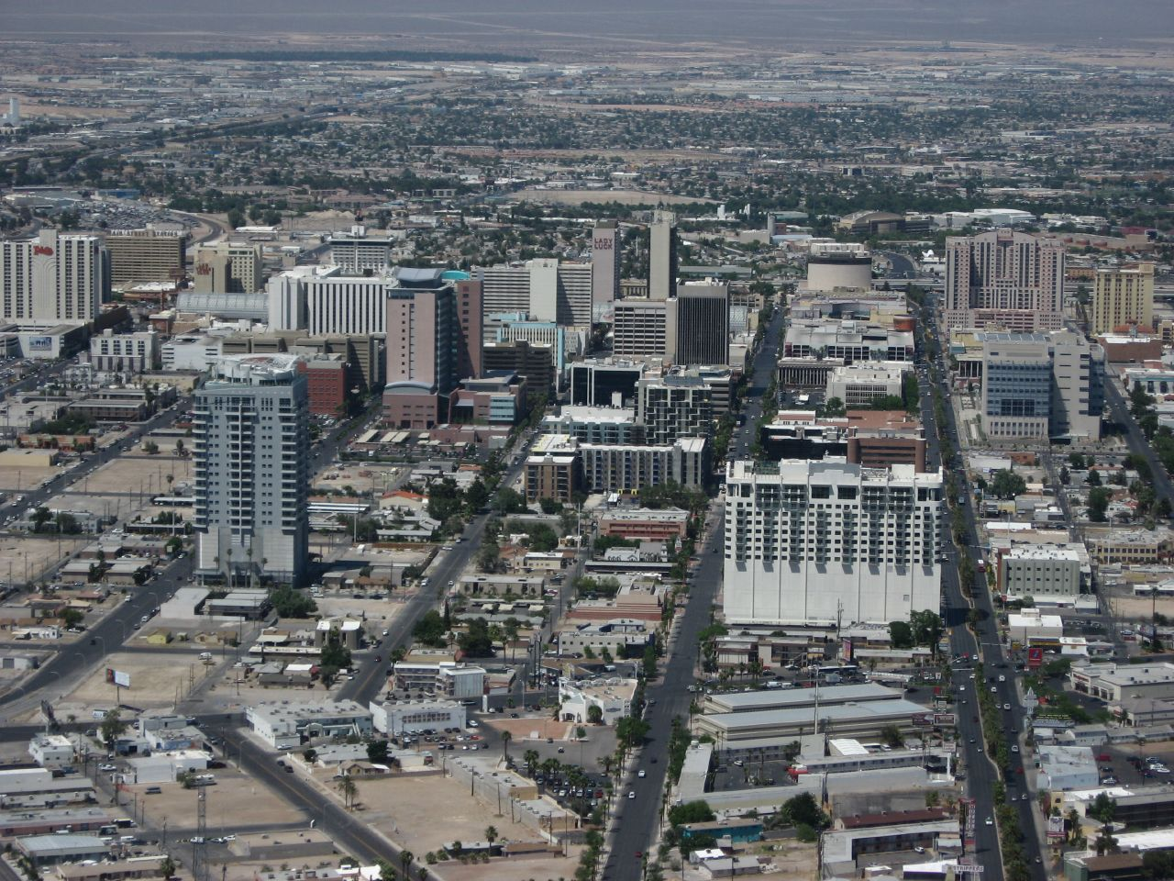
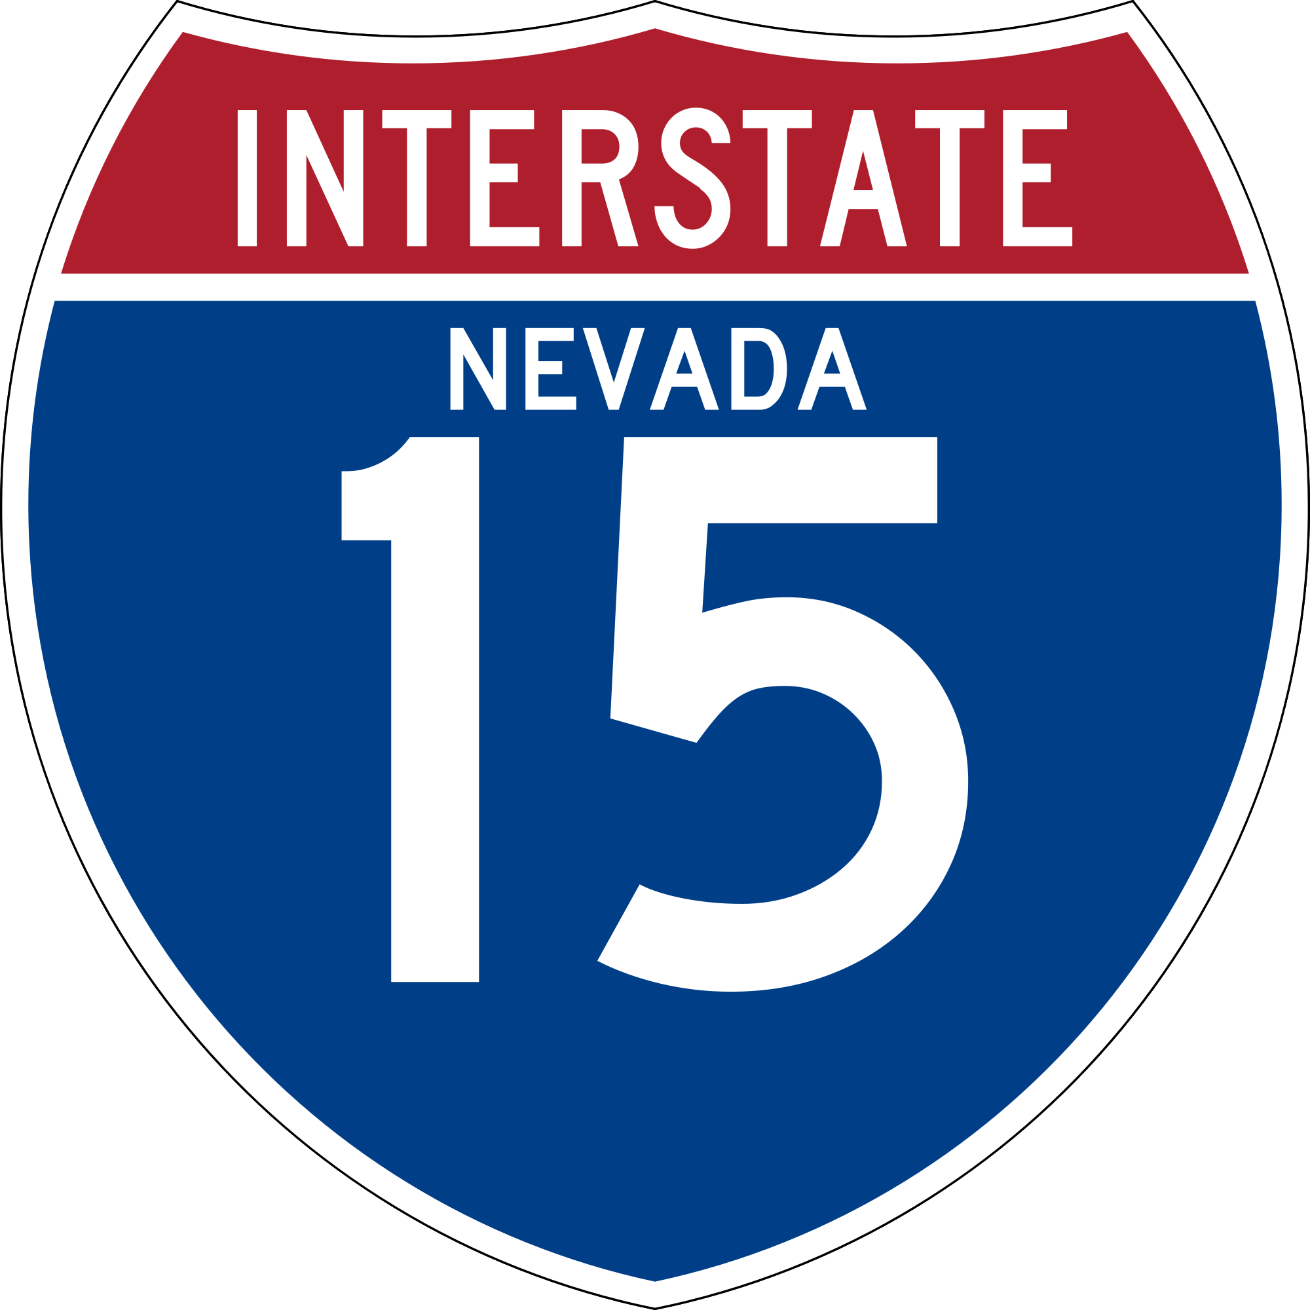
Importance
Half of all visitors to Las Vegas arrive by car and most are from California.
People visit for gambling, entertainment, and conventions
Jobs for about 300,000 people
Contribute billions of dollars to the economy that funds schools, museums, and city services.
Notes:
Intersate: Las Vegas Convention & Visitors Authority
Las Vegas Seal: Las Vegas Convention & Visitors Authority
Downtown Vegas: Ken Lund
Slots: Las Vegas Convention & Visitors Authority
Skyline Las Vegas: Las Vegas Convention & Visitors Authority
Lion King: Photofest

Slide 16
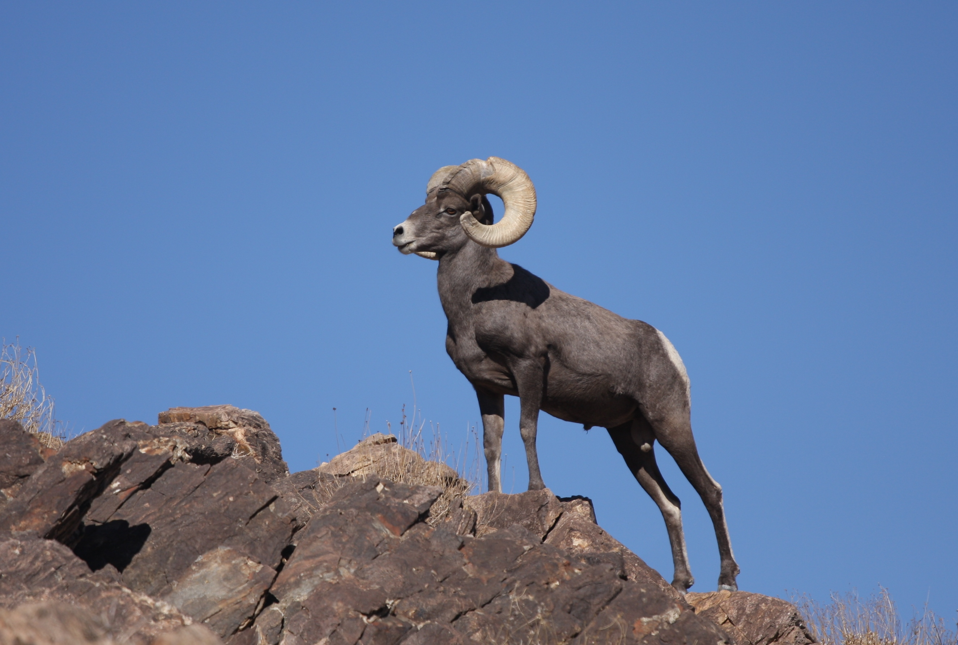
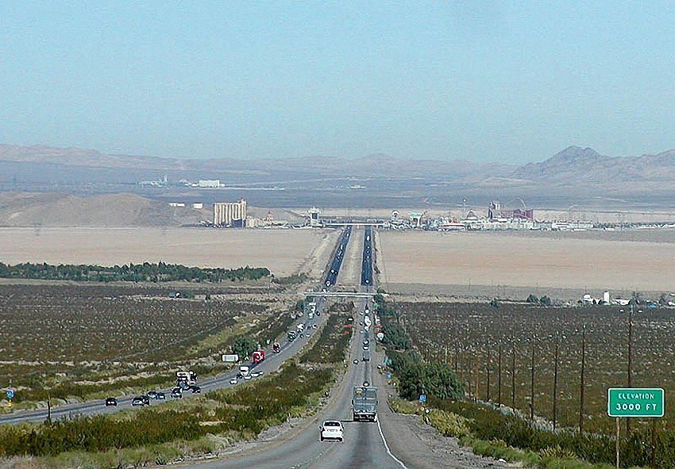
We know the highways are important, but one scientist wondered how they might affect the sheep.
Notes:
Longhorn Sheep: Magnus Kjaergaard
Route 15: Stan Shebs

Slide 17
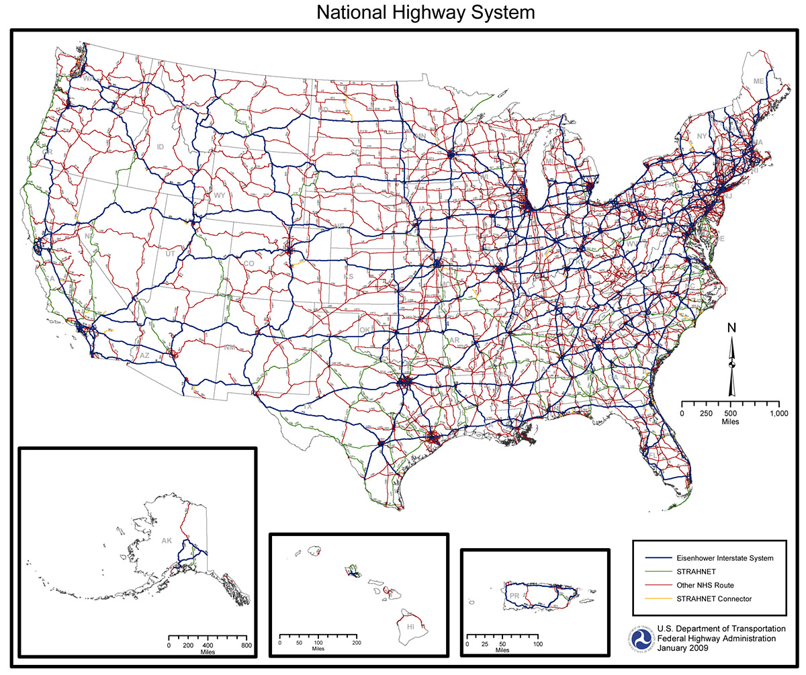
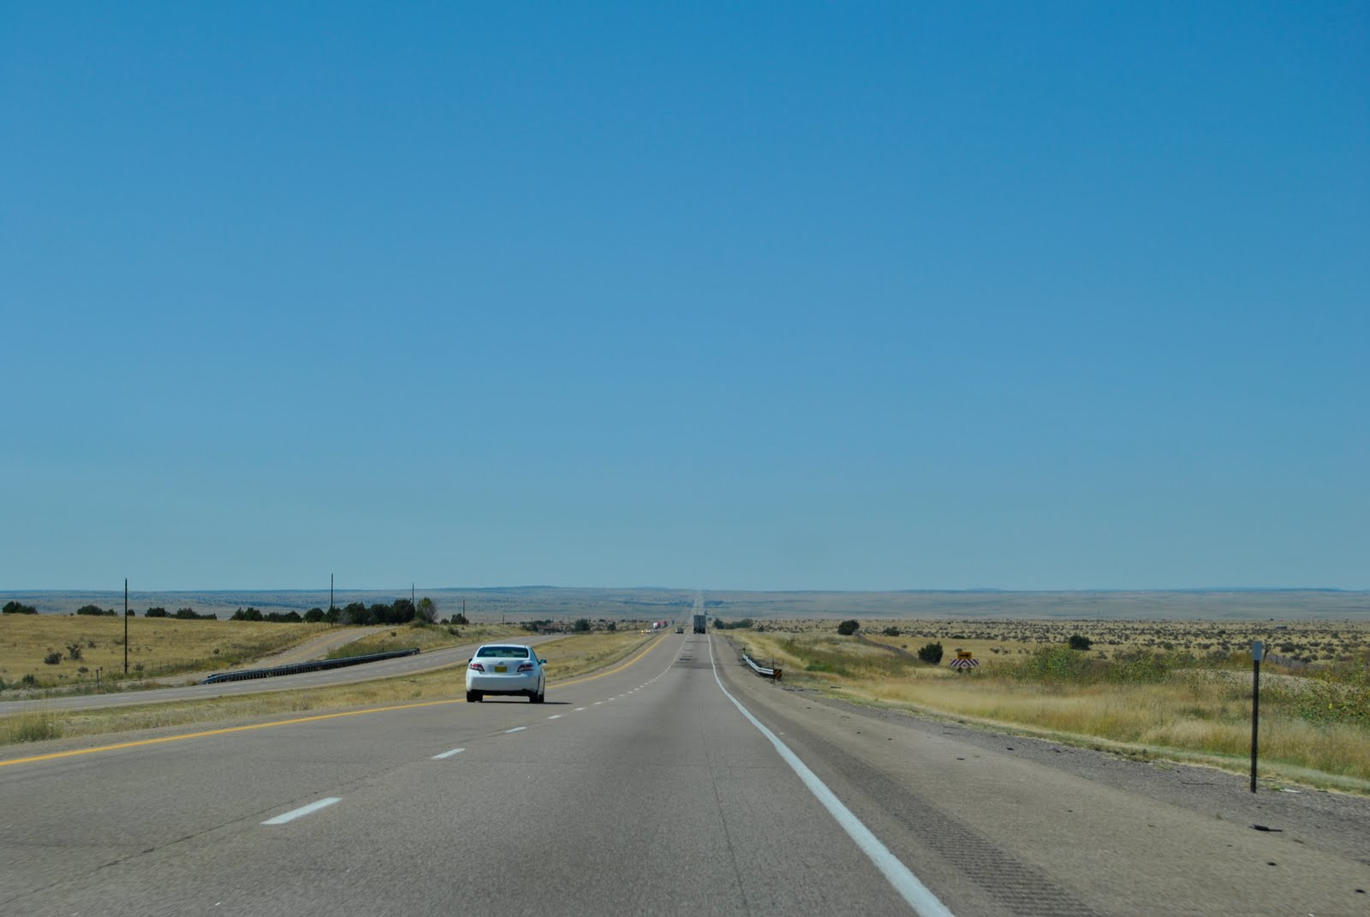
How might highways impact living things that live near them?
Notes:
Map National Highway System: US Department of Transportation/Federal Highway Administration
Cali Interstate 5: Thought Balloons Blog

Slide 18
What do you notice about this picture?
Notes:
Route 15: Stan Shebs

Slide 19
What do you notice about this picture?
Fence
Clinton Epps wondered if the fenced highways setup un-natural borders for wild bighorn sheep populations.
Notes:
Route 15: Stan Shebs

Slide 20
Image Credits
13-14. Road Map LA/Vegas: CA Department of Transportation; Desert Road: Jimmy Hoofa; Welcome to Las Vegas Sign: Las Vegas Convention & Visitors Authority
15. Interstate Sign, Las Vegas Seal, Slots, Skyline Las Vegas : Las Vegas Convention & Visitors Authority; Lion King: Photofest; Downtown Las Vegas: Ken Lund
16. Bighorn Sheep: Magnus Kjaergaard Route 15: Stan Shebs
17. Highway Map: US Department of Transportation/Federal Highway Administration California Interstate 5: Thought Balloons Blog
18-19.Route 15: Stan Shebs

