Slide 1



Five Tools and Processes for
Translating the NGSS into Instruction and Classroom Assessment
Tool 5:
Using Evidence of Learning Specifications
to Develop a Performance Task and Rubric

Slide 2
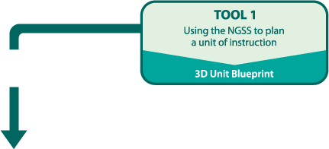
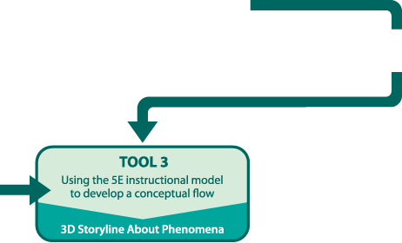
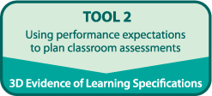
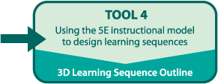
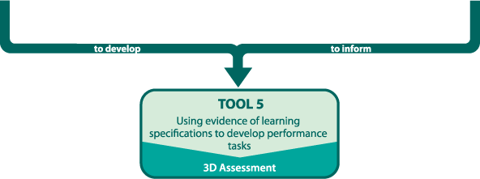




Slide 3
Goals
Apply a common understanding of high quality classroom assessment to the development of a performance task
Deepen understanding of how performance tasks align to Evidence of Learning Specifications based on Performance Expectations.
Use Evidence of Learning Specifications developed in Tool 2 to create a performance task with rubrics as a summative assessment of an instructional sequence

Slide 4
Developing Assessments for the
Next Generation Science Standards
What does three-dimensional assessment mean to you?

Slide 5
Developing Assessments for the
Next Generation Science Standards
“Assessment tasks have to be designed to provide evidence of students’ ability to use practices, to apply their understanding of the crosscutting concepts, and draw on their understanding of specific disciplinary ideas, all in the context of addressing specific problems.”
      Pellegrino, Wilson, Koenig, Beatty, Editors, Developing Assessments for the Next Generation Science Standards National Academies Press (2014)

Slide 6


PE
Clarification
Statement
To Teachers
Assessment Boundary
= Claim
DCI
SEP
CCC
Assessment Task
Evidence of Learning Specifications
Nature of Science
Engineering, Tech, and App of Science
Evaluate Lesson

Slide 7
Classroom Assessment Design
Design Guidelines | What is it? | How Does NGSS help me think about it? | How do I use it?
Performance Expectations | States what students should know and be able to do. | Reminds me that PEs integrate the three dimensions: SEPs, DCIs, CCCs | Tool 1
Evidence of Learning Specifications | Specifications for the evidence that students have achieved and/or surpassed the PE. The evidence is obtained through observations of students and/or student work products. | Helps me describe an assessment(s) that integrates the three dimensions within the PE(s). | Tool 2
Assessment Task and Rubric | The Assessment Task requires students to demonstrate that they have achieved and/or surpassed the PEs by performing or producing student work aligned to the Evidence of Learning Specifications |  | Tool 5
Provide the foundation for assessment task

Slide 8
Tool 2: Planning for Assessment
What are the performance expectations?
PE
What evidence of learning specifications will guide assessment task(s) development?
Evidence
of Learning Specs
Tool 5: Developing Classroom Assessments
How will students demonstrate their achievement of the performance expectations?
Task

Slide 9
Thinking Through a Performance Task
Read a performance task
Respond to the prompts
Compare your responses to the Scoring Rubric
Check alignment with Evidence of Learning Specifications and PEs

Slide 10
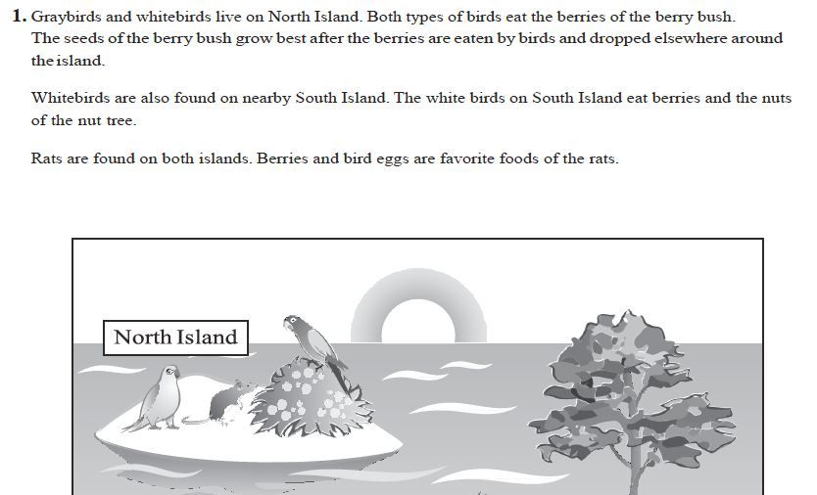
Performance Task for Instructional Sequence 1

Slide 11
Performance Task and Student Checklist
Read Performance Task and review the Student Checklist
With a partner write an ideal student response for each prompt

Slide 12
Scoring Rubric
Compare your responses to the Scoring Rubric
To what extent do your responses align with the Scoring Rubric?
What was alike? What was different?
Consider the ways each response combines SEPs, DCIs, and CCCs.

Slide 13
Checking Alignment
Read the PE and the Evidence of Learning Specifications (EoLS)
Read each Performance Task prompt.
On your performance task handout, record the number of each Evidence of Learning Specification near the corresponding section.
Use the appropriate color to highlight the prompt to show how it makes student thinking about each dimension visible.
  Orange = DCI
  Blue = SEP
  Green = CCC

Slide 14
Making Decisions
How might you modify this task to better support students’ learning?

Slide 15
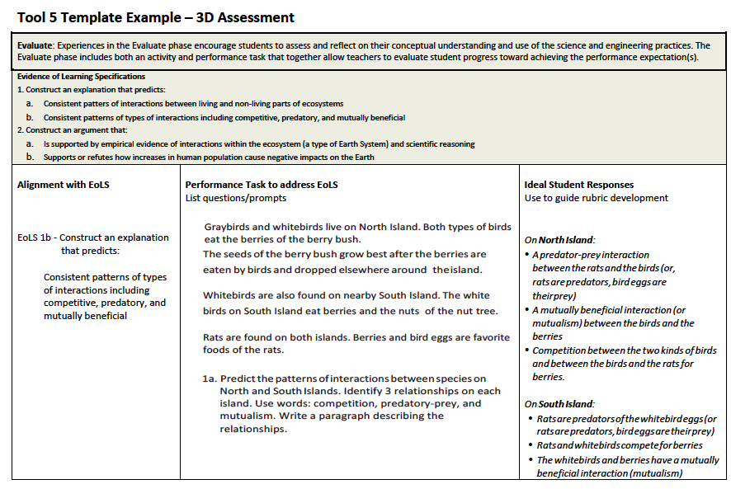
Tool 5 Example

Slide 16
Guide for Developing a
Performance Task & Rubric
Step 1: Review your EoLS
Step 2: Explore resources, use Evaluate Analysis Guide
Step 3: Construct performance task questions and prompts aligned with EoLS
Step 4: Develop Scoring Rubric (high, low, and medium levels as needed)
Step 5: Develop Student Checklist

Slide 17
Developing a Performance Task
How does this process compare to what you have traditionally done in developing assessments?

Slide 18
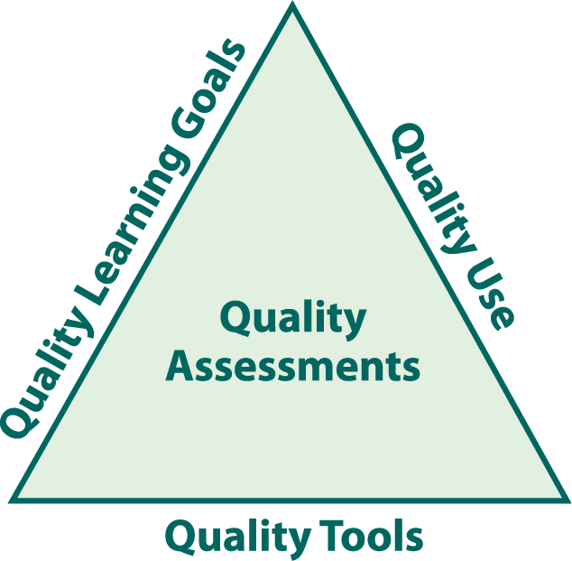
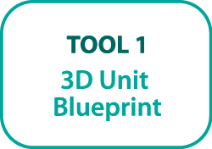
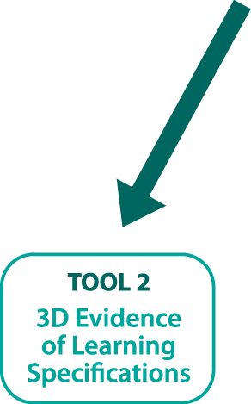

Quality Assessments
Adapted from the
Assessment-Centered Teaching Framework

Slide 19
Your Turn
Use the Guide to Developing a Performance Task and Rubric to complete Tool 5 and design a performance task, scoring rubric, and student checklist for the Evaluate in your learning sequence from Tool 4.

Slide 20
Reflection
How has your thinking about developing performance tasks for classroom assessment in the era of NGSS changed?

