Slide 1



Five Tools and Processes for
Translating the NGSS into Instruction and Classroom Assessment
Tool 4:
Using the 5E Instructional Model
to Design Learning Sequences

Slide 2
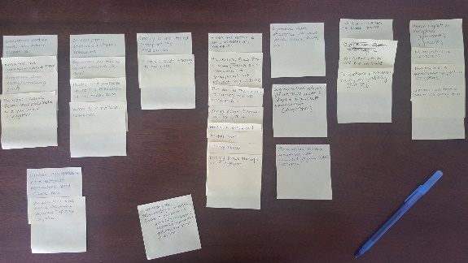
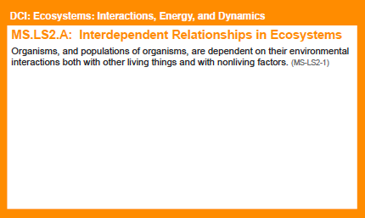
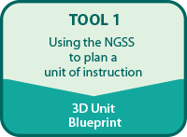

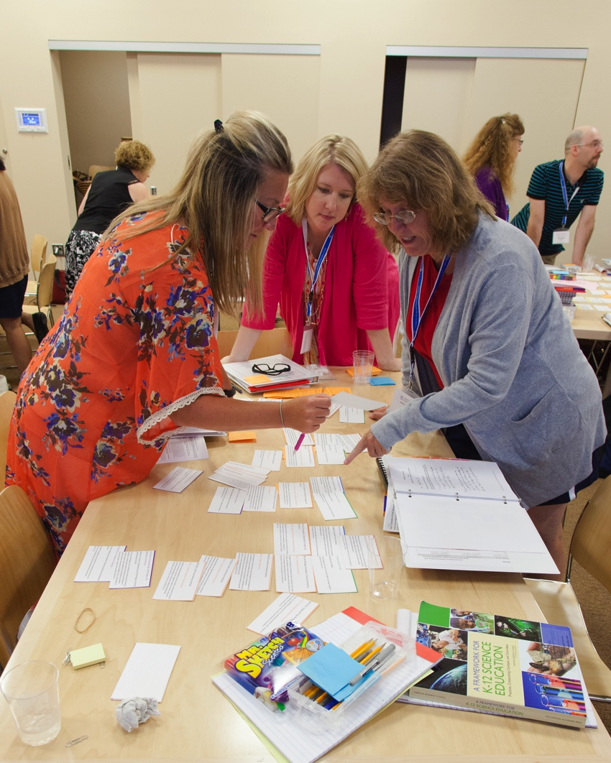




Slide 3
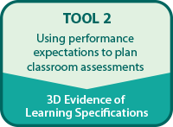
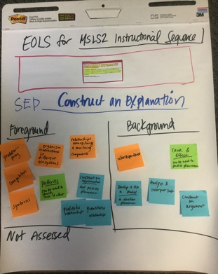
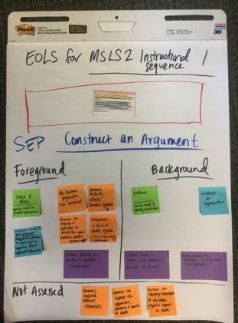
Performance Expectations
Evidence of Learning Specifications

Slide 4
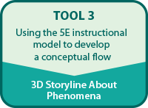
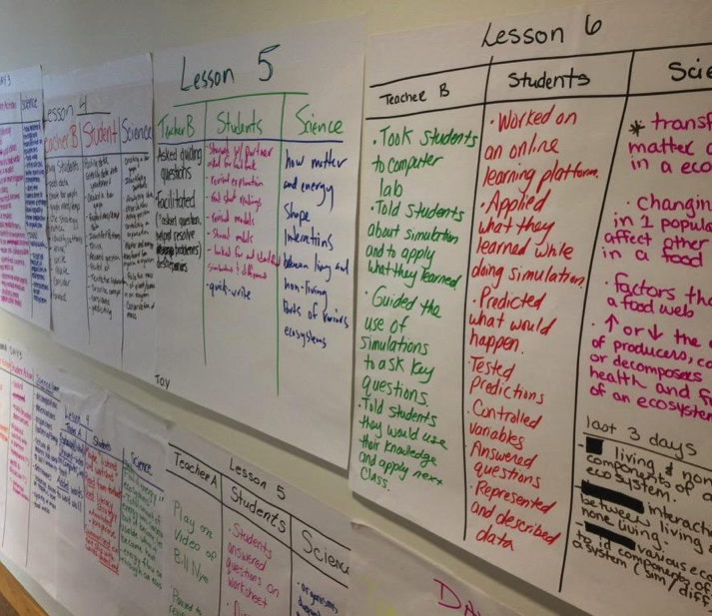
Classroom
Scenario
Ms. Rivera
Instructional Sequence
5E Model
Storyline
Anchor Phenomena
5E Model
Engage
Explore
Explain
Elaborate
Evaluate

Slide 5
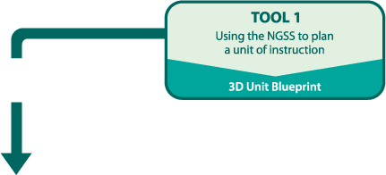
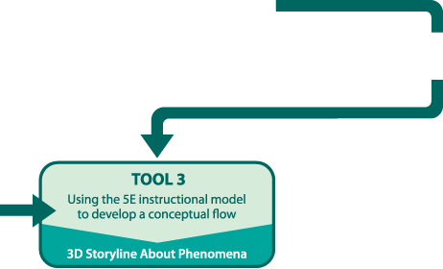
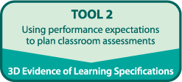
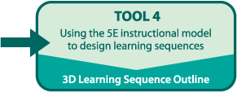
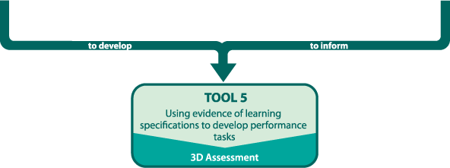

Slide 6
Goals
Develop a shared vision for science teaching and learning informed by the NGSS
Deepen understanding of how Conceptual Flow, Storyline about Phenomena and the 5E Instructional Model support Three Dimensional Learning
Use instructional materials and results of work with Tools 1, 2 and 3 to outline lessons for one 5E sequence that supports implementation of the NGSS

Slide 7

How Will We Accomplish These Goals?
Use our Storyline about Phenomena and
Conceptual Flow
Use the 5E Instructional Model
to design an instructional sequence aligned to the NGSS DCIs, SEPs, CCCs, and Connections

Slide 8
Ms. Rivera
What do you think Ms. Rivera considered as she planned for instruction and during instruction?

Slide 9
Tool 4
Part 1
Title
Key Resources
SEP; DCI; CCC
Connections
PEs
Prior Knowledge
Common Student Ideas
Part 2
What teachers are doing | What students are doing | Science Concepts
NGSS

Slide 10
Linking to the NGSS
As a group, review the lesson you charted from Ms. Rivera’s 5E sequence
Use colored sticky-notes to code for evidence in your chart of NGSS alignment
  DCIs (orange)
  SEPs (blue)
  CCCs (green)
  Connections to NOS and ETAS (purple)

Slide 11
Alignment with 5E Model
Use the handout to identify what is consistent and what is inconsistent with the 5E model.
On your chart, underline key words or phrases that are consistent with the “E” of your lesson.

Slide 12
Connections to Tool 3
Tool 3 helped develop the storyline. Tool 4 will help develop the instructional sequence that supports teaching the storyline.
As you use Tool 4,
Keep the phenomenon in mind at all times.
If an idea is not related to the phenomenon, it is distracting.
Do not include activities or ideas just because they are “interesting.”
Review the storyline often.
Include guiding questions for each activity. This will help you and your students stay focused.

Slide 13
Tool 4
Part 1
Title
Key Resources
SEP; DCI; CCC
Connections
PEs
Prior Knowledge
Common Student Ideas
Part 2
What teachers are doing | What students are doing | Science Concepts
NGSS

Slide 14
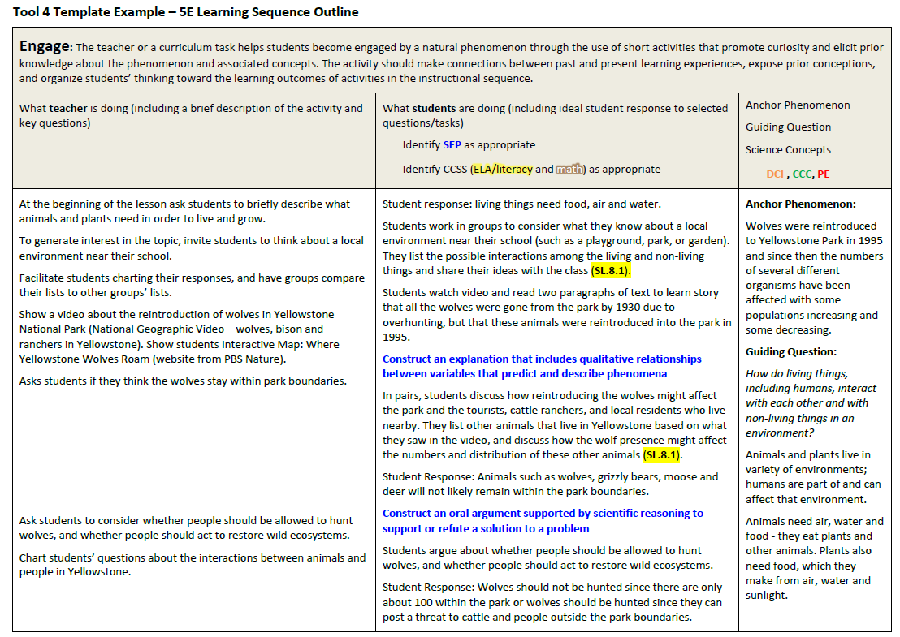
Tool 4 Example

Slide 15
Ms. Rivera’s Tool 4 Example
Read your lesson in the Tool 4 Example.
Ms. Rivera used Tool 3 to create the 3rd column (Anchor Phenomena, Guiding Question and Science Concepts).
What did she need to consider in order to plan what the teacher was going to do and what the students were going to do?
Notes:
15 min
Review the directions on the slide with participants. Based on the Ms. Rivera lesson each group charted, instruct each group to find the corresponding section for the same lesson in the Tool 4 Example.
Ms. Rivera reviewed: SEPs, ELA and math connections
Participants should review the Connections to Common Core cards for ELA/Literacy and Mathematics that were first shared during Tool 1 and set aside until now. Identify the ELA/Literacy and Mathematics connections cards that align with the PEs for this instructional sequence.
Note: Look for Common Core cards aligned with MS---LS2---2. There are five ELA/Literacy cards and one Mathematics card that align.
Tell the participants to compare their charts with the Tool 4 Example.

Slide 16
Steps for Completing Tool 4
Brainstorm/Identify activities/prompts/investigations from your instructional materials.
Use the Analysis Guides to decide to keep, tweak, or delete activities/prompts/investigations to support your NGSS aligned conceptual flow
Enter your work electronically on Tool 4

Slide 17
Using Analysis Guides
Identify
  What activities/prompts/investigations do I have related to the concept and “E?”
Analyze
  How well does the “current” activity ….
Revise
  Can I use the resource in the development of my 5E instructional sequence?
    Keep it
    Tweak it
    Get rid of it
  How will I use the resources for this phase of the 5E instructional sequence?

Slide 18
Using Analysis Guides
Identified “E”-- Explore
Identified Concepts
  Food webs can represent patterns of feeding relationships among organisms in an environment.
  Cause and effect relationships represented in a food web may be used to predict phenomena.
Sample Activity
Work in your group using the Explore Analysis Guide to determine if you would keep, tweak or get rid of the activity
Share your thinking

Slide 19
Steps for Completing Tool 4
Brainstorm/Identify activities/prompts/investigations from your instructional materials.
Use the Analysis Guides to decide to keep, tweak, or delete activities/prompts/investigations to support your NGSS aligned conceptual flow
Enter your work electronically on Tool 4

Slide 20
Share your Work
Partner with another group and share what you have been working on.
Before sharing, let the other group know specifically what you might want feedback on.

Slide 21
Reflection
What is one thing you want to remember about aligning instruction with the NGSS?
What is one thing you want to remember about using the Analysis Guides to plan instruction?

