Slide 1
Five Tools and Processes for Translating the NGSS into Instruction and Classroom Assessment
Tool 3:
Using the 5E Instructional Model
to Develop a Conceptual Flow

Slide 2
Planning for Teaching and Learning
Quick-write
How would you describe your classroom and the factors that guide your decisions about science teaching and learning?
How are these factors influenced by the NGSS?
Be prepared to share one idea from your quick-write

Slide 3
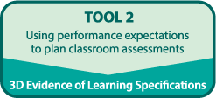
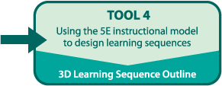
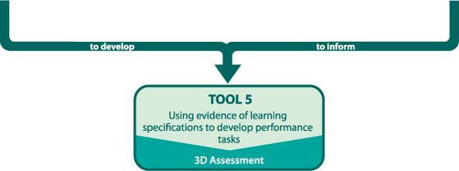

Slide 4
Goals and Outcomes
Deepen understanding of the BSCS 5E Instructional Model to support planning for instruction and assessment aligned with the NGSS
Develop a coherent storyline about phenomena and a conceptual flow aligned with the NGSS

Slide 5
Science Teaching and Learning
Read the Classroom Scenario A
Individually highlight your assigned lesson(s)
What is the teacher doing? (highlight in yellow)
What are students doing? (highlight in pink)
What is the science in this lesson? (underline)
As a group, chart what you highlighted for your assigned lesson(s)
Gallery Walk
How would you describe this classroom?
Individual Reflection
How would you describe this classroom?
Lesson ______
Teacher A | Students | Science

Slide 6
Science Teaching and Learning
Read the Classroom Scenario B
Individually highlight your assigned lesson(s)
What is the teacher doing? (highlight in yellow)
What are students doing? (highlight in pink)
What is the science in this lesson? (underline)
As a group, chart what you highlighted for your assigned lesson(s)
Gallery Walk
How would you describe this classroom?
Individual Reflection
How would you describe this classroom?
Lesson ______
Teacher B | Students | Science

Slide 7
Ms. Rivera
What is the evidence (or not) that Ms. Rivera considered the following in her planning?
Planned using her Tool 1 blueprint instructional sequence 1 focused on MS-LS2
Integration of laboratory experiences with ELA literacy
Ways in which students engage in the practices
Use of formative assessment
What other factors do you think she considered?

Slide 8
How People Learn
Summarize the key ideas of the reading
How are these ideas evident in Ms. Rivera’s lessons?

Slide 9
Thinking beyond a Lesson to an Integrated Instructional Sequence
Integrated instructional units interweave laboratory experiences with other types of science learning activities, including discussion, reading, writing, and mini-lectures.
Students are engaged in forming research questions, designing and executing investigations, gathering and analyzing data, and constructing explanations and arguments.
Diagnostic and formative assessments are embedded into the instructional sequence and can be used to promote self-reflection about students’ thinking.
National Research Council, 2006

Slide 10
NGSS Instructional Design
Instructional materials are designed with clear performance expectations in mind
Learning experiences are thoughtfully sequenced into the flow of classroom science instruction
Learning experiences are designed to integrate learning of science concepts (DCI and CCC) with learning about the SEP
Students have opportunities for ongoing reflection, discussion, discourse, & argumentation
Bybee, 2014

Slide 11
Research-Based Instructional Model
NRC’s
How People Learn
Meta-analysis of 30 years of research
BSCS 5E Instructional Model
Developed by BSCS for a curriculum project
NRC’s
Curriculum Framework
Framework for the NGSS

Slide 12
BSCS 5E Instructional Model Is a specific example of the general architecture for an Integrated Instructional Sequence
An Engage Lesson
Exploration Lesson(s)
Explanation Lesson(s)
Elaboration Lesson(s)
Evaluation Lesson(s)
Bybee, 2014

Slide 14
Selected Reading
Focus questions while reading
What are the key characteristics of each phase of the model?
How does the entire BSCS 5E instructional model support student learning?
Be prepared to share your response to question 2 with your small group.
Notes:
25 min
Option
Read the 5Es
Short reading from HPL/HSL – 1 pager.
No reading from the Framework
Option
Slide w/ a few key points….Visual graphic that represents how Framework, HPL/HSL/5Es connect, THEN focus on reading about the 5Es.
How do the 5Es map back to this…strong statement at the end about Framework and learning for all students.

Slide 15
Revisit Ms. Rivera’s Lessons
Work with your group to label each of Ms. Rivera’s lessons with the phase of the 5E Model.
Write the E for each lesson on a sticky note and place it on the corresponding chart

Slide 16
Science Teaching and Learning
Think back to the research on How People Learn and How Students Learn Science in the Classroom
How does the BSCS 5E Instructional Model reflect the themes from this research?

Slide 17
Connecting to Ms. Rivera
How did 5Es help Ms. Rivera develop a coherent unit of instruction?
How could an instructional model (like the 5Es) help you develop a coherent unit of instruction?

Slide 18
Coherence means . . .
Coherent instruction is intentionally organized to promote student learning. A coherent learning sequence is designed to build toward a bundle of NGSS performance expectations which serve as the learning goals.
Throughout a coherent instructional sequence, students become more sophisticated in using DCIs, SEPs and CCCs to make sense of phenomena and to design solutions.

Slide 19
Coherence and Storyline
A storyline is situated in a context that drives student engagement and motivation about a phenomenon or problem.
In a coherent storyline, students engage in making sense of phenomena or designing solutions to problems.

Slide 20
Science Teaching and Learning
. . . K-12 science and engineering education should focus on a limited number of disciplinary core ideas and crosscutting concepts, be designed so that students continually build on and revise their knowledge and abilities over multiple years and support the integration of such knowledge and abilities with the practices needed to engage in scientific inquiry and engineering design . . .
(p. 2 Framework for K-12 Science Education)
How can the BSCS 5E Instructional Model help achieve the vision set forth by the NGSS?

Slide 21
Phenomena Card Sort
Sequence the cards from most phenomena-like to least phenomena-like.
Note those that were easy to place and those that were difficult. Why were some easier/more difficult to place than others?

Slide 22
Phenomena and Concepts
As you read, be prepared to discuss the following questions:
What are anchor phenomena?
What is the difference between phenomena and concepts?

Slide 23
Ms. Rivera’s Phenomena and Conceptual Flow
Use sentence strips to identify:
The phenomenon of each lesson and/or the instructional sequence
The concept for each of the 7 lessons

Slide 24
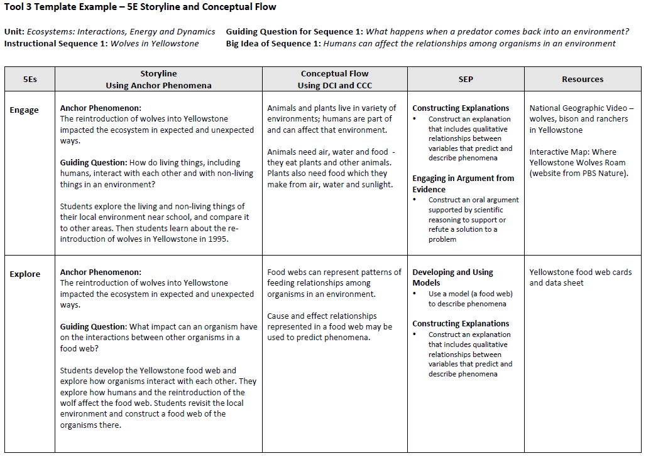
Tool 3 Example

Slide 25
Tool 3 Example
Review Ms. Rivera’s Storyline: how does it compare to your sentence strips?
Review Ms. Rivera’s 3D Conceptual Flow: where do you see alignment with the three dimensions?

Slide 26
Your Turn
Read the Guide to Developing a Storyline and Conceptual Flow about a Phenomenon
Review the three dimensions and PEs from instructional sequence 2.
Follow the steps in the Guide and work with your group to develop a coherent 5E sequence

Slide 27
Sharing
Share your storyline and conceptual flow with another team!

Slide 28
Reflection
Talk with a partner
What do you think will be your greatest challenges in planning lessons, or helping teachers plan lessons, that are conceptually coherent?

