Slide 1
Five Tools & Processes for NGSS
Tool 1: Using the NGSS to plan a unit of instruction

Slide 2
Science Teaching and Learning
What do you think about when planning a unit of instruction for your classroom?

Slide 3
Goals and Outcomes
Deepen understanding of the NGSS and increase abilities to plan for coherent instruction based on the NGSS
Begin to design unit of instruction and assessments for middle school students focused on ecosystems

Slide 4
Conceptual Shifts Offered by the NGSS
K-12 science education should reflect the interconnected nature of science as it is practiced and experienced in the real world.
The NGSS are student performance expectations, not curriculum.
The science concepts in the NGSS build coherently from K-12.
The NGSS focus on deeper understanding of content as well as application of content.
Science and engineering are integrated in the NGSS from kindergarten through twelfth grade.
The NGSS are designed to prepare students for college, careers, and citizenship.
The NGSS and Common Core State Standards are aligned.

Slide 5
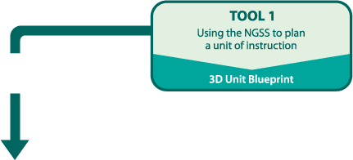
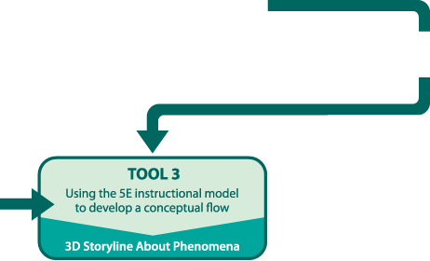
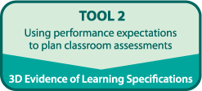
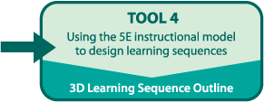
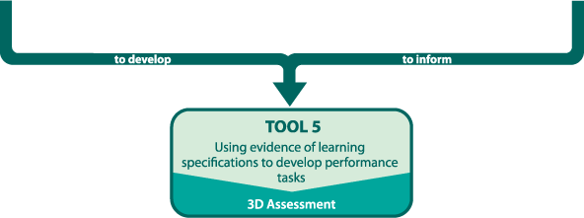

Slide 6
Tool 1: Using the NGSS to plan a unit of instruction
Our ideas
What do students need to know/understand about the topic?
DCIs
How can we build from what we know and the disciplinary core ideas to ensure coherent instruction?
PEs
What can we learn by studying the performance expectations?
  How can we build coherence using the science and engineering practices and crosscutting concepts?
SEPs & CCCs
  How do ideas about the nature of science, engineering, and common core influence our sequence?
Connections

Slide 7
Planning for Instruction
What do middle school students need to understand about Ecosystems: Interactions, Energy, and Dynamics?
Write your response in sentences and as a paragraph.

Slide 8
Planning for Instruction
Record one “idea” per yellow sticky note from your paragraph.
Each “idea” should be written as a complete sentence.
Determine the “grain-size” of each idea.
Examples of ideas by “grain-size”:
Big Idea:
  Ecosystems are the interactions between living and nonliving things.
Supporting Idea:
  Ecosystems change over time.
Smaller Idea:
  Some of the changes are beneficial, some are not.

Slide 9
Planning for Instruction
Share sticky notes and group similar ideas together.
Each person should “play” a sticky note one at a time – all ideas are valid.
If ideas are the same, you can put them on top of each other.

Slide 10
Planning for Instruction
Organize the grouped ideas into an instructional sequence that makes sense to you and could be used to teach students
  How do ideas build on one another?
  Do the ideas build from concrete to abstract?
  How can you tell a story with the sequence of ideas?

Slide 11
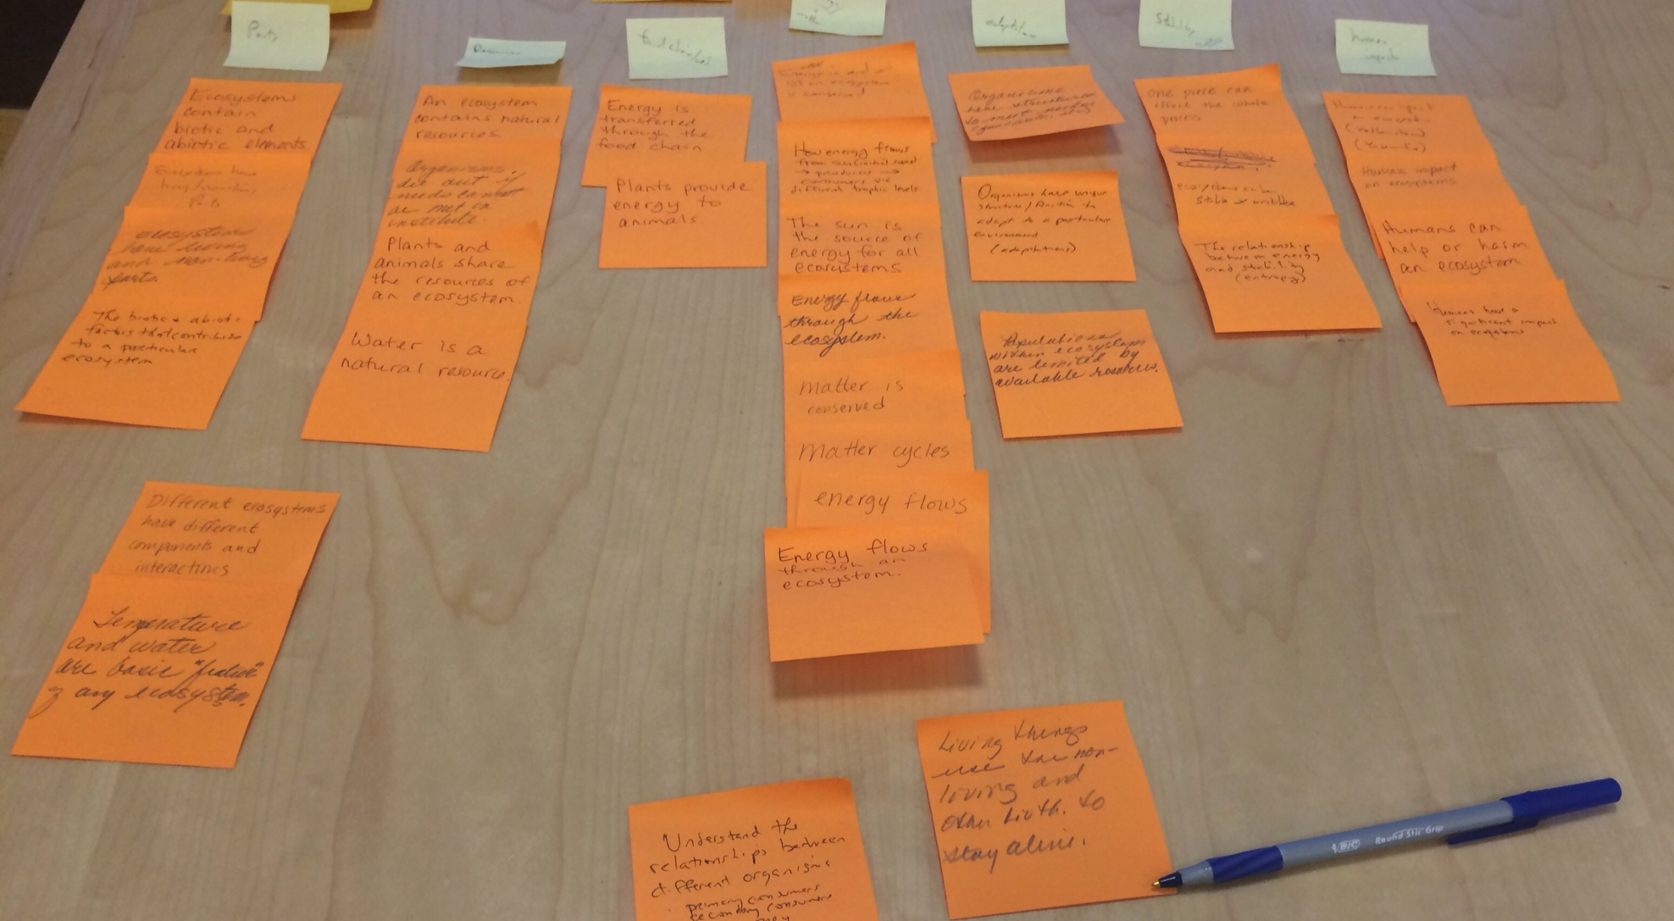
Example of a Conceptual Flow

Slide 12
Facts and Concepts
Fact
  Facts or definitions are pieces of information. The focus is on verifiable and discrete details.
  In teaching facts are often presented without making connections to the big ideas in science.
Concept
  Concepts are over-arching ideas that clearly show the relationships between facts. They are frequently abstract.
  In teaching, concepts are often presented with connections to the real world and to the big ideas of science.

Slide 13
Develop a Conceptual Flow
Using the “grain size” of each idea, begin to organize the ideas into a conceptual flow
  What is the biggest idea?
    Place at the top
  Which are the supporting ideas?
    Place under the big idea in an instructional sequence
  Which are the smaller ideas?
    Place under supporting ideas

Slide 14
Conceptual Flow Graphic
Sequencing/Grouping Ideas

Slide 15
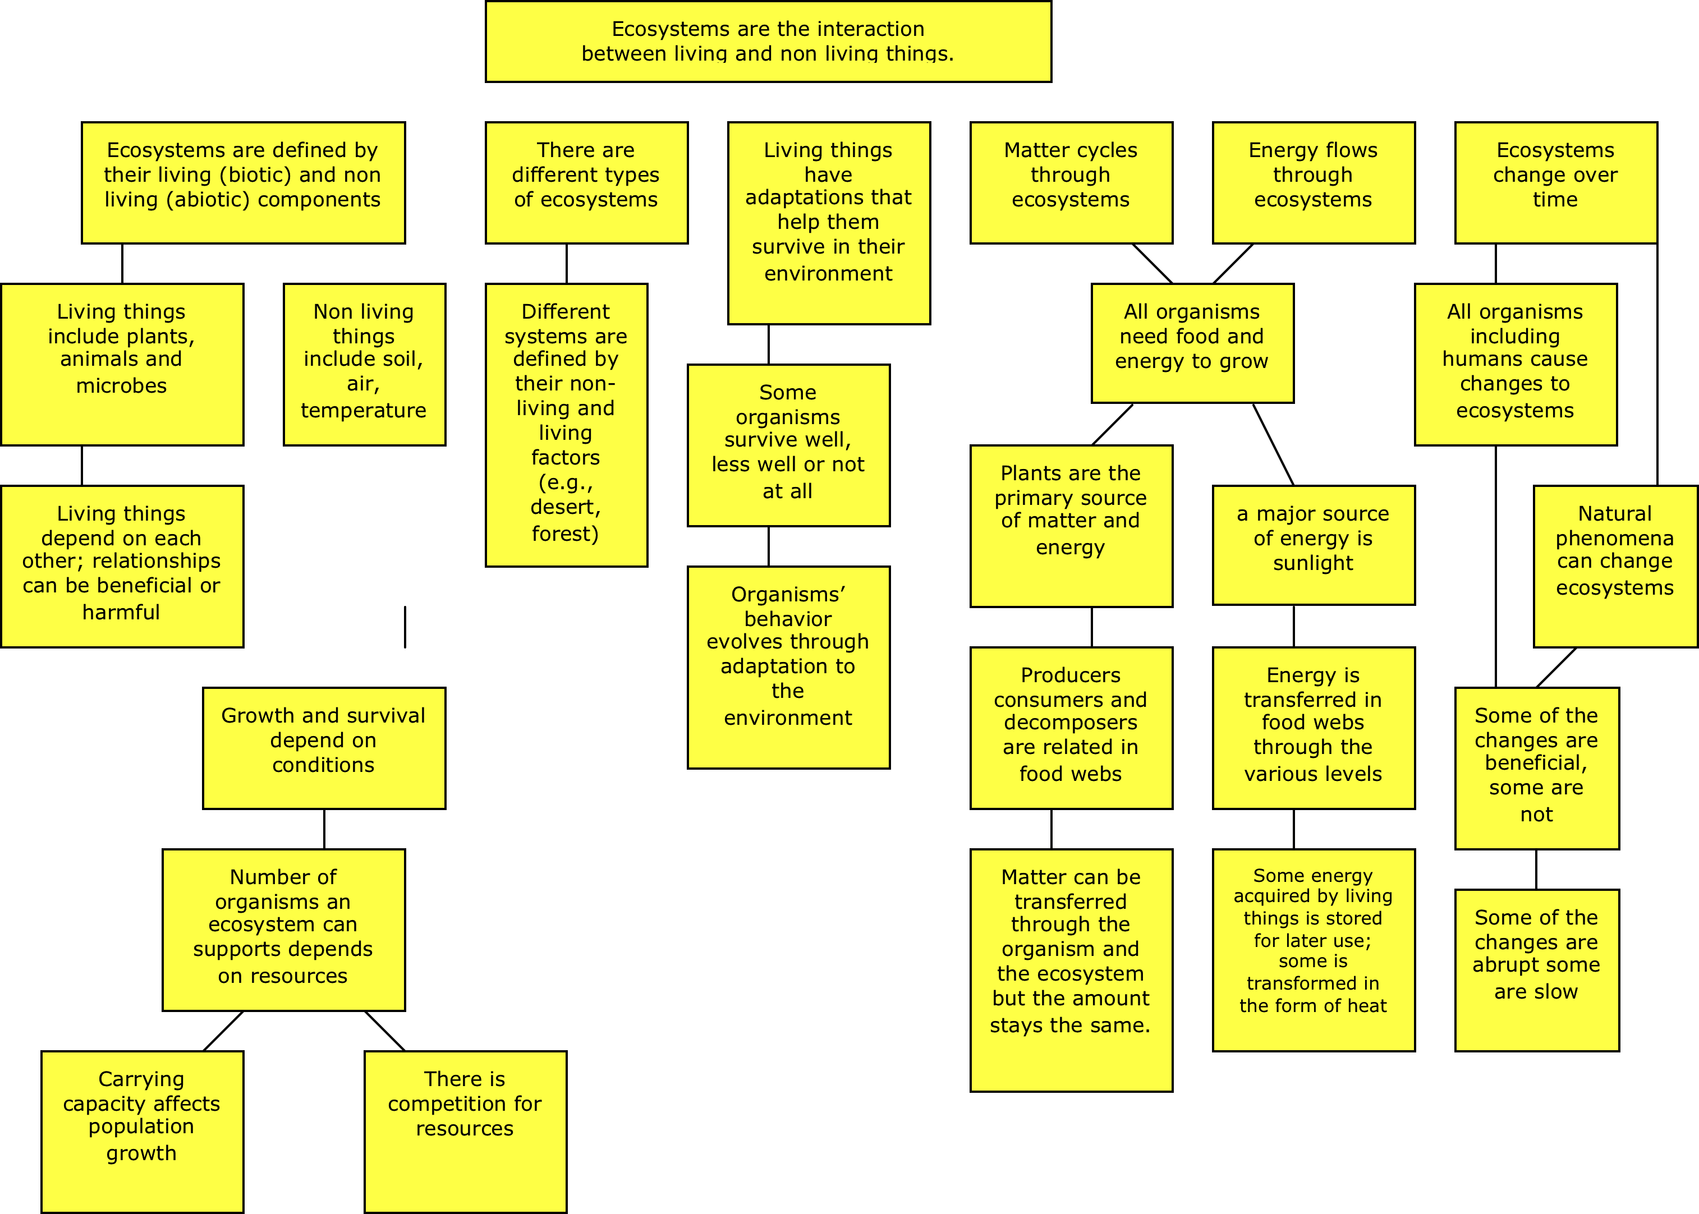
Example of a Conceptual Flow Graphic about Ecosystems

Slide 16
Tool 1: Using the NGSS to plan a unit of instruction
Our ideas
What do students need to know/understand about the topic?
DCIs
How can we build from what we know and the disciplinary core ideas to ensure coherent instruction?
PEs
What can we learn by studying the performance expectations?
  How can we build coherence using the science and engineering practices and crosscutting concepts?
SEPs & CCCs
  How do ideas about the nature of science, engineering, and common core influence our sequence?
Connections

Slide 17

A Framework for K-12 Science Education
Practices, Crosscutting Concepts, & Core Ideas
“The framework is designed to help realize a vision for education in the sciences and engineering in which students, over multiple years of school, actively engage in scientific and engineering practices and apply crosscutting concepts to deepen their understanding of the core ideas in these fields.”
Crosscutting Concepts
Core Ideas
Practices
National Research Council, 2012

Slide 18
Planning for Instruction
What’s the core idea?
See NGSS Reading Guide Reading 1
  Review p. 140 and p. 142 (Box 6-1) and to see where core idea LS2 fits into the life sciences
See NGSS Reading Guide Reading 2, Part 1.
  Read the narrative for LS2 on p. 150.

Slide 19
Planning for Instruction
  What are the component ideas for this core idea?
  See NGSS Reading Guide Reading 2, Part 2, for the component ideas
  LS2A. Interdependent Relationship and Ecosystems pp. 150-151 and grade 8 end point on p. 152
  LS2B. Cycles of Matter and Energy Transfer in Ecosystems pp. 152-153 and grade 8 end point on p. 153-154
  LS2C. Ecosystems, Dynamics, and Resilience pp. 154-155 and grade 8 end point on p. 155
How well do your grouped ideas match the ideas from the Framework?
You can add additional sticky notes or remove them from your conceptual flow based on what your group decides makes the most coherent storyline.

Slide 20
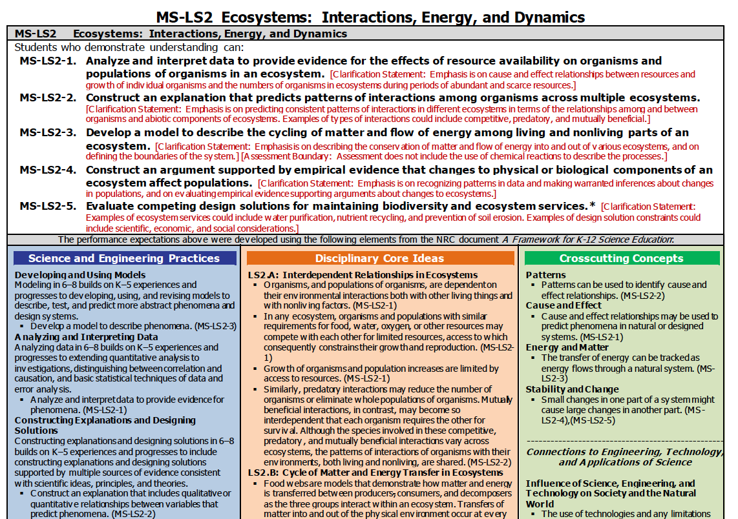

Slide 21
Core Idea
Component Idea
Element

Slide 22
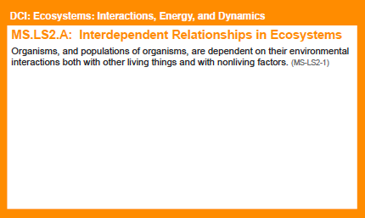

Slide 23
Disciplinary Core Ideas (DCIs)
First step
Note the component code and text on each DCI card
  LS2A
  LS2B
  LS2C
  LS4D (read Framework p. 166 and grade 8 end point p. 167)
  ETS1B (read Framework p. 206-207 and grade 8 end point p. 208)
Consider how the engineering/ design DCIs fit here.
  Why do you think the authors made an explicit link in this topic?
  How well do they fit?
  How do they add value?

Slide 24
Disciplinary Core Ideas (DCIs)
Second steps
Incorporate the MS-LS2 DCI cards with your sequence as appropriate.
Add Connecting DCIs from other standards pages if (and only if) they enhance your storyline.
  See NGSS Reading Guide Reading 4 MS-LS2 connections to other DCIs in this grade band p. 149
Sequence

Slide 25
Disciplinary Core Ideas (DCIs)
Third step
Consider how DCIs progress across grade bands.
  See NGSS Reading Guide Reading 5 Appendix E pp. 43-44 for prior knowledge and to inform boundaries
Sequence

Slide 26
Big Ideas
On a larger sticky note write one paragraph about each “chapter” of your unit storyline.
  What do you want students to be thinking about?
You'll probably have 3-5 paragraphs across
Feel free to adjust your storyline as you work

Slide 27
Tool 1: Using the NGSS to plan a unit of instruction
Our ideas
What do students need to know/understand about the topic?
DCIs
How can we build from what we know and the disciplinary core ideas to ensure coherent instruction?
PEs
What can we learn by studying the performance expectations?
  How can we build coherence using the science and engineering practices and crosscutting concepts?
SEPs & CCCs
  How do ideas about the nature of science, engineering, and common core influence our sequence?
Connections

Slide 28
Performance Expectations (PEs)
First step
Read each PE statement linked to the DCIs included in your sequence (Note: Pay attention to the codes (e.g., MS-LS2-1)
Determine if each PE contributes to the storyline of your unit and place the PE at the top of the appropriate sequence of DCIs
Note: PE with an asterisk* means this PE integrates traditional science content with engineering through a practice of DCI.

Slide 29
Performance Expectations (PEs)
Second step
Look at the PEs from connecting DCIs and determine if they are connected to an instructional sequence
Note: You should end up with a bundle of 2-3 PEs associated with each instructional sequence
If appropriate, revise how DCIs are sequenced or grouped (Note: Pay attention to the codes (e.g., MS-LS2-1)

Slide 30
Performance Expectations (PEs)
Third step
Study the bundle of PEs and DCIs in your sequence
  Highlight aspects of the PE and clarification statement that would be in the foreground (supporting ideas in sequence).
  Cross out aspects of the PE and clarification statement that would not be considered part of sequence.
  Leave “unmarked” aspects of the PE that would be in the background (smaller ideas in sequence).

Slide 31
PE Example
Performance Expectation MS-ESS3-4
Construct an argument supported by evidence for how increases in human population and per-capita consumption of natural resources impact Earth’s systems.
Clarification Statement: Examples of evidence include grade-appropriate databases on human populations and the rates of consumption of food and natural resources (such as freshwater, mineral, and energy). Examples of impacts can include changes to the appearance, composition, and structure of Earth’s systems as well as the rates at which they change. The consequences of increases in human populations and consumption of natural resources are described by science, but science does not make the decisions for the actions society takes.

Slide 32
Bundling
“Bundling” is the process of grouping associated learning goals (which can be PEs or parts of PEs) together to help create coherent instruction. A bundle of PEs or parts of PEs should be used as the learning goals for a unit of instruction as they provide opportunities for greater explanatory power of phenomena and coherence within instruction.
-Achieve

Slide 33
Tool 1: Using the NGSS to plan a unit of instruction
Our ideas
What do students need to know/understand about the topic?
DCIs
How can we build from what we know and the disciplinary core ideas to ensure coherent instruction?
PEs
What can we learn by studying the performance expectations?
  How can we build coherence using the science and engineering practices and crosscutting concepts?
SEPs & CCCs
  How do ideas about the nature of science, engineering, and common core influence our sequence?
Connections

Slide 34
Science and Engineering Practices (SEPs)
Study the Practices associated with the PEs in your sequence using the NGSS Reading Guide Reading 6 NGSS V2 Appendix F p. 48
  Why did the authors emphasize practices?
  What does this practice look like for this grade band?

Slide 35
Science and Engineering Practices (SEPs)
Read each PE to identify the embedded SEP. You may need to read the clarification statement and assessment boundary.
Add appropriate SEP cards to your sequence (Note: Pay attention to the PE code on the SEP card)

Slide 36
Tool 1: Using the NGSS to plan a unit of instruction
Our ideas
What do students need to know/understand about the topic?
DCIs
How can we build from what we know and the disciplinary core ideas to ensure coherent instruction?
PEs
What can we learn by studying the performance expectations?
  How can we build coherence using the science and engineering practices and crosscutting concepts?
SEPs & CCCs
  How do ideas about the nature of science, engineering, and common core influence our sequence?
Connections

Slide 37
Crosscutting Concepts (CCCs)
Patterns
Cause and effect: Mechanisms and explanation
Scale, proportion, and quantity
Systems and system models
Energy and matter: Flows, cycles, and conservation
Structure and function
Stability and change

Slide 38
Crosscutting Concepts (CCCs)
Study the CCC associated with the PEs using NGSS Reading Guide Reading 7 NGSS V2 Appendix G
  Why do you think the authors emphasized these CCC for this topic?
Read each CCC statement.
Add CCC to your sequence. (Note: Pay attention to the PE code on the CCC card)

Slide 39
Tool 1: Using the NGSS to plan a unit of instruction
Our ideas
What do students need to know/understand about the topic?
DCIs
How can we build from what we know and the disciplinary core ideas to ensure coherent instruction?
PEs
What can we learn by studying the performance expectations?
  How can we build coherence using the science and engineering practices and crosscutting concepts?
SEPs & CCCs
  How do ideas about the nature of science, engineering, and common core influence our sequence?
Connections

Slide 40
  Connections to Nature of Science and Engineering, Technology, and Applications of Science
Nature of Science
Science Investigations Use a Variety of Methods
Scientific Knowledge is Based on Empirical Evidence
Scientific Knowledge is Open to Revisions in Light of New Evidence
Scientific Models, Laws, and Theories Explain Natural Phenomena
Science is a Way of Knowing
Scientific Knowledge Assumes an Order and Consistency in Natural Systems
Science is a Human Endeavor
Science Addresses Questions About the Natural and Material World
Engineering, Technology, and Applications of Science
The Interdependence of Science, Engineering, and Technology
The Influence of Engineering, Technology, and Science on Society and the Natural World

Slide 41
Connections
Study the connections using NGSS Reading Guide Reading 8 NGSS V2 Appendix H, I, and J
  Why do you think the NGSS emphasize these connections for this topic?
Read each “Connections to” statement identified in the foundations boxes.
Add NoS and Applications cards to your sequence as appropriate (Note: Pay attention to the PE code on the NoS and Applications card)

Slide 42
Tool 1: Using the NGSS to plan a unit of instruction
Our ideas
What do students need to know/understand about the topic?
DCIs
How can we build from what we know and the disciplinary core ideas to ensure coherent instruction?
PEs
What can we learn by studying the performance expectations?
  How can we build coherence using the science and engineering practices and crosscutting concepts?
SEPs & CCCs
  How do ideas about the nature of science, engineering, and common core influence our sequence?
Connections

Slide 43
Common Core
Read each Common Core statement
  Can you see this being embedded in your unit of study?
  Set aside these cards to use during Tool 4.
Math
ELA
ELA
Math

Slide 44
Tool 1: Using the NGSS to plan a unit of instruction
Our ideas
What do students need to know/understand about the topic?
DCIs
How can we build from what we know and the disciplinary core ideas to ensure coherent instruction?
PEs
What can we learn by studying the performance expectations?
  How can we build coherence using the science and engineering practices and crosscutting concepts?
SEPs & CCCs
  How do ideas about the nature of science, engineering, and common core influence our sequence?
Connections

Slide 45
Gallery Walk
Identify a docent for your sequence to be available to answer questions
The rest of the team will move clockwise to the next group’s sequence. Shift again at the chime.
Return to your group and share your findings.

Slide 46
Review and Revise
Review your sequence
  How well does the sequence tell a story?
    PEs
    DCIs
    SEPs
  How do the CCCs and NoS add to your story?
  What makes the strongest story? DCI? CCC? SEP?
Revise your sequence as needed. You may want to revise the paragraph you wrote on the large sticky note for each of the sequences in your unit.
Transfer your instructional sequence into the Tool 1 Template.

Slide 47
Reflection
What have you learned through this experience?
  About the NGSS?
  About Ecosystems: Interactions, Energy, and Dynamics?
What more do you want to learn?
What about the process we used contributed to your learning or inhibited your learning?

