Slide 1
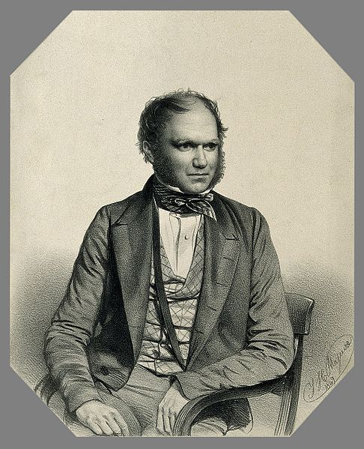
Hacking Darwin
Darwin Manuscripts Project, AMNH Research Library

Slide 2
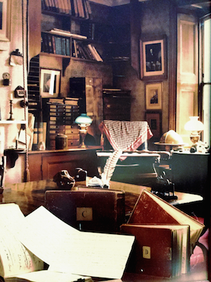
Darwin’s Study

Slide 3
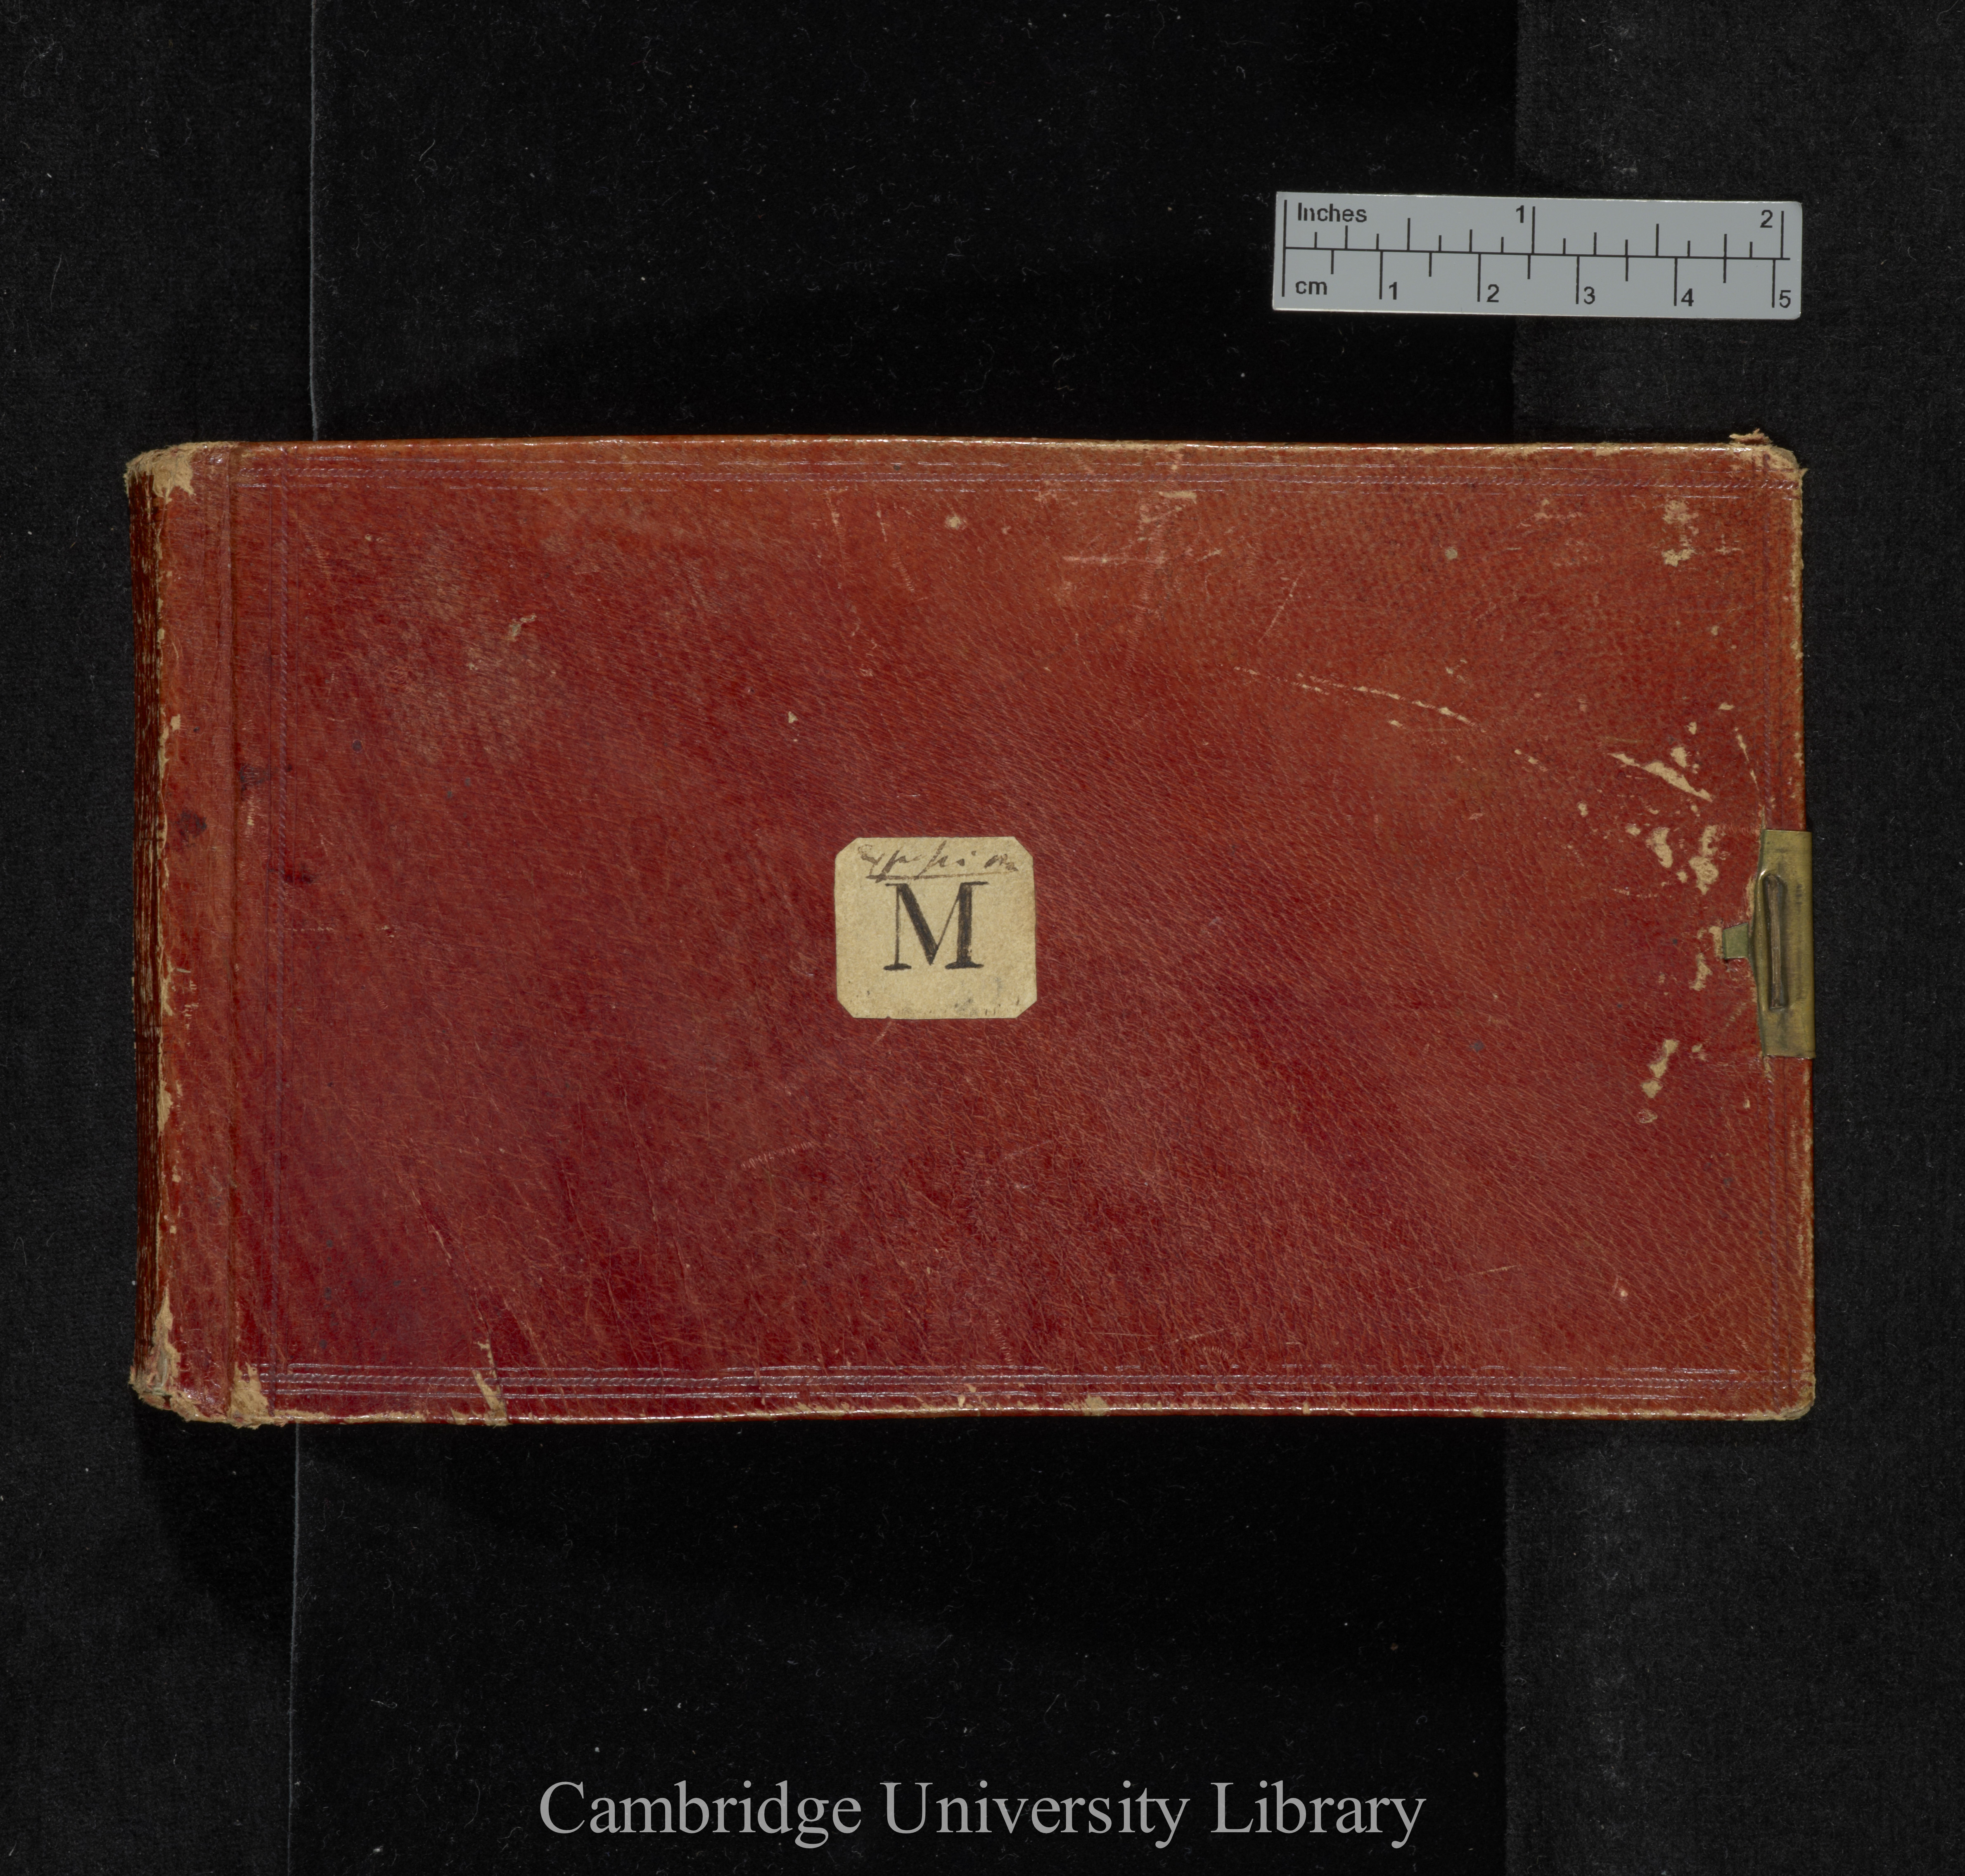
Notebook M

Slide 4
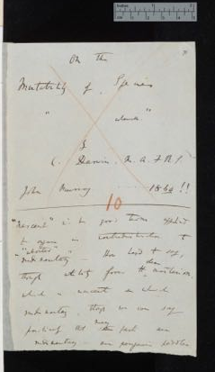
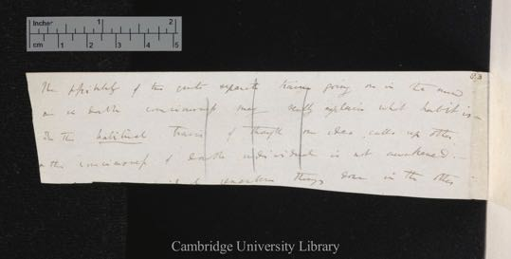
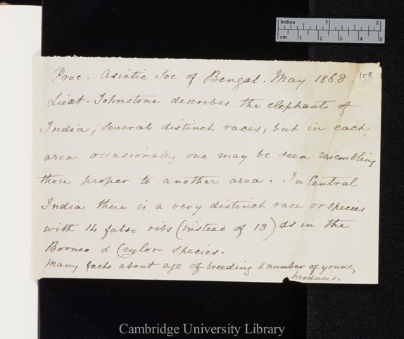
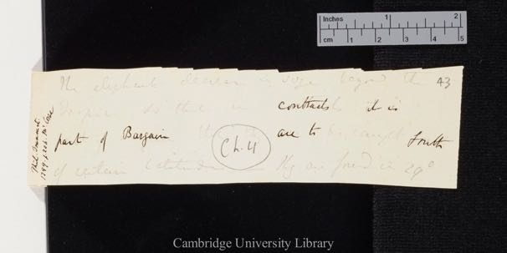
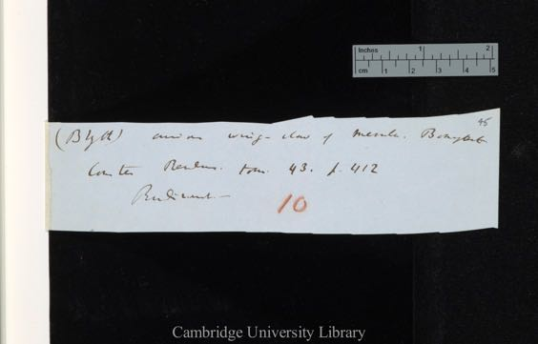
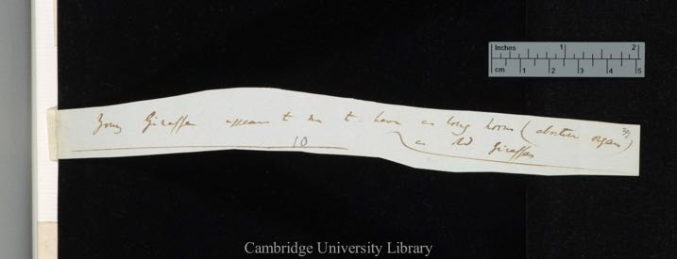
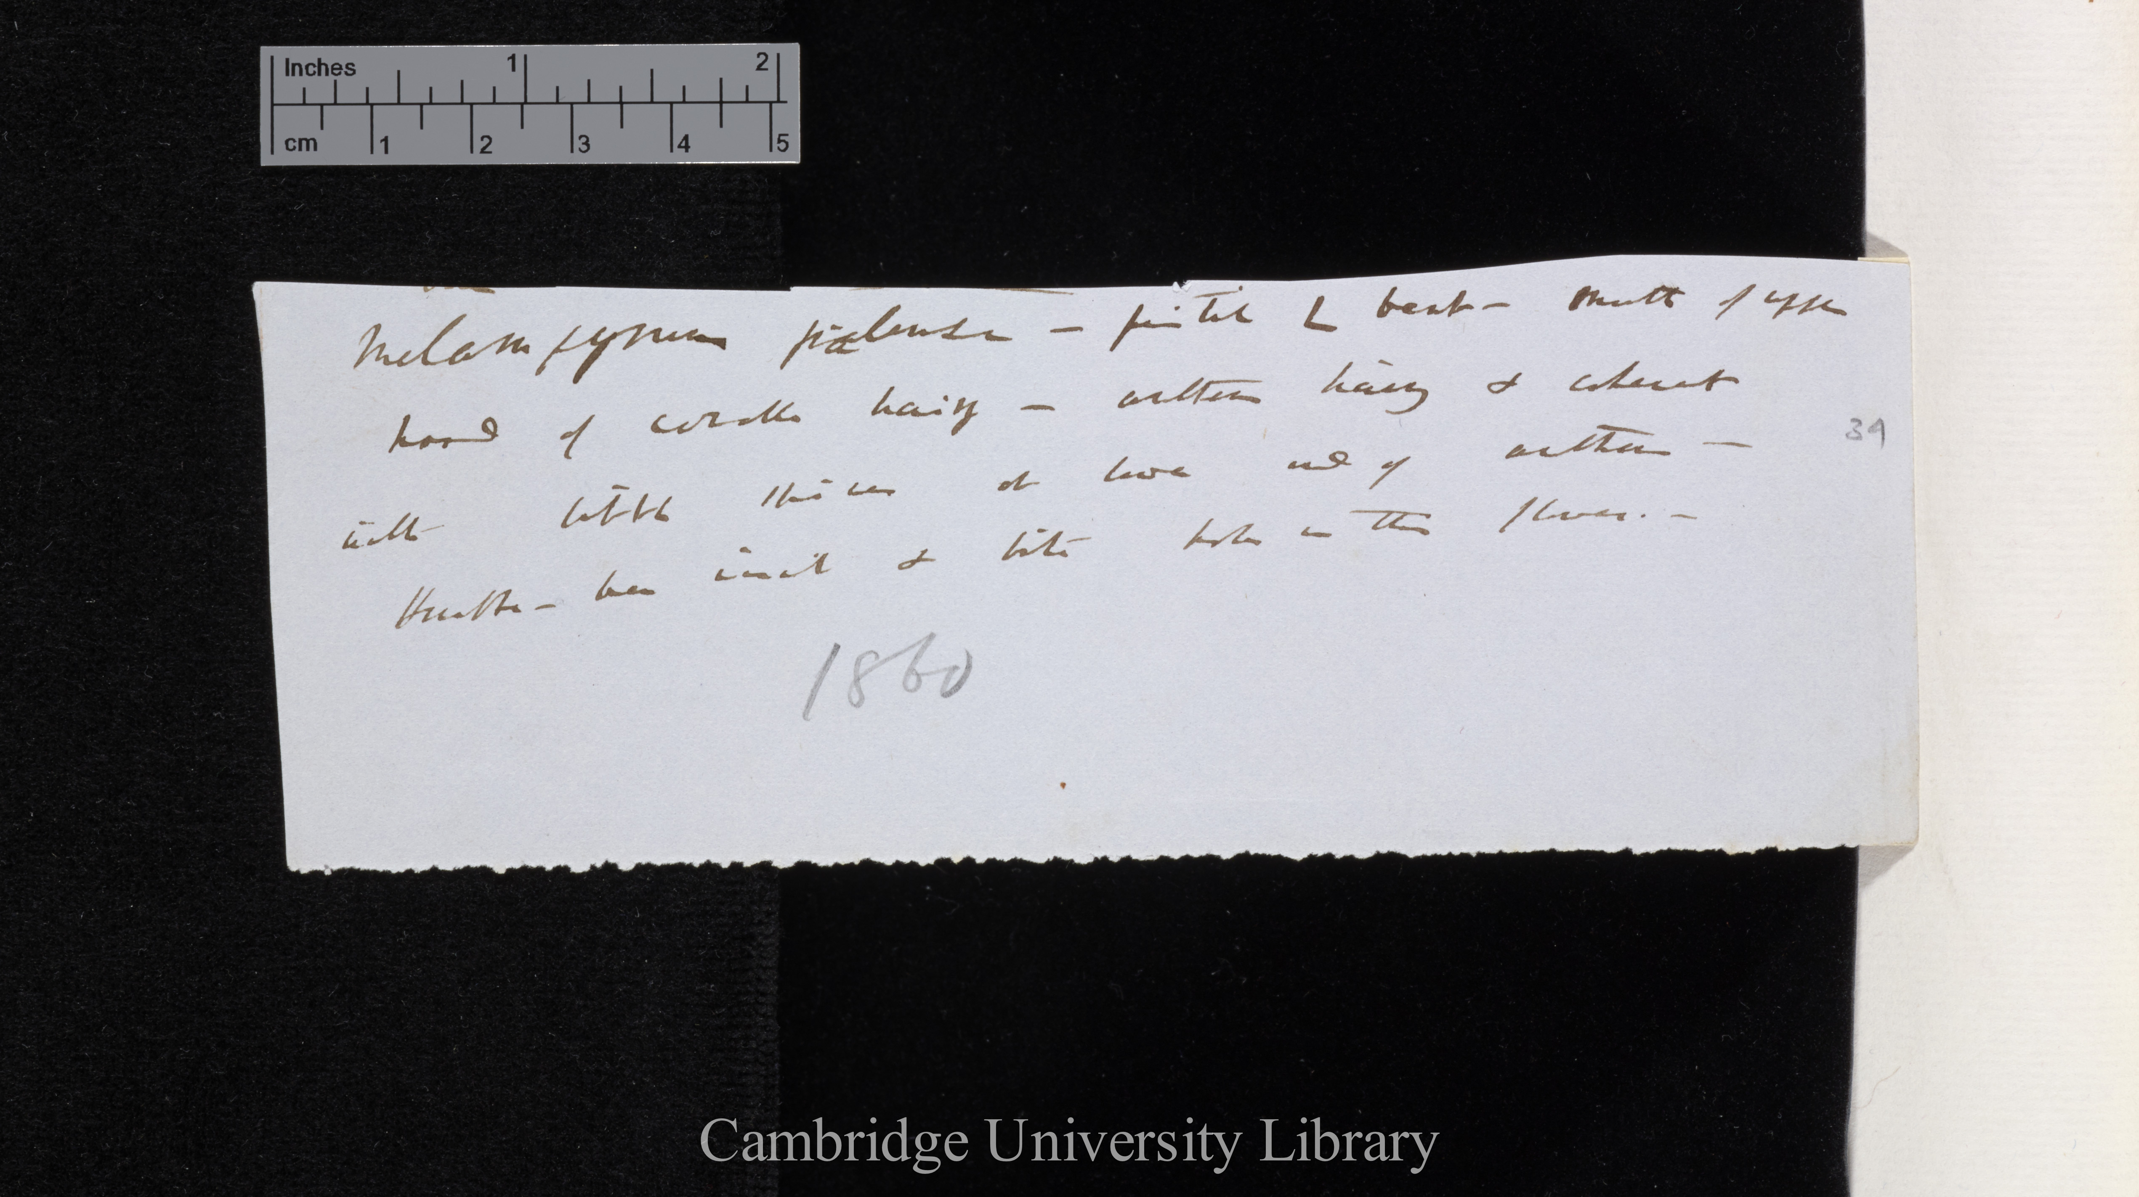
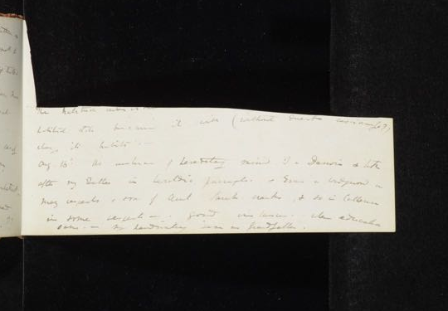
A MASSIVE JIGSAW

Slide 5
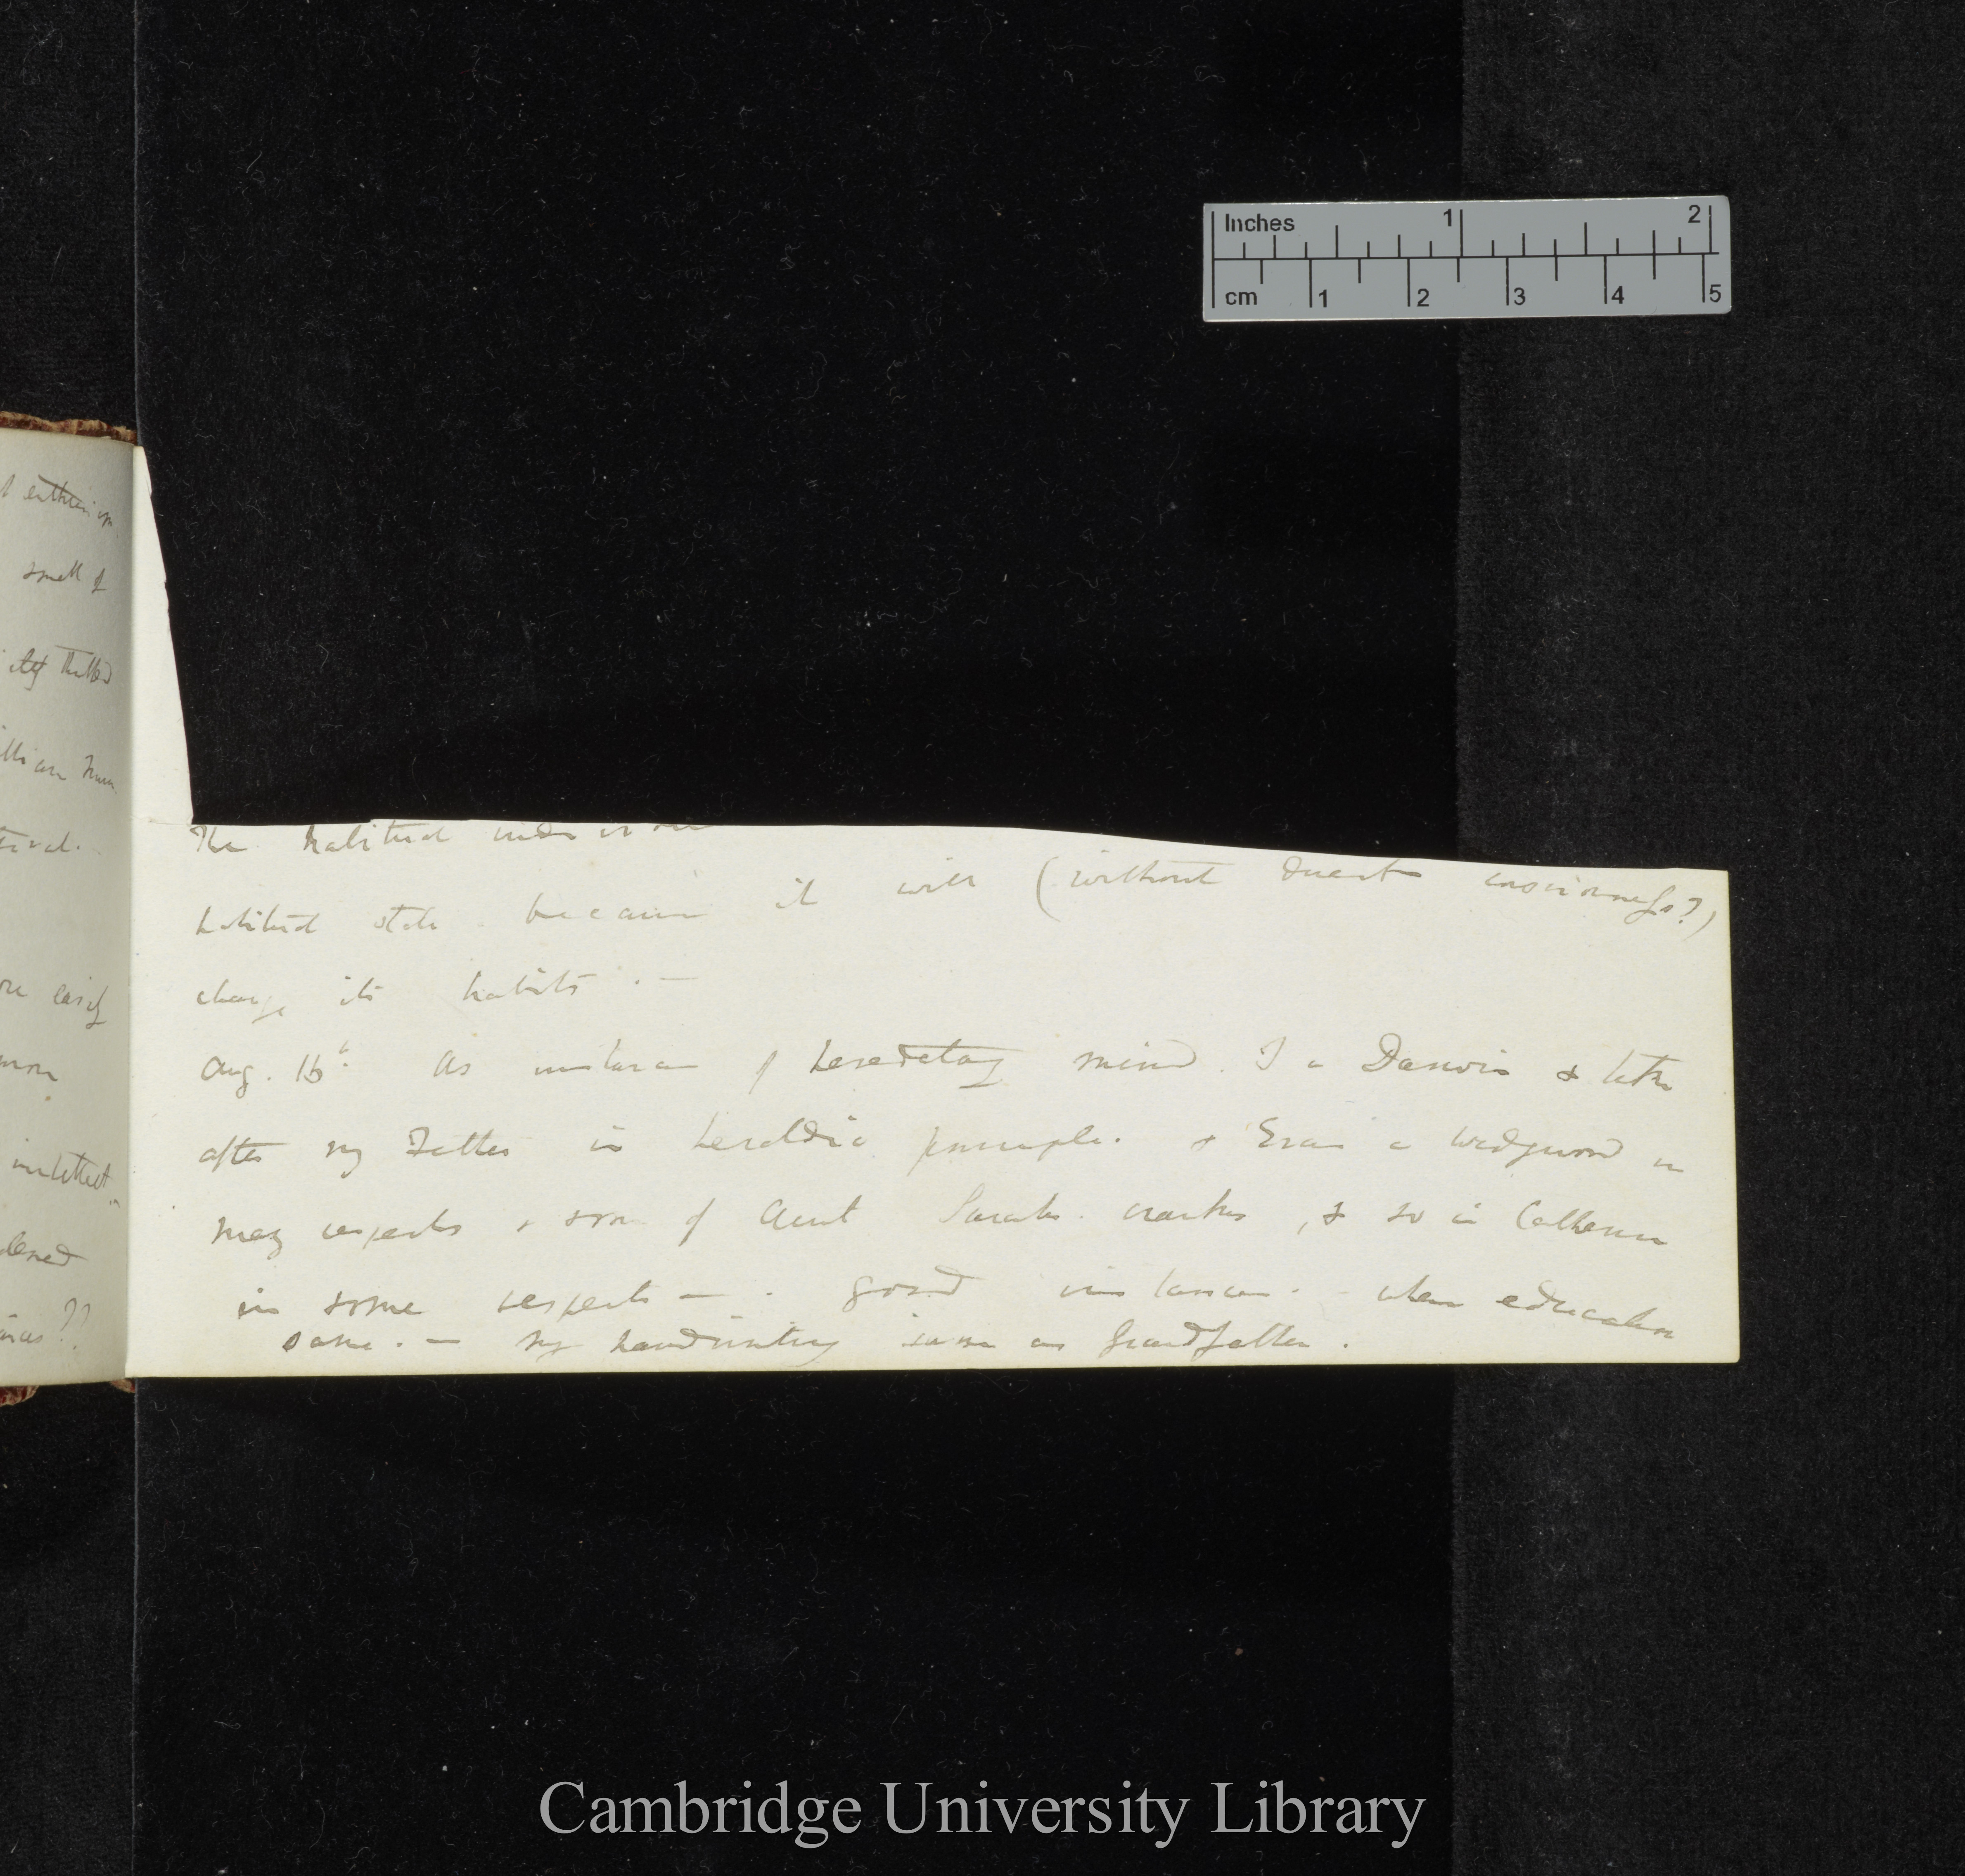
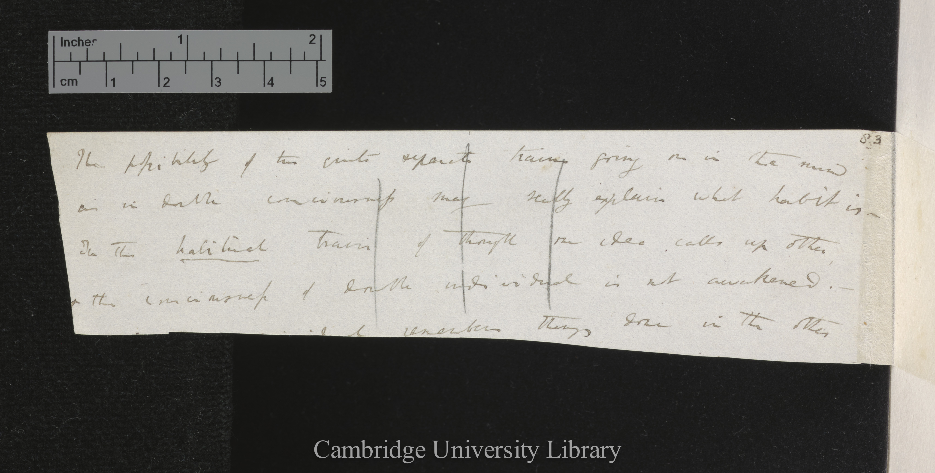
Two matching pieces found in 1970s by eye
Loose note DAR 53.1
Metaphysical Notebook M

Slide 6
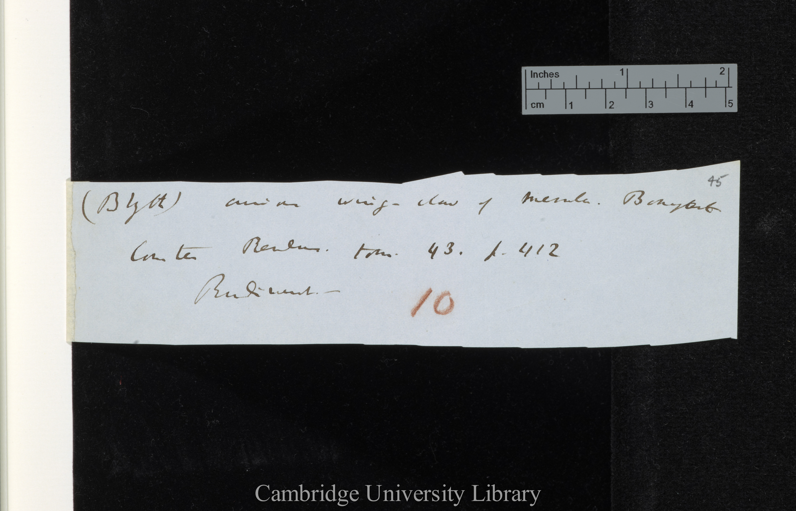
saw-tooth edgege
DAR 205.1: 45
Notes:
DAR 205.1: 45 saw toothed

Slide 7
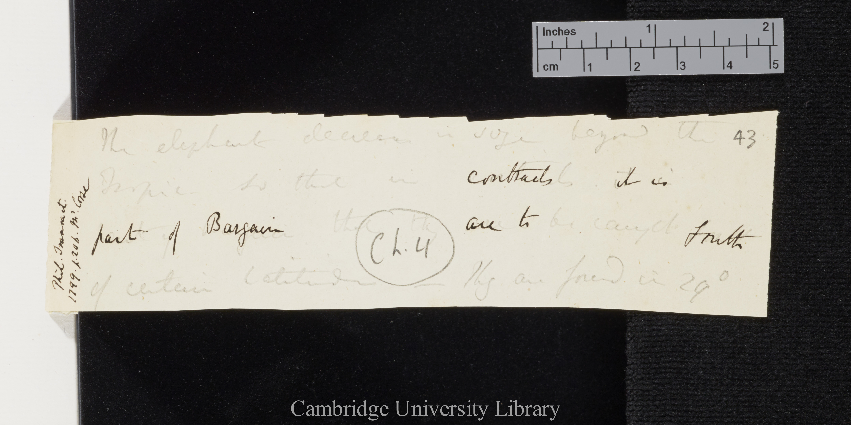
saw-tooth edgege
DAR 45: 43

Slide 8
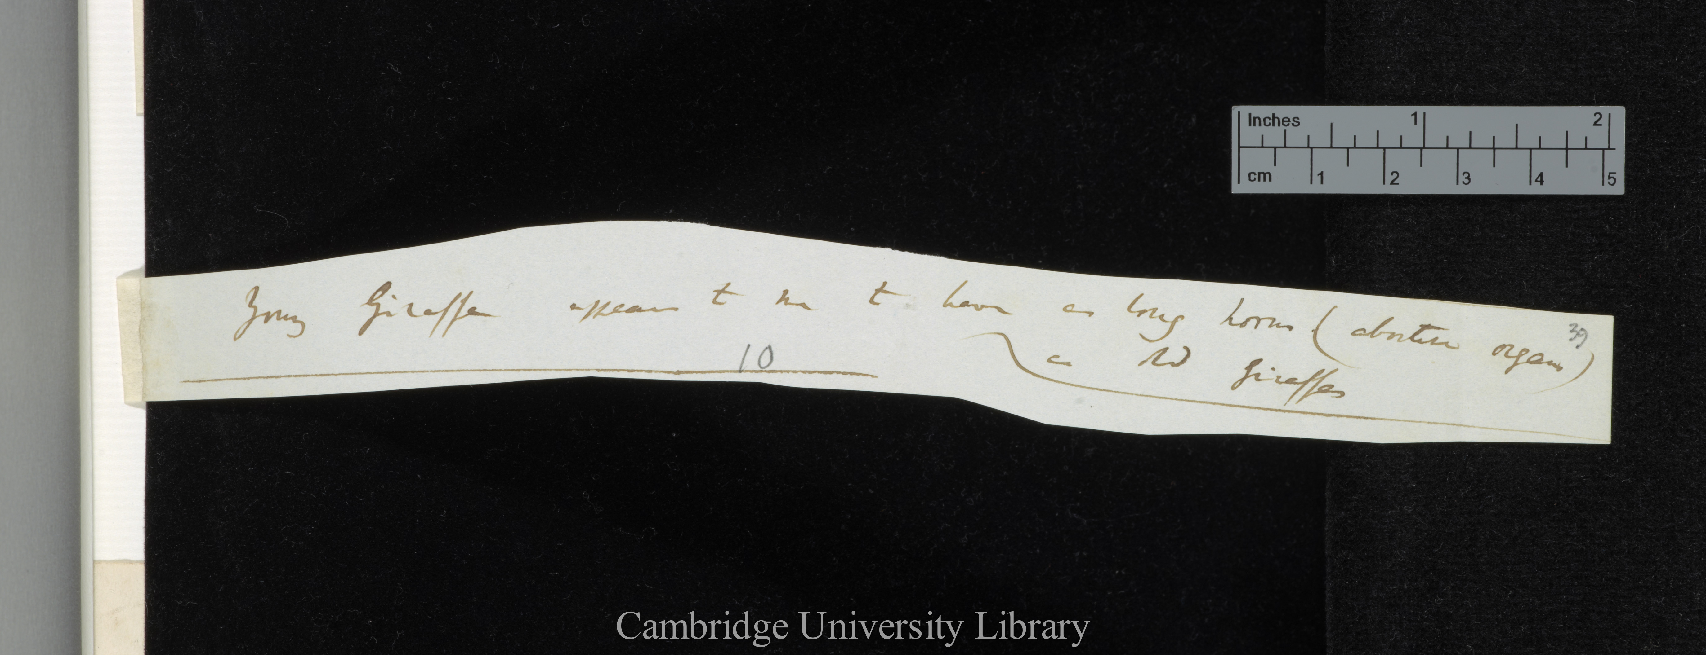
curved cut edge
DAR 205.1: 39

Slide 9
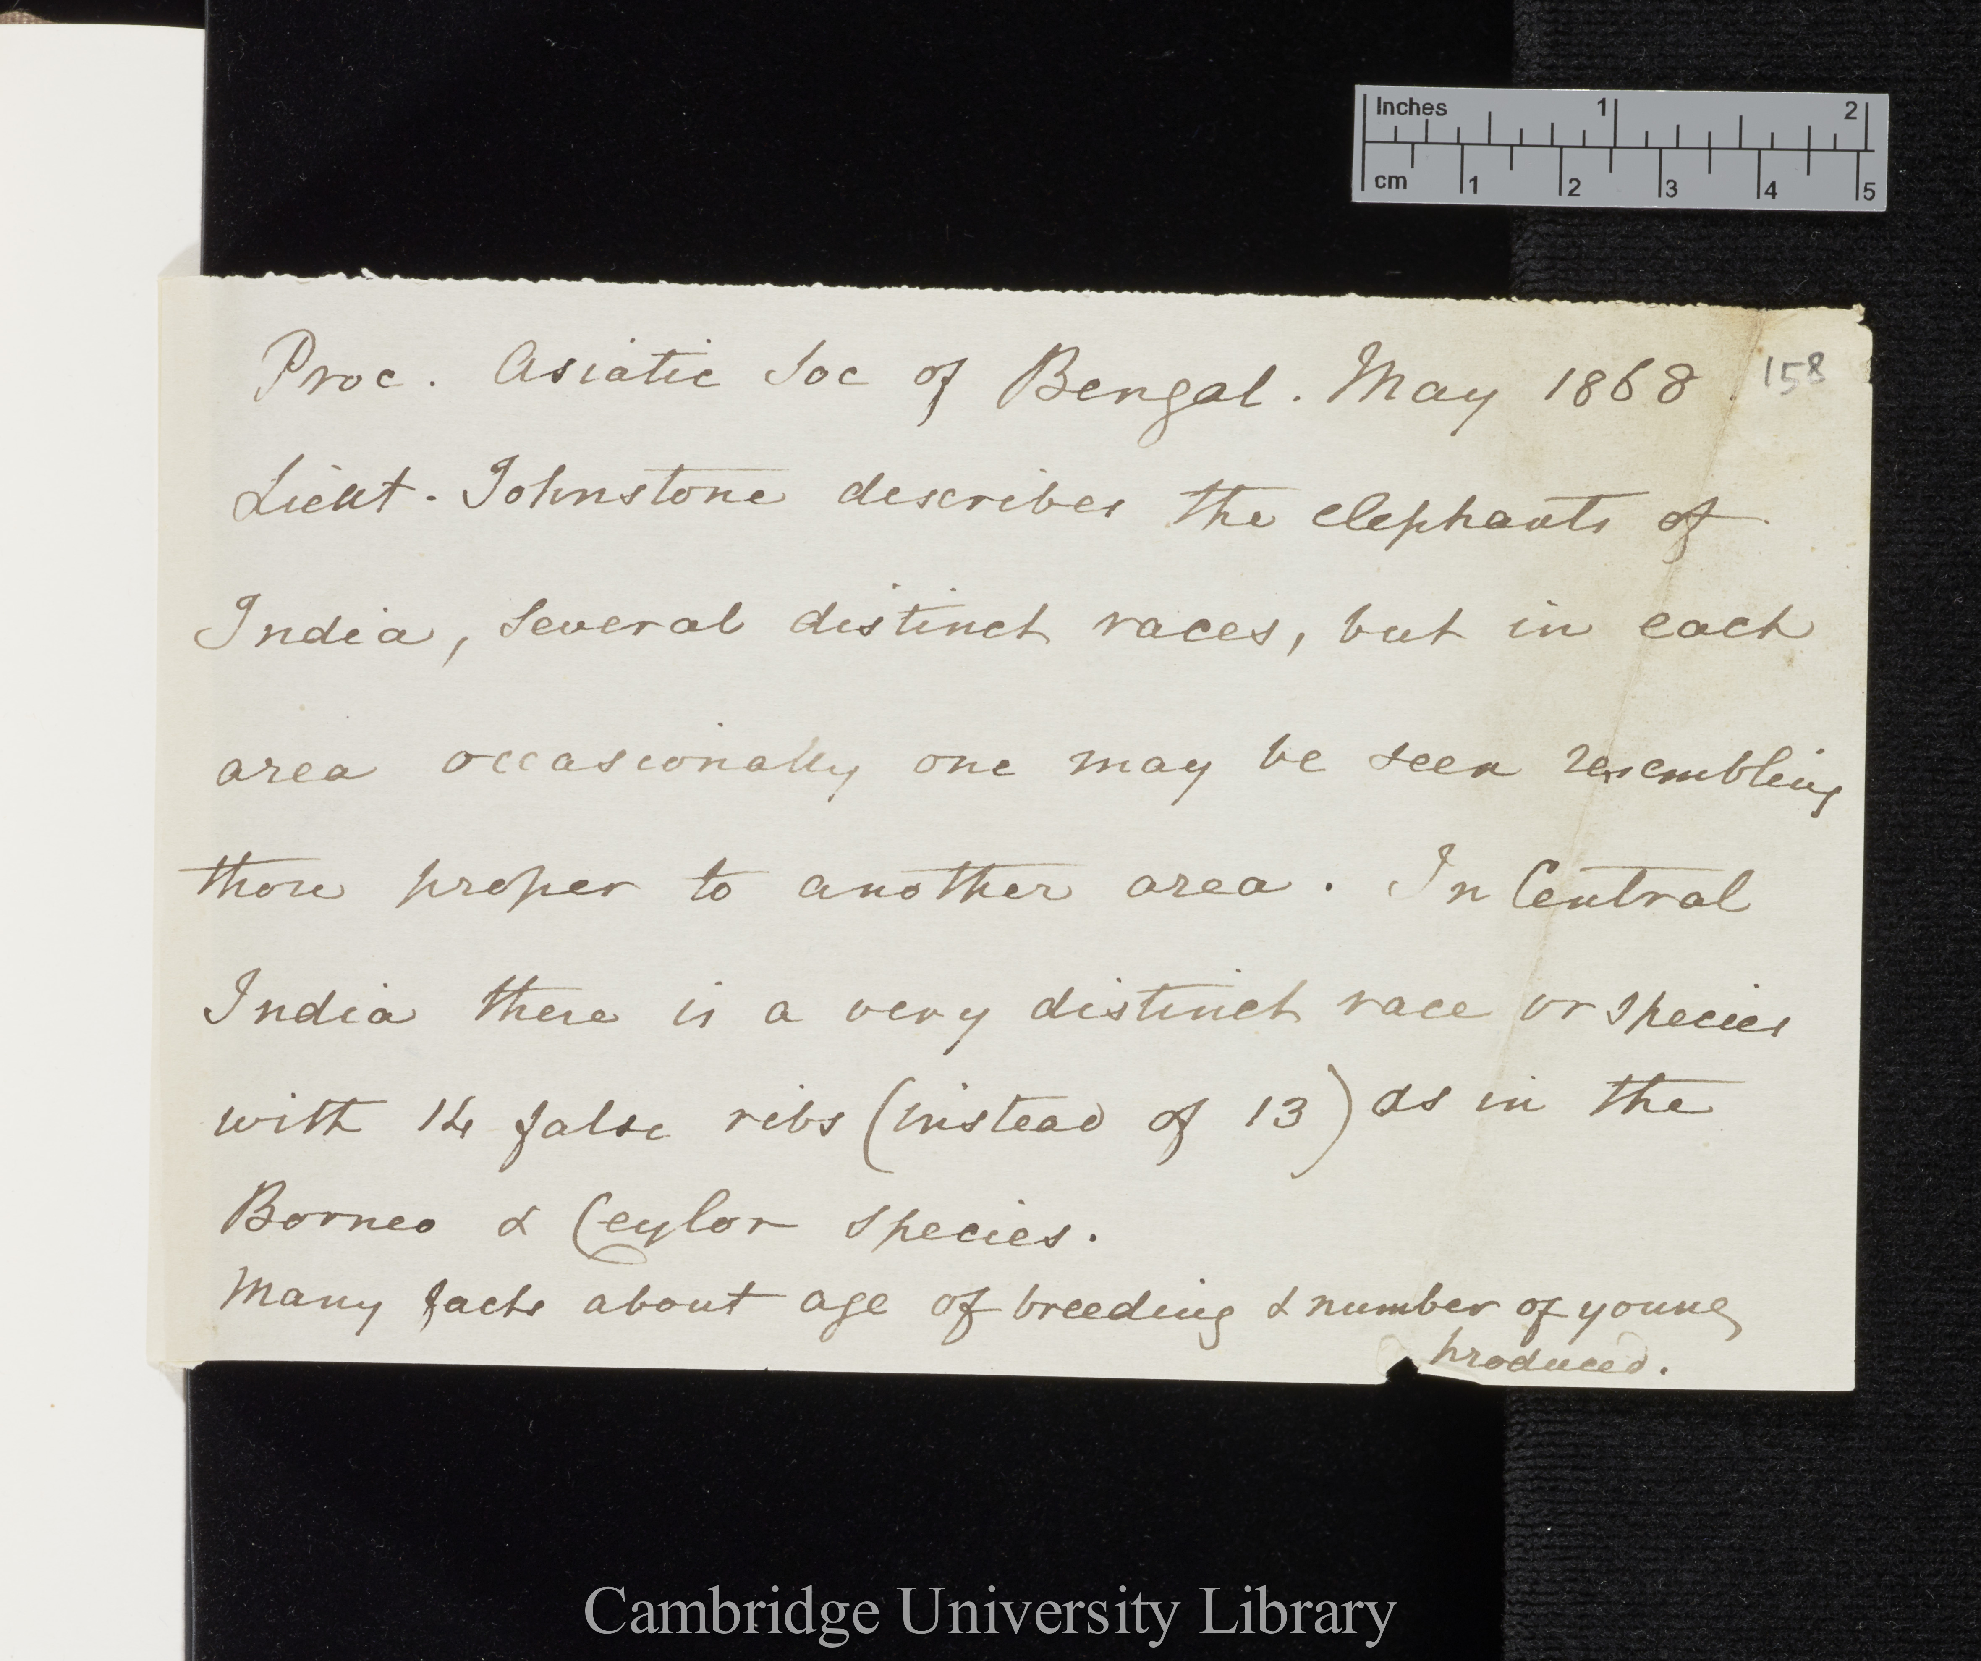
fuzzy edge
tear
DAR 45: 158
DAR 45: 158

Slide 10
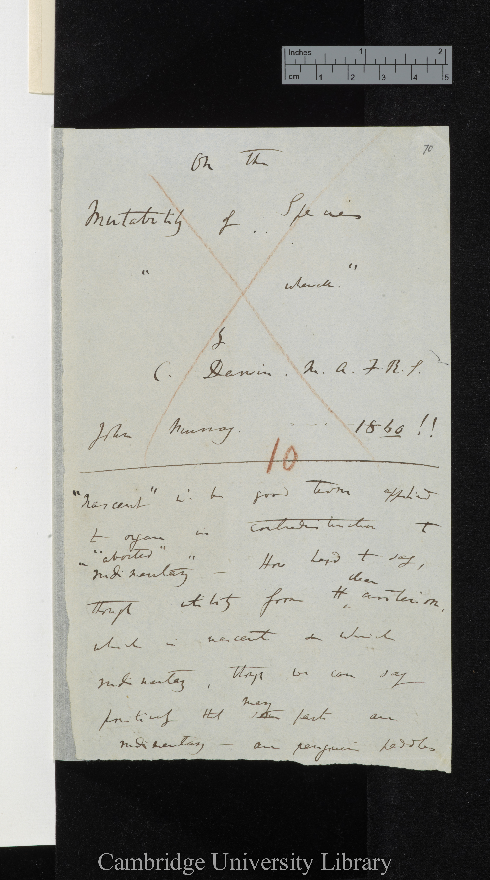
DAR 205.1: 70
fuzzy edge
irregular shape
fuzzy edge detail

Slide 11
very fuzzy edge
DAR 46.2: C34

Slide 13
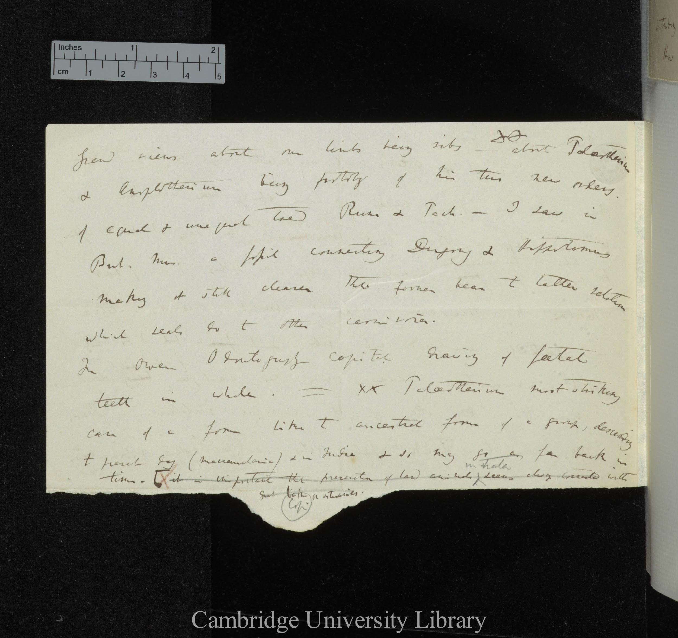
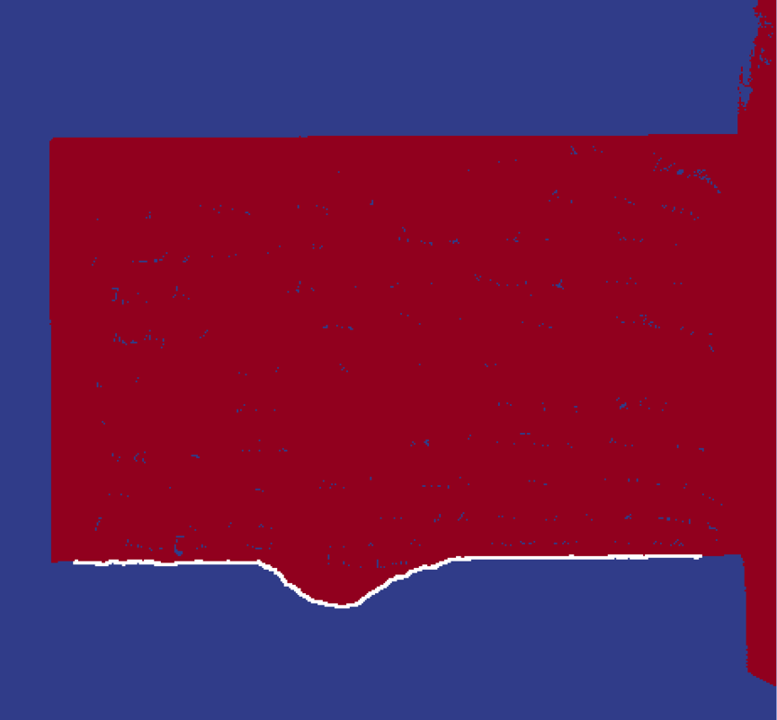


Slide 14
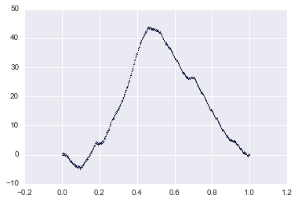
Normalising edge plots
“The Fourier Transform is a tool that breaks a waveform (a function or signal) into an alternate representation, characterized by sine and cosines. The Fourier Transform shows that any waveform can be re-written as the sum of sinusoidal functions.”
thefouriertransform.com
sample_csv/74584_MS-DAR-00125-000-00073_north.csv
Notes:
The Fourier Transform is a tool that breaks a waveform (a function or signal) into an alternate representation, characterized by sine and cosines. The Fourier Transform shows that any waveform can be re-written as the sum of sinusoidal functions.

Slide 15
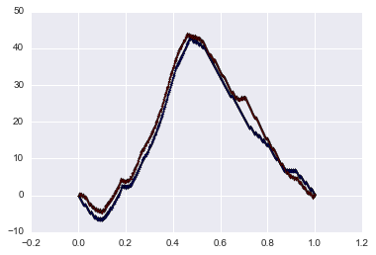
Calculate Euclidean Distance
d = 75.545766

Slide 16
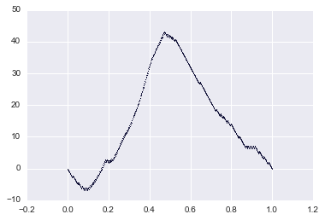
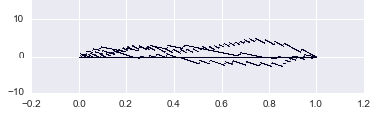
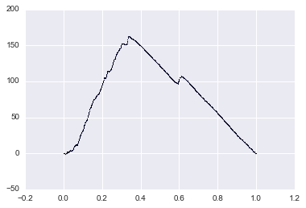
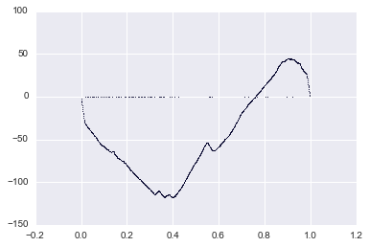
K-Means Clustering

Slide 17
Closest Matches

Slide 18
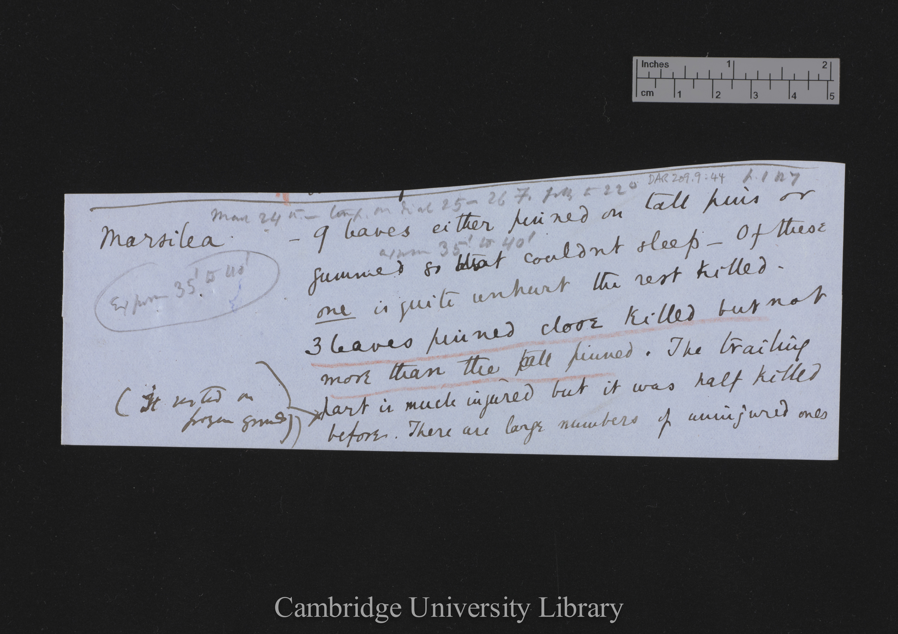
First two matches found Jan 2017 by computer,
Team Darwin ~ AMNH Library Hack the Stacks
Top piece DAR 209.9: 83r
Bottom piece DAR 209.9: 44r Marsilea
Both pieces were originally on one page in Darwin’s c. 4000
notes for the Power of Movement in Plants, 1880.
The cut off bottom piece is about the genus Marsilea and was moved 39 pages to other notes on Marsilea.

Slide 19
Match 1
Notes:
Match2 seamed

Slide 20
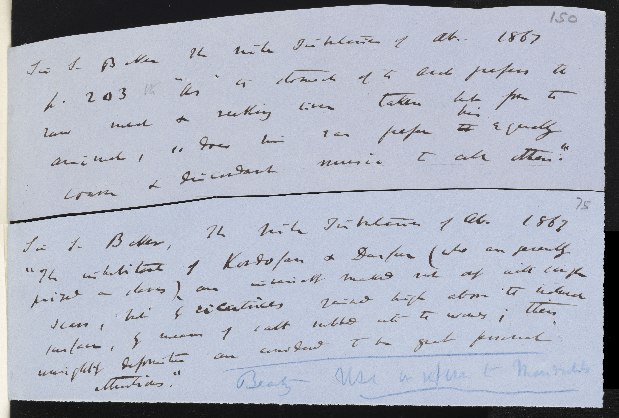
Match 2
DAR 84.2: 150r
DAR 85: A75r
AMNH Darwin Hackathon application matched a fragment about SEXUAL SELECTION IN BIRDS (top) with a fragment about SEXUAL SELECTION IN MAMMALS (bot). This is a match between notes in two different portfolios used in writing the Descent of Man, 1871. The information on this page ended up in two different chapters of Descent.
Notes:
Match1 seamed

