Slide 1
Advancing Tools and Processes for Next Generation Science
Planning for Instruction
Introduction to the Five Tools and Processes for Translating the NGSS into Instruction and Classroom Assessment

Slide 2
Introductions
Your name
Your role in your school/district
What do you hope to take away from this session?

Slide 3



My thoughts about the NGSS...
Around the room are Magnetic Quotes about the NGSS.
Choose a statement that “attracts” you and move to the appropriate chart.
Share with those in your small group why you chose this statement. Be prepared to share a summary of your conversation

Slide 4
Teachers want to engage students, but find it difficult to find time to integrate the practices—in part due to the current focus on testing and assessment results. If the assessments remain the same, teachers won’t see a need to change.

Slide 5
Teachers tend to be content-focused and don’t have much experience or interest in engineering. The focus on engineering puts them outside their comfort Zone. This will be a challenge for us.

Slide 6
Traditional approaches to science teaching—teacher-centered, lecture-based, teacher as the holder of all knowledge—will not move us to the vision set forth in the NGSS. We need to be able to help students MAKE MEANING through the NGSS.

Slide 7
Teachers tend to plan day-to-day, think lesson-to-lesson, and teach the scientific method during the first few weeks of school. The NGSS call for a focus on a UNIT of instruction with rich tasks that BUNDLES performance expectations.

Slide 8
We (ALL) need instructional materials that embody the NGSS. How will we find time to develop effective units of instruction? How can we find high quality materials?

Slide 9
Teachers often miss out on opportunities to go more in depth and engage students in doing science as scientists because they are concerned about teaching content so students will do well on tests. AND they only have limited time to teach science at the elementary level.

Slide 10
Goals
To provide an introduction to the shifts and innovations of the NGSS
To deepen participants understanding of the research and rationale for the development of the Five Tools and Processes for Translating the NGSS

Slide 11
Norms
Given the articulated goals for our work together and needs of the group:
What behaviors address those goals and needs?
What norms promote these behaviors?

Slide 12



The vision of the NGSS: 3 Readings
Part 1: In your reading group, summarize the key ideas of the passage
Part 2: In your jigsaw group, answer the following question on chart paper: How does this help you think about your teaching and learning?
Part 3: Gallery walk / share-out
Appendix A - Conceptual Shifts
Synthesis of Research
Notes:
https://www.jigsaw.org/history/

Slide 13

Innovations of NGSS
https://www.youtube.com/watch?v=JZZFJS3yUwo

Slide 14
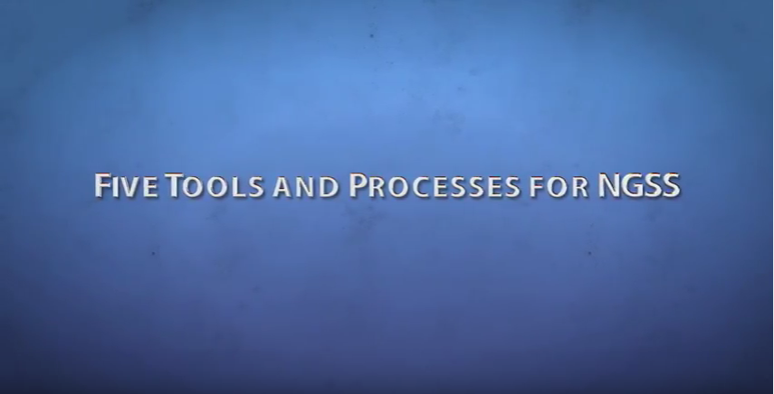
How do we build the necessary teacher knowledge to translate the NGSS?
https://www.youtube.com/watch?v=EU1RfziAG1o

Slide 15
NGSS vs. Our Old State Standards
Compare a page from:
the state standards
the NGSS
What do you notice?

Slide 16

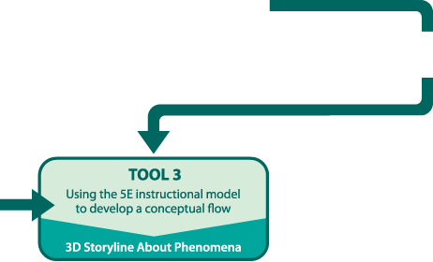
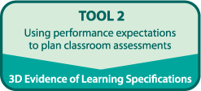
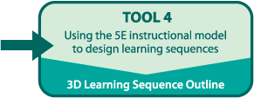
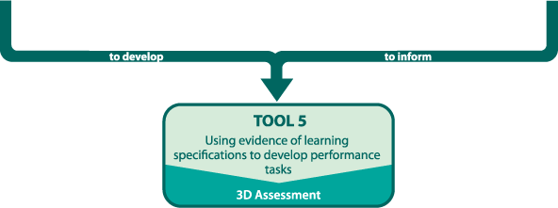
Reflection
What challenges do you anticipate in translating these new standards into instruction and classroom assessment?
LITE!

