Slide 1
Advancing Tools and Processes for Next Generation Science
Planning for Instruction
Tool 4: Using the 5E instructional model to design learning sequences

Slide 2
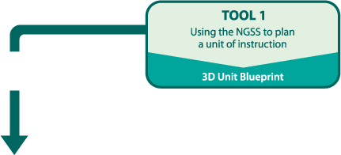
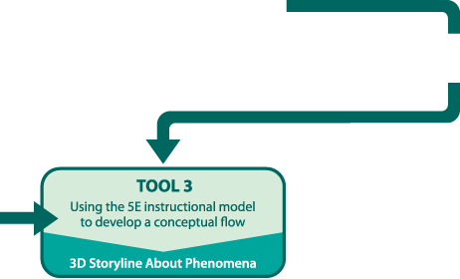
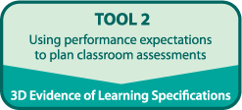
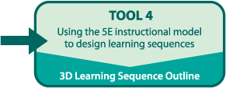
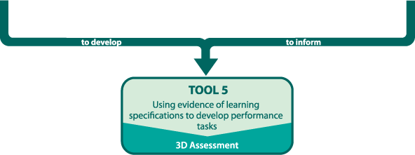
Planning for Instruction
LITE!

Slide 3
Goals
Develop a shared vision for science teaching and learning informed by the NGSS
Deepen understanding of how Conceptual Flow, Storyline about Phenomena and the 5E Instructional Model support Three Dimensional Learning
Use instructional materials and results of work with Tools 1, 2 and 3 to outline lessons for one 5E sequence that supports implementation of the NGSS

Slide 4

How Will We Accomplish These Goals?
Use Our Storyline about Phenomena and
Conceptual Flow
Use the 5E Instructional Model
to design an instructional sequence aligned to the NGSS DCIs, SEPs, CCCs, and Connections

Slide 5
Ms. Rivera
What do you think Ms. Rivera considered as she planned for instruction and during instruction?

Slide 6
Tool 4
Part 1
Title
Key Resources
SEP; DCI; CCC
Connections
PEs
Prior Knowledge
Common Student Ideas
Part 2
What teacher is doing | What students are doing | Science
NGSS

Slide 7
Linking to the NGSS
As a group, review the lesson you charted from Ms. Rivera’s 5E sequence
Use colored sticky-notes to code for evidence in your chart of NGSS alignment
  DCIs (orange)
  SEPs (blue)
  CCCs (green)
  Connections to NOS and ETAS (purple)

Slide 8
Alignment with 5E Model
Read over the handout to learn about what is consistent and what is inconsistent with the 5E model. Review what the teacher is doing and what the students are doing.
Go back to your chart and underline key words or phrases that signal the “E” the lesson is aligned with.

Slide 9
Connections to Tool 3
Tool 3 helped you develop the storyline. Tool 4 will help you develop the instructional sequence that will help you teach that storyline.
As you use Tool 4,
Keep the phenomenon in mind at all times.
If an idea is not related to the phenomenon, it is distracting.
Do not include activities or ideas just because they are “interesting.”
Review the storyline often.
Include guiding questions for each activity. This will help you and your students stay focused.

Slide 10
Tool 4
Part 1
Title
Key Resources
SEP; DCI; CCC
Connections
PEs
Prior Knowledge
Common Student Ideas
Part 2
What teachers are doing | What students are doing | Science Concepts
NGSS

Slide 11
Ms. Rivera’s Tool 4 Example
Find the section of Ms. Rivera’s Tool 4 Example that your group charted
Review the Connections to Common Core cards for ELA/Literacy and Mathematics you set aside during Tool 1
How does your chart compare to what Ms. Rivera wrote in Tool 4?

Slide 12
Steps for Completing Tool 4
Brainstorm/Identify activities/prompts/investigations from your instructional materials.
Use the Analysis Guides to decide to keep, tweak, or delete activities/prompts/investigations to support your NGSS aligned conceptual flow
Enter your work electronically on Tool 4

Slide 13
Using Analysis Guides
Identify
  What activities/prompts/investigations do I have related to the concept and “E?”
Analyze
  How well does the “current” activity ….
Revise
  Can I use the resource in the development of my 5E instructional sequence?
    Keep it
    Tweak it
    Get rid of it
  How will I use the resources for this phase of the 5E instructional sequence?

Slide 14
Using Analysis Guides
Identified “E”-- Explore
Identified Concepts
  Food webs can represent patterns of feeding relationships among organisms in an environment.
  Cause and effect relationships represented in a food web may be used to predict phenomena.
Sample Activity
Work in your group using the Explore Analysis Guide to determine if you would keep, tweak or get rid of the activity
Share your thinking

Slide 15
Steps for Completing Tool 4
Brainstorm/Identify activities/prompts/investigations from your instructional materials.
Use the Analysis Guides to decide to keep, tweak, or delete activities/prompts/investigations to support your NGSS aligned conceptual flow
Enter your work electronically on Tool 4

Slide 16
Share your Work
Partner with another group and share what you have been working on.
Before sharing, let the other group know specifically what you might want feedback on.

Slide 17
Reflection
What is one thing you want to remember about aligning instruction with the NGSS?
What is one thing you want to remember about using the Analysis Guides to plan instruction?

