Slide 1
Advancing Tools and Processes for Next Generation Science Planning for Classroom Assessment
Tool 2: Using Performance Expectations to Plan Classroom Assessments

Slide 2
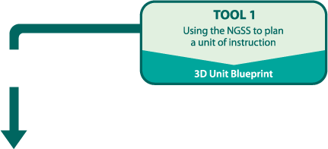
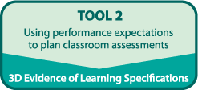
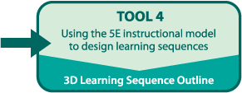
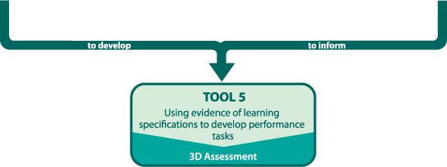
Planning for Classroom Assessment

Slide 4
Goals
Understand the role of NGSS performance expectations in classroom assessment
Consider how SEPs, DCIs, and CCCs impact assessment and instruction
Develop specifications to frame the summative assessment for an instructional sequence

Slide 5
High Quality Classroom Assessment
Table group brainstorm: What are the characteristics of high quality classroom assessment?
Chart your ideas
Be prepared to share with the whole group
Notes:
Comes from Kathy d and k12 alliance – access prior knowledge and provide a framework to organize their thinking.
Important to point out Sets up this work and work on Tool 5 – we want to think about h q assessment even while planning instruction

Slide 6
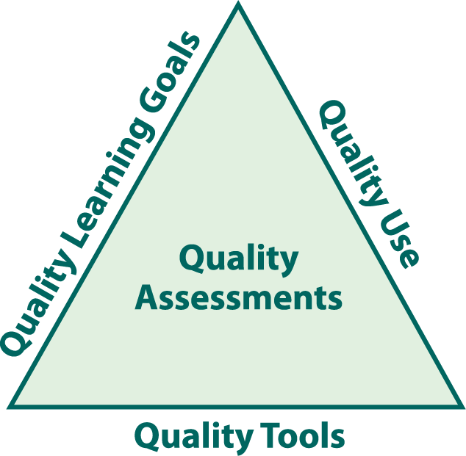
Three Facets of High Quality Assessments
Adapted from the
Assessment-Centered Teaching Framework
Notes:
Need q tools, need to use them effectively for h q learning goals

Slide 7
Code Your Brainstormed List
Quality Goals for Student Learning = G
Quality Tools = T
Quality Use = U

Slide 8
Connection to the Five Tools
Adapted from the
Assessment-Centered Teaching Framework
Notes:
Where we will attend to these aspects
The tools don’t address quality use

Slide 9
Types of Assessment
Formative Assessment
Summative Assessment
Assessment becomes formative in nature only when either the teacher or the student uses that information to inform teaching and/or to influence learning.
Measures student progress at the end of instruction to demonstrate achievement of the learning goals.
Notes:
Ask for thoughts on differences then show slides

Slide 10
Classroom Assessment Design
Design Guidelines | What is it? | How does NGSS help me think about it? | How do I use it?
Performance Expectations | States what students should know and be able to do. | Reminds me that PEs integrate the three dimensions: SEPs, DCIs, XCCs | Tool 1
Evidence of Learning Specifications | Specifications for the evidence that students have achieved and/or surpassed the PE. The evidence is obtained through observations of students and/or student work products. | Helps me describe an assessment(s) that integrates the three dimensions within the PE(s). | Tool 2
Assessment Task and Rubric | The Assessment Task requires students to demonstrate that they have achieved and/or surpassed the PEs by performing or producing student work aligned to the Evidence of Learning Specifications |  | Tool 5
Provide the foundation for the assessment task

Slide 11
What are Evidence Statements?
In an effort to describe more specifically what you would see in proficient student performance of the NGSS PEs, evidence statements should be developed.
Evidence statements provide clear, measurable components that, if met, fully satisfy a PE. These statements should provide detail on how students will use the practices, crosscutting concepts, and disciplinary core ideas together in their demonstration of proficiency on the PEs by the end of instruction.
Adapted from Achieve, 2015
Notes:
Don’t use – this is Achieve
Include in Leadership Institute because of Tool 2 lite

Slide 12
Tool 2: Planning for Assessment
What are the performance expectations?
PE
What evidence of learning specifications will guide assessment task(s) development?
Evidence
of Learning Specs
Tool 5: Developing Classroom Assessments
How will students demonstrate their achievement of the performance expectations?
Task

Slide 13
Dinner Party “Performance Expectation”
Plan an interactive dinner party. [Clarification Statement: Dinner party for 8-10 friends who are acquainted with one another.] [Assessment Boundary: Dinner party is not associated with a special occasion or holiday.]
Disciplinary Core Idea: People, food, and beverage are important components of a dinner party
Practice: Plan for interaction
Crosscutting Concept: Community and belonging require the development of relationships
Notes:
Planning vs conducting a dinner party…
Model: what if someone said, “people talked to lots of people at the dinner party” turn and talk… this isn’t planning. What would PE need to say to include this/ (Plan and conduct)

Slide 14
Dinner Party Example
PE
Plan an interactive dinner party
Specs
Guest list of 8-10 friends who are acquainted with each other
Lists of wines that go with the food
Menu and shopping list for food based on the dietary needs of guests
Sketch of seating area
Beverages for people who are non-wine drinkers
Plan for interaction includes:
Notes:
First bullet represents a 3-D aspect.
This pattern will be for MS LS 2
Sentence stem is the practice

Slide 15
Developing Evidence of Learning Specifications
Consider:
PE(s) for an instructional sequence from Tool 1
clarification statement
assessment boundary
SEPs, DCIs, CCCs and Connections in an instructional sequence from Tool 1
SEPs from the PEs associated with connected DCIs

Slide 16
EoLS for _____________
PE(s)
SEP: ____________________________________
Foreground (SEPs, DCIs, CCCs, and Connections) | Background (SEPs, DCIs, CCCs and Connections)
NOT assessed

Slide 17
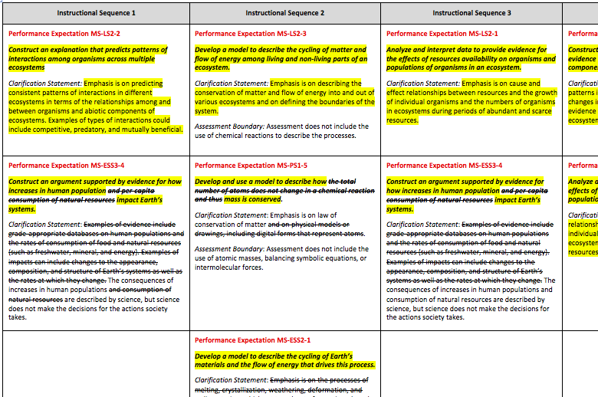
Tool 1: Template Example - Unit Blueprint
MS-LS2 Ecosystems: Interactions, Energy, and Dynamics

Slide 18
Developing Evidence of Learning Specifications
Consider:
PE(s) for an instructional sequence from Tool 1
clarification statement
assessment boundary
SEPs, DCIs, CCCs and Connections in an instructional sequence from Tool 1
SEPs from the PEs associated with connected DCIs

Slide 19
Bundled PEs
Performance Expectation MS-LS2-2
Construct an explanation that predicts patterns of interactions among organisms across multiple ecosystems
Clarification Statement: Emphasis is on predicting consistent patterns of interactions in different ecosystems in terms of the relationships among and between organisms and abiotic components of ecosystems. Examples of types of interactions could include competitive, predatory, and mutually beneficial.
Performance Expectation MS-ESS3-4
Construct an argument supported by evidence for how increases in human population and per-capita consumption of natural resources impact Earth’s systems.
Clarification Statement: Examples of evidence include grade-appropriate databases on human populations and the rates of consumption of food and natural resources (such as freshwater, mineral, and energy). Examples of impacts can include changes to the appearance, composition, and structure of Earth’s systems as well as the rates at which they change. The consequences of increases in human populations and consumption of natural resources are described by science, but science does not make the decisions for the actions society takes.
Notes:
Show then talk about sequences

Slide 20
Getting Familiar with one PE
Performance Expectation MS-LS2-2
Construct an explanation that predicts patterns of interactions among organisms across multiple ecosystems
[Clarification Statement: Emphasis is on predicting consistent patterns of interactions in different ecosystems in terms of the relationships among and between organisms and abiotic components of ecosystems. Examples of types of interactions could include competitive, predatory, and mutually beneficial.]
Review the PE and think about the following questions:
What is the big idea?
How does the clarification statement help you refine the big idea?

Slide 21
Developing Evidence of Learning Specifications
Consider:
PE(s) for an instructional sequence from Tool 1
clarification statement
assessment boundary
SEPs, DCIs, CCCs and Connections in an instructional sequence from Tool 1
SEPs from the PEs associated with connected DCIs

Slide 22
Developing Evidence of Learning Specifications
Consider:
PE(s) for an instructional sequence from Tool 1
clarification statement
assessment boundary
SEPs, DCIs, CCCs and Connections in an instructional sequence from Tool 1
SEPs from the PEs associated with connected DCIs

Slide 23
Getting Familiar with the other PE
Performance Expectation MS-ESS3-4
Construct an argument supported by evidence for how increases in human population and per-capita consumption of natural resources impact Earth’s systems.
Clarification Statement: Examples of evidence include grade-appropriate databases on human populations and the rates of consumption of food and natural resources (such as freshwater, mineral, and energy). Examples of impacts can include changes to the appearance, composition, and structure of Earth’s systems as well as the rates at which they change. The consequences of increases in human populations and consumption of natural resources are described by science, but science does not make the decisions for the actions society takes.
Review the PE and think about the following questions:
What is the big idea?
How does the clarification statement help you refine the big idea?

Slide 24
Developing Evidence of Learning Specifications
Consider:
PE(s) for an instructional sequence from Tool 1
clarification statement
assessment boundary
SEPs, DCIs, CCCs and Connections in an instructional sequence from Tool 1
SEPs from the PEs associated with connected DCIs

Slide 25
Evidence of Learning Specifications Initial example
Construct an explanation that:
shows patterns of interactions between living and non-living parts of ecosystems
includes different types of interactions among organisms
Construct an argument:
that is supported by evidence
for how increases in human population impact the Earth

Slide 26
Evidence of Learning Specifications Revised example
Construct an explanation that predicts:
consistent shows patterns of interactions between living and non-living parts of ecosystems
consistent includes different patterns of types of interactions between organisms including competitive, predatory, and mutually beneficial
Construct an argument that:
that is supported by empirical evidence of interactions within the ecosystem (a type of Earth system) and scientific reasoning
supports or refutes for how increases in human population cause negative impacts on the Earth

Slide 27
Evidence of Learning Specifications
Construct an explanation that predicts:
consistent patterns of interactions between living and non-living parts of ecosystems
consistent patterns of types of interactions including competitive, predatory, and mutually beneficial
Construct an argument that:
is supported by empirical evidence of interactions within the ecosystem (a type of Earth system) and scientific reasoning
supports or refutes how increases in human population cause negative impacts on the Earth

Slide 28
Apply Process
Use the instructions on the handout to guide the develop of Evidence of Learning Specifications for one of your instructional sequences.
You will have approximately 90 minutes.

Slide 29
Gallery Walk
Review at least one other groups’ work associated with the same PE.
What do you notice about their evidence of learning specifications?
Use sticky notes to provide comments and feedback

Slide 30
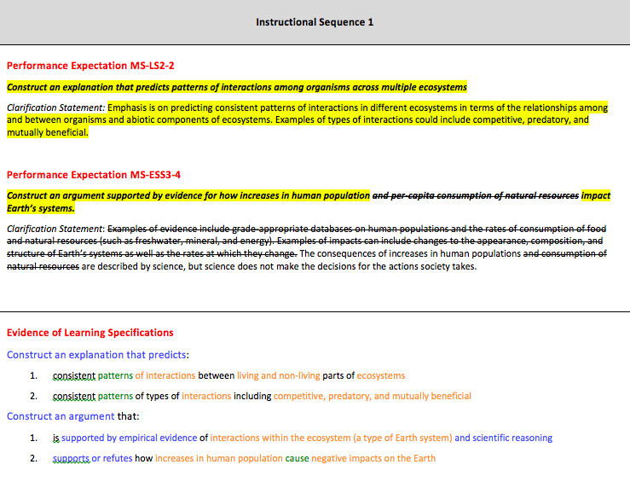
Enter Your EoL Specs on Tool 2

Slide 31
Reflection
How does the use of Tool 2 help you plan for assessment in ways consistent with the NGSS?
How does the work with Tools 1 and 2 help you think about the Conceptual Shifts we to make to implement the vision of the NGSS?

