Slide 1
Advancing Tools and Processes for
Next Generation Science
Three-Dimensional
Phenomena Driven Instruction

Slide 2


Introductions
Your name
Your role in your school/district
What do you hope to take away from this session?

Slide 3
Goals
Increase understanding of phenomena-focused three-dimensional teaching and learning
Develop understanding of the opportunities and challenges in implementing phenomena-focused three-dimensional teaching and learning presents
Promote awareness of how phenomena-focused three-dimensional teaching and learning of science connects to mathematics and ELA student learning.

Slide 4
Agenda
Opening
Immersive experience: Zebra mussels
Effective Science Teaching and Learning
Considering the NGSS innovations in your context
Closing

Slide 5
Norms
The Basics
Arrive prepared and on time; stay for the duration; return from breaks on time.
Remain attentive, thoughtful, and respectful; engage and be present.
Eliminate interruptions (turn off cell phones, email, electronics, avoid sidebar conversations).
Make room for participation from all (monitor your floor time).
The Heart
Keep the goal in mind: We are analyzing teaching to improve student learning.
Share your ideas, uncertainties, confusions, disagreements, questions, and good humor; all points of views are welcome.
Expect and ask questions to deepen everyone’s learning; be “constructively challenging.”
Listen carefully; seek to understand others’ point of view.

Slide 6
Effective Teaching and Learning
What are the characteristics of effective teaching and learning in the science classroom?
  What are students doing?
  What are teachers doing?
Chart your ideas and be prepared to share your ideas with the group.

Slide 7
Set up
For the next hour, you will be in science learner mode.
We designed this experience for you. This experience would occur toward the end of chapter 4 of 5 in a MS unit focused on disruptions in ecosystems.
We’ll use this common experience to launch conversations about phenomenon-focused three dimensional student learning.

Slide 8

Science Learner
Notes:
Baseball hat image
https://en.wikipedia.org/wiki/File:Baseball_cap.jpg

Slide 9
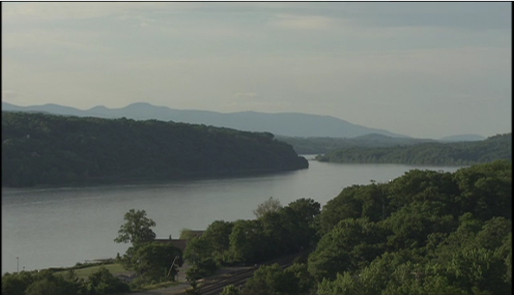
An Unwelcome Newcomer
How do you think zebra mussels might affect the Hudson River ecosystem?
What data about the river might scientists collect to investigate this question?
http://www.amnh.org/education/resources/rfl/web/riverecology/watch.html#intro
Notes:
http://www.amnh.org/education/resources/rfl/web/riverecology/watch.html#intro

Slide 10
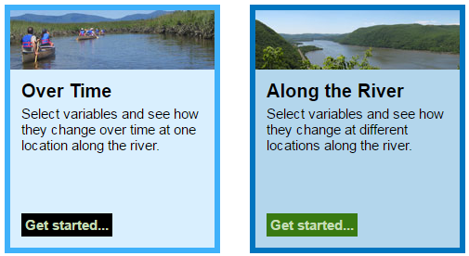
Data Collection

Slide 11
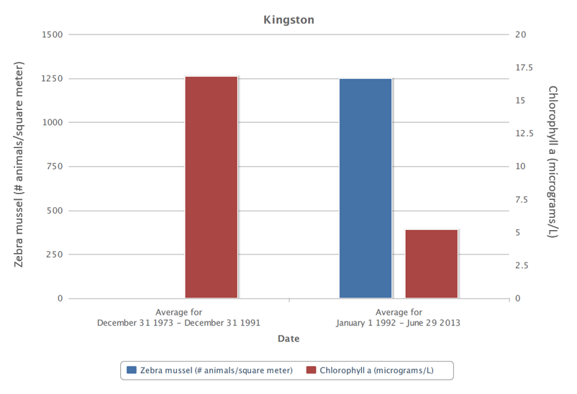
Zebra Mussels and Phytoplankton

Slide 12
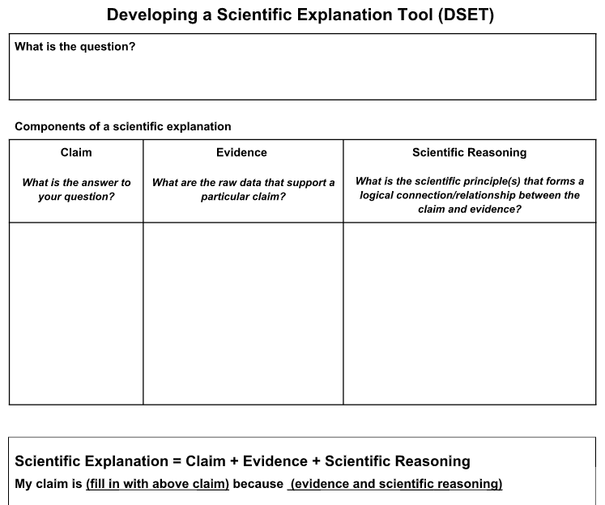
Developing a Scientific Explanation

Slide 13
Effects of Zebra Mussels on the Hudson River Ecosystem
Share your explanation with two other participants
  Discuss similarities and differences between your explanation and others’ explanations
Share your findings with your partner

Slide 14
Effects of Zebra Mussels on the Hudson River Ecosystem
How did your ideas change throughout the activity?
What additional questions do you have about how zebra mussels might affect the Hudson River ecosystem?
Be prepared to share your responses

Slide 15

Educator
Notes:
https://commons.wikimedia.org/wiki/Category:Graduation_hat_icons#/media/File:Sciences_humaines.svg

Slide 16
Reflecting on the Experience
What could one learn through this experience?
What contributed to your learning?
  What were you doing?
  What were the PD Leaders doing?
Be prepared to share your thoughts.

Slide 17
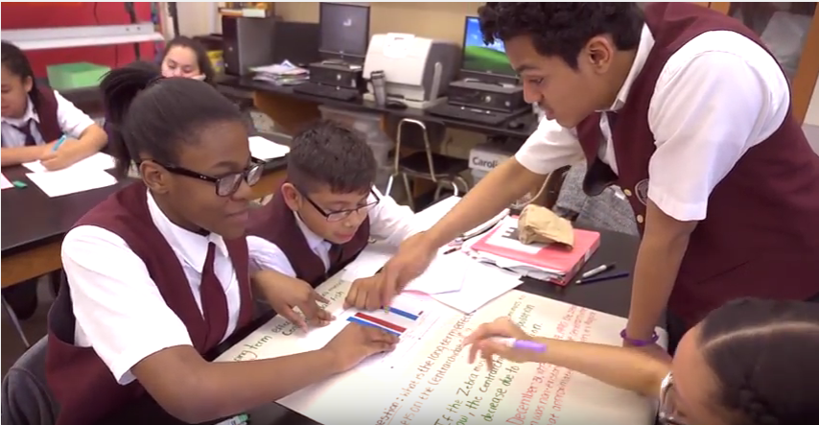
Writing a Scientific Explanation
https://youtu.be/lOnYkc2ncsk?t=5m11s
Notes:
https://youtu.be/lOnYkc2ncsk?t=5m11s
http://www.amnh.org/explore/curriculum-collections/integrating-literacy-strategies-into-science-instruction/writing-a-scientific-explanation/

Slide 18
Opportunities for Learners
Consider the common experience:
What opportunities were present for learners to experience three-dimensional learning?
  Disciplinary Core Ideas
  Science and Engineering Practices
  Crosscutting Concepts
  What opportunities were present for learners to connect science learning to ELA and mathematics?

Slide 19
Effective Teaching and Learning
Revisit your T-chart
Use a different color to revise and add ideas
Be prepared to share your thinking

Slide 20
Science Teaching and Learning
Read the Classroom Scenario A
Individually highlight your assigned lesson(s)
  What is the teacher doing? (highlight in yellow)
  What are students doing? (highlight in pink)
  What is the science in this lesson? (underline)
As a group, chart what you highlighted for your assigned lesson(s)
Gallery Walk
  How would you describe this classroom?
Individual Reflection
  How would you describe this classroom?
Lesson ______
Teacher A | Students | Science

Slide 21
Science Teaching and Learning
Read the Classroom Scenario B
Individually highlight your assigned lesson(s)
  What is the teacher doing? (highlight in yellow)
  What are students doing? (highlight in pink)
  What is the science in this lesson? (underline)
As a group, chart what you highlighted for your assigned lesson(s)
Gallery Walk
  How would you describe this classroom?
Individual Reflection
  How would you describe this classroom?
Lesson ______
Teacher B | Students | Science

Slide 22
Phenomena in Teaching and Learning
“By phenomena we mean, what is it that is happening in our world that we need our science to explain?” - Brian Reiser
Identify the phenomema learners explained in
Our common experience
Mr. Coles' classroom
Ms. Rivera’s classroom

Slide 23
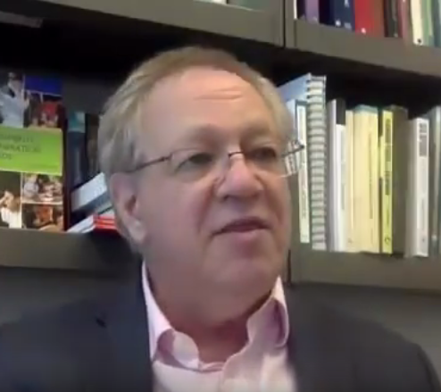
Phenomena in Three-Dimensional Teaching and Learning
Why are phenomena important in the NGSS?
How do phenomena help support student learning?
https://youtu.be/Jyiv1Lc0dng
Notes:
https://youtu.be/Jyiv1Lc0dng

Slide 24
Phenomena in Three-Dimensional Teaching and Learning
How did Ms. Rivera’s use of an anchor phenomenon
  create a coherent instructional sequence?
  support student learning?

Slide 25
Thinking beyond a Lesson to an Integrated Instructional Sequence
Integrated instructional units interweave laboratory experiences with other types of science learning activities, including discussion, reading, writing, and mini-lectures.
Students are engaged in forming research questions, designing and executing investigations, gathering and analyzing data, and constructing explanations and arguments.
Diagnostic and formative assessments are embedded into the instructional sequence and can be used to promote self-reflection about students’ thinking.
National Research Council, 2006

Slide 26
NGSS Instructional Design
Instructional materials are designed with clear performance expectations in mind
Learning experiences are thoughtfully sequenced into the flow of classroom science instruction
Learning experiences are designed to integrate learning of science concepts (DCI and CCC) with learning about the SEP
Students have opportunities for ongoing reflection, discussion, discourse, & argumentation
Bybee, 2014

Slide 27
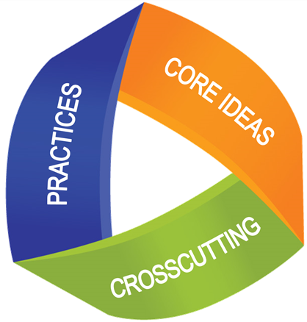
Three-Dimensional Teaching and Learning
In Ms. Rivera’s classroom, where do you see evidence of
Disciplinary Core Ideas
Science and Engineering Practices
Crosscutting Concepts

Slide 28
Effective Teaching and Learning
Revisit your T-chart
Use a different color to revise and add ideas
Be prepared to share your thinking

Slide 29
State of Science Reflection
How closely does our school’s science instructional approach align with Ms. Rivera’s classroom?
What resources or supports do we need to create NGSS-aligned classrooms?

Slide 30
Opening
Insert an appropriate opening for your setting and participants.

Slide 31
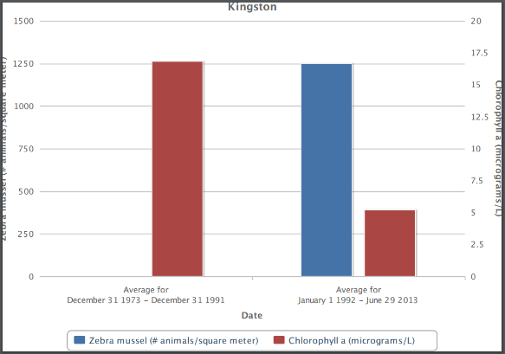

Review of Last Session
Learners and Leaders:
Analyzing data and constructing explanations about zebra mussels
Analyzing Mr. Coles’ and Ms. Rivera’s classrooms: 3D learning and phenomena

Slide 32
Effective Teaching and Learning
How have your ideas about effective science teaching and learning changed (or not) since our last session?

Slide 33
Innovations of the NGSS
Part 1: In your reading group, summarize the key ideas of your assigned innovations
Part 2: In your jigsaw group, represent your answer the following question on chart paper: How does this help you think about science teaching and learning in your setting?
Part 3: Share out
Notes:
https://www.jigsaw.org/history/

Slide 34
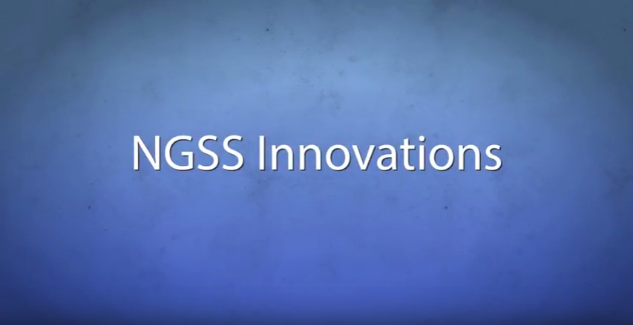
Innovations of NGSS
https://www.youtube.com/watch?v=JZZFJS3yUwo

Slide 35
NGSS vs. Our Old State Standards
Compare a page from:
the state standards
the NGSS
What do you notice?

Slide 36
Meta Moment
Consider the changes you made (or did not make) to the Effective Learning and Teaching chart
  How has your vision of effective learning and teaching changed?
  Which characteristics resonate most strongly with you
  Where do you see evidence (or not) of these characteristics in your building or district?

Slide 37
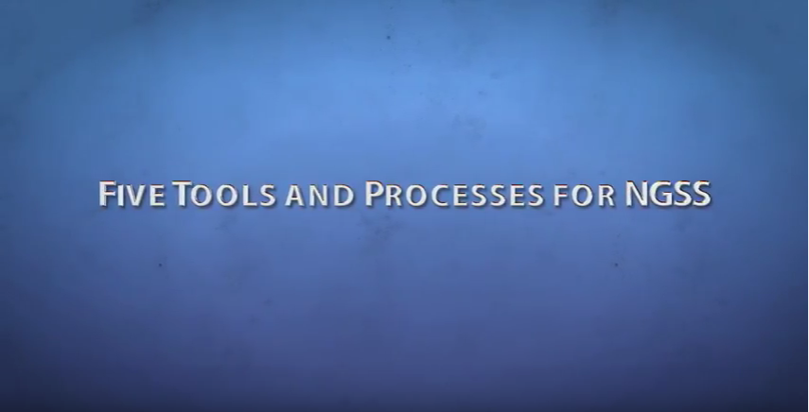
How do we build the necessary teacher knowledge to translate the NGSS?
https://www.youtube.com/watch?v=EU1RfziAG1o

Slide 38
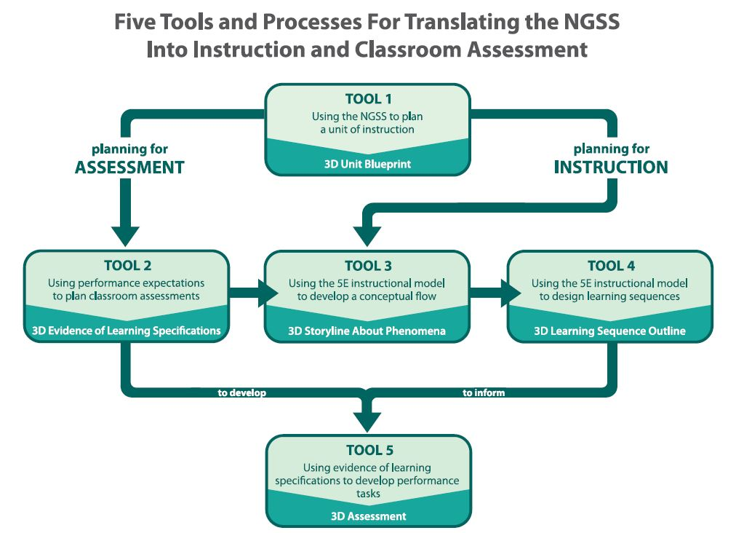
Five Tools and Processes

Slide 39
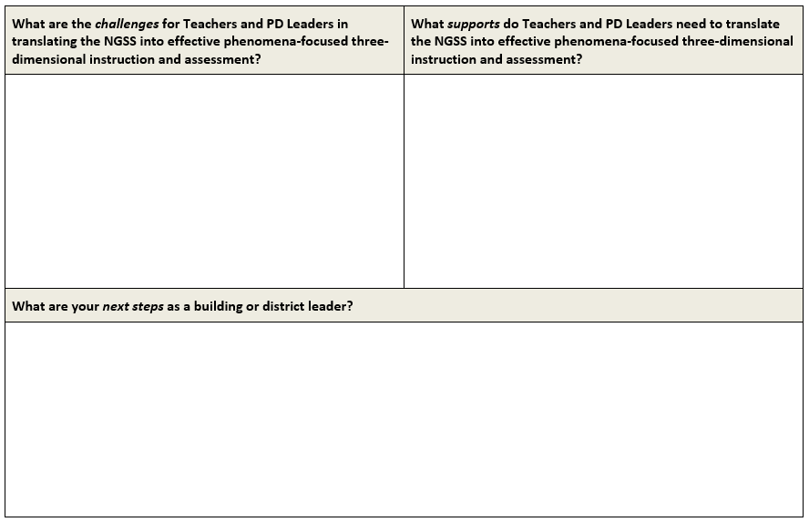
Analysis and Action Steps

Slide 40
Analysis: Challenges and Supports

Slide 41
Action Steps

Slide 42
Goals
Increase understanding of phenomena-focused three-dimensional teaching and learning
Develop understanding of the opportunities and challenges in implementing phenomena-focused three-dimensional teaching and learning presents
Promote awareness of how phenomena-focused three-dimensional teaching and learning of science connects to mathematics and ELA student learning.

Slide 43
Closing
Head, Heart, and Hand

