Slide 1
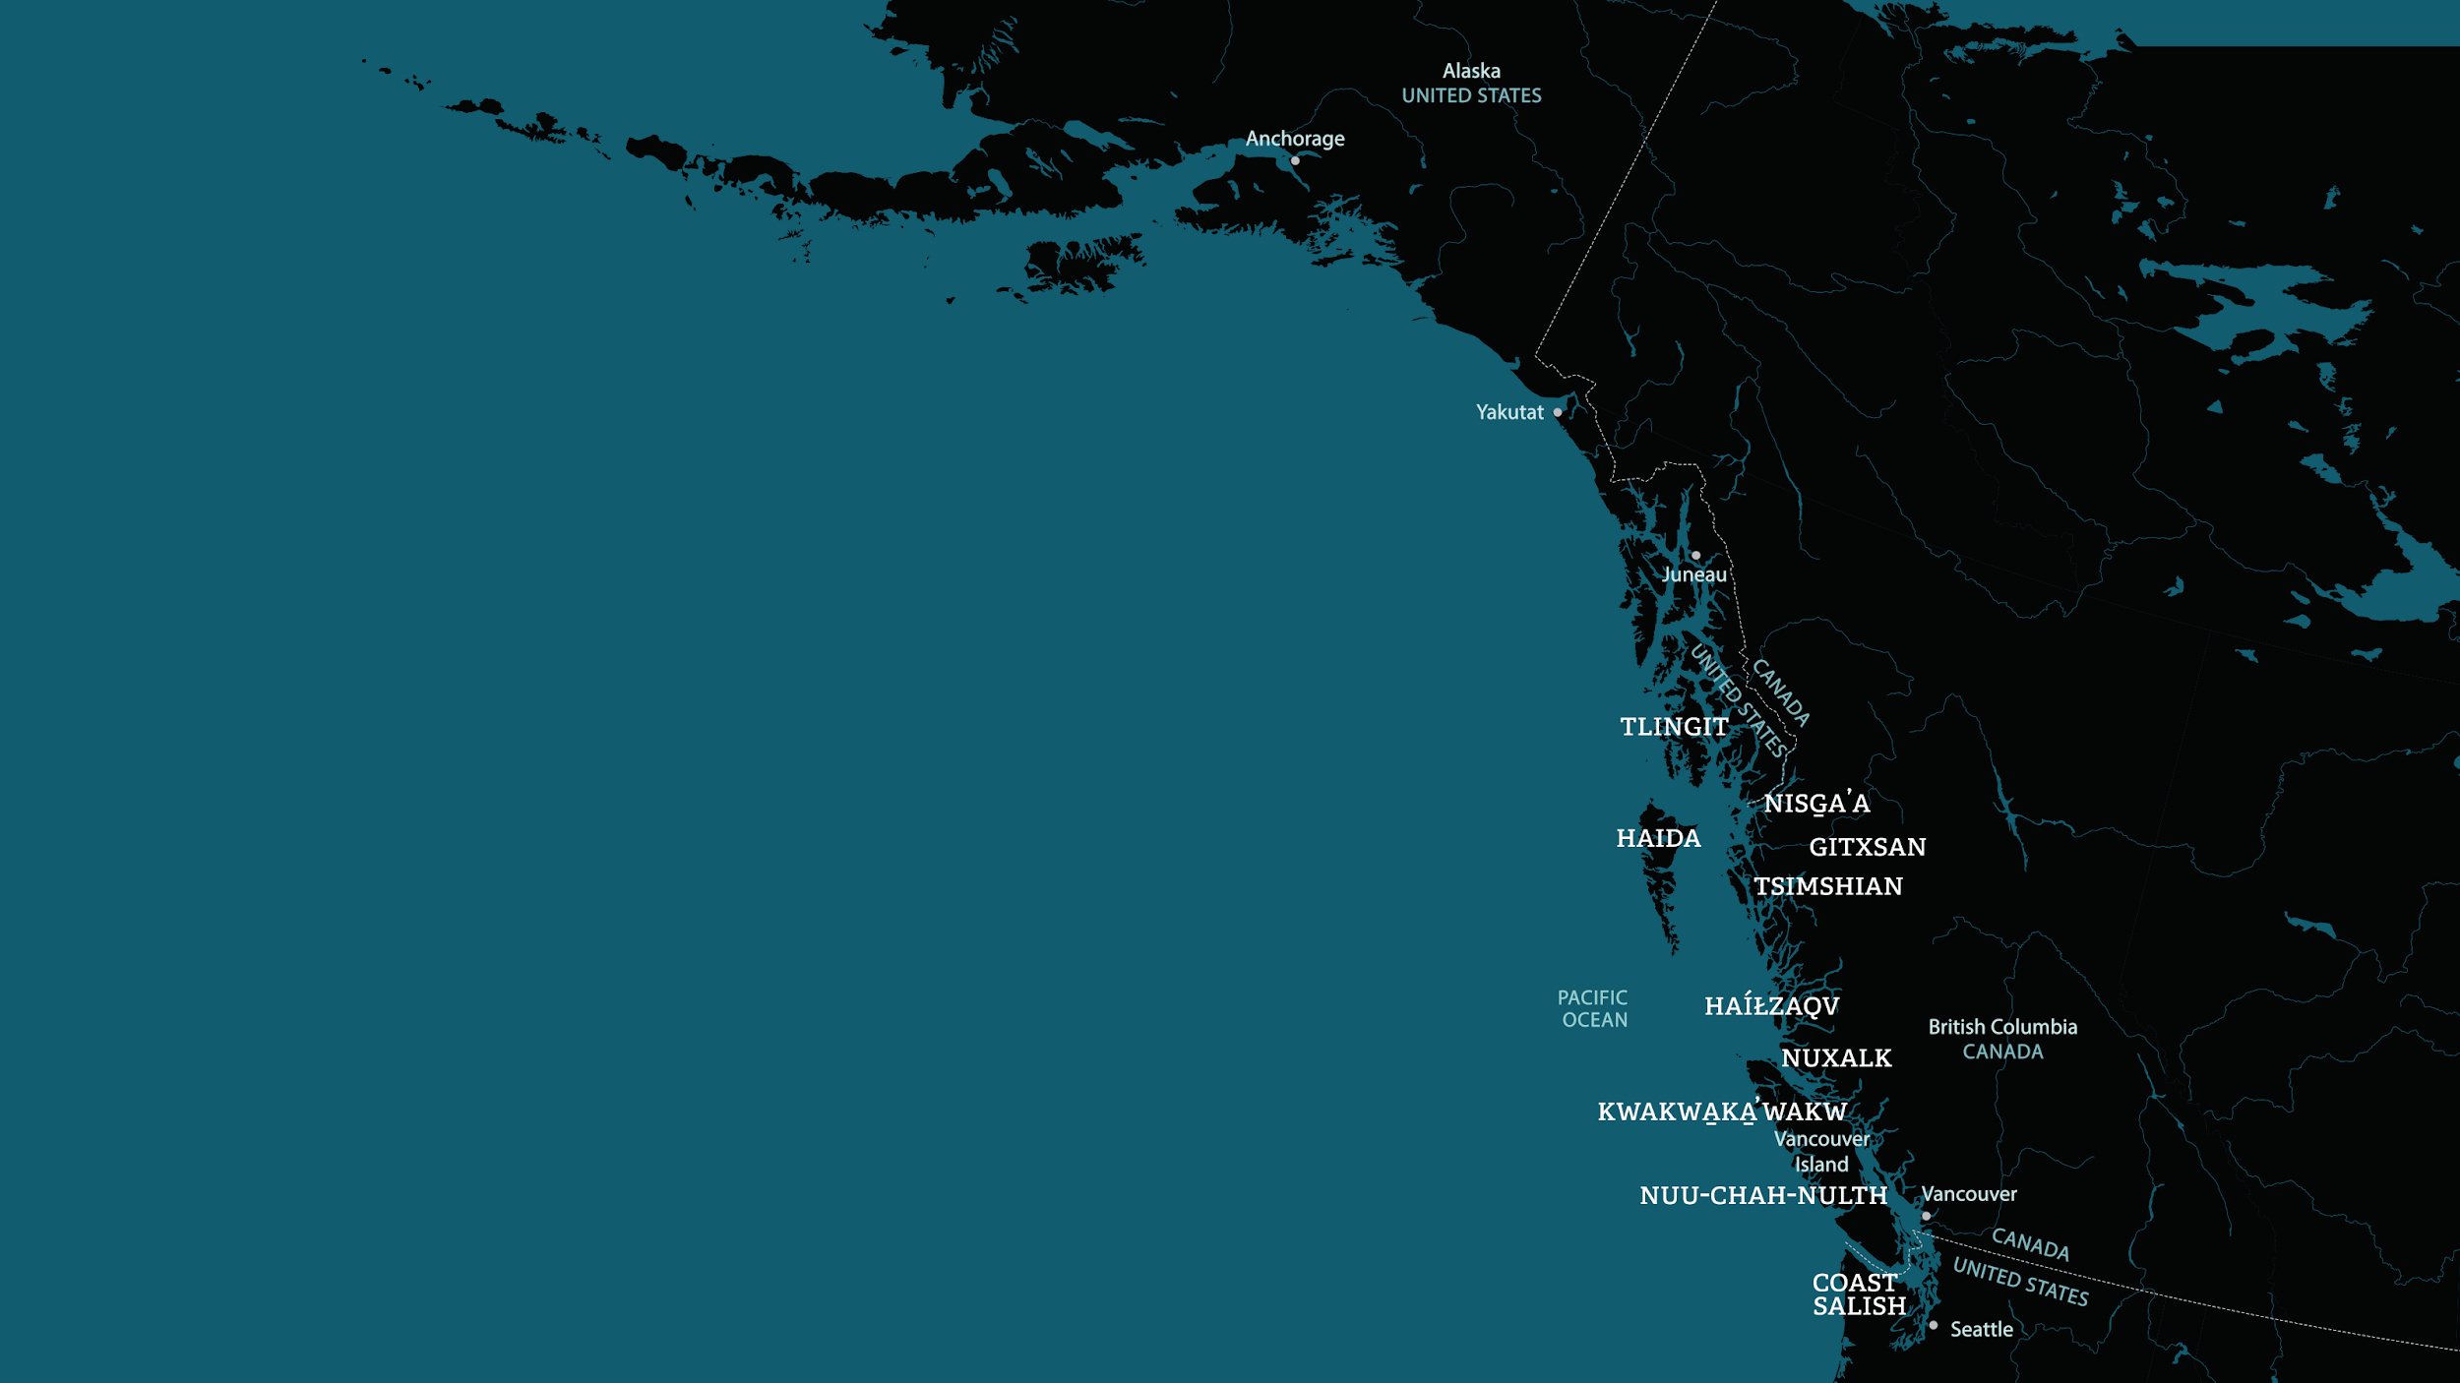

People of many Native Nations live along the Northwest Coast of North America.
The belongings on display in the Museum's Northwest Coast Hall come primarily from those shown on this map.

