Slide 1
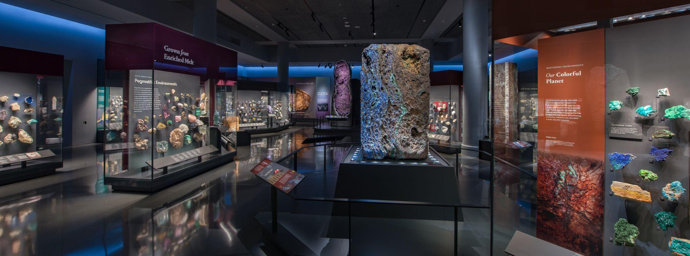
Mignone Halls of Gems and Minerals
GRADES 6–8
In this activity, you will…
Observe specimens that were formed in different environments
Notes:
Notes for Educator
This activity includes two parts:
Part 1: Before the Museum Visit
Part 2: After the Museum Visit

Slide 2
Part 1
Before the Museum Visit
Mignone Halls of Gems and Minerals
GRADES 6–8
Notes:
Notes for Educator
Part 1 is an engagement activity that uses the Visual Thinking Strategy (VTS) to help students practice observation, thinking, listening, and communication skills. It explores five different minerals to help students understand that minerals come in different colors, shapes, and sizes.
The concluding slide invites students general questions about minerals and how they may have formed. These questions can be recorded on a class or group chart, and be used as prompts for discussion after their Museum visit and/or for further research.

Slide 3
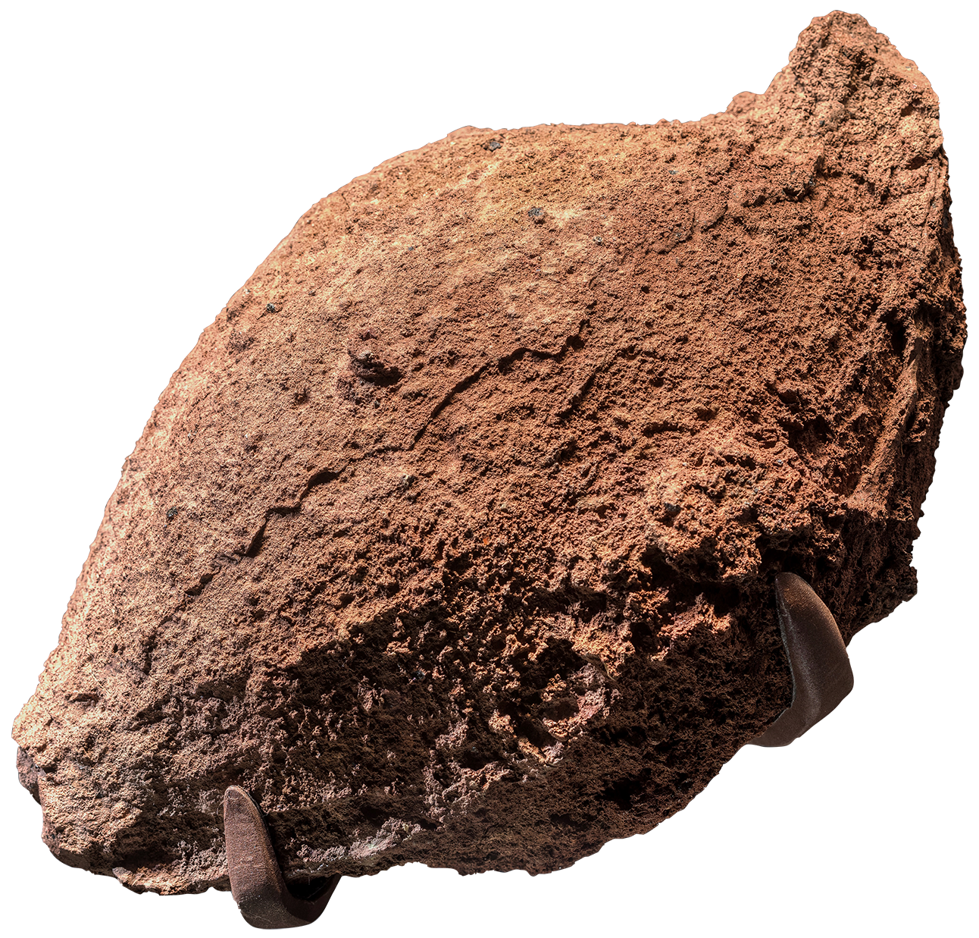
Look closely…
What do you see?

Slide 4
What do you notice about its…
Color?
Shape?
Crystal size?

Slide 5
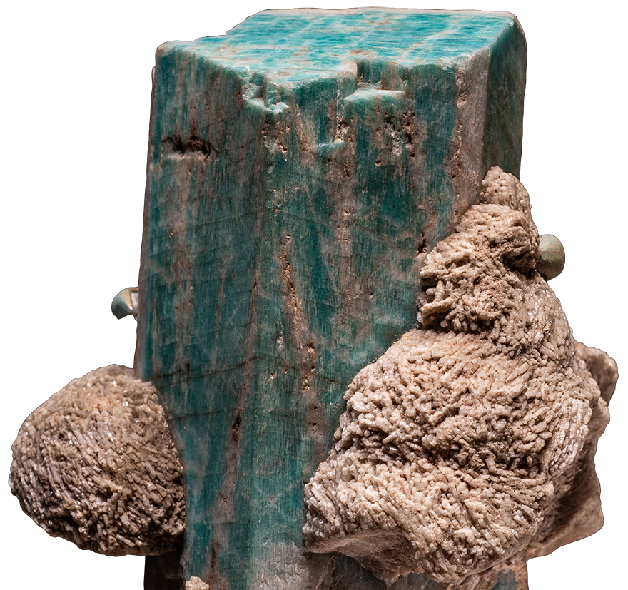
Look closely…
What do you see?

Slide 6
What do you notice about its…
Color?
Shape?
Crystal size?

Slide 7
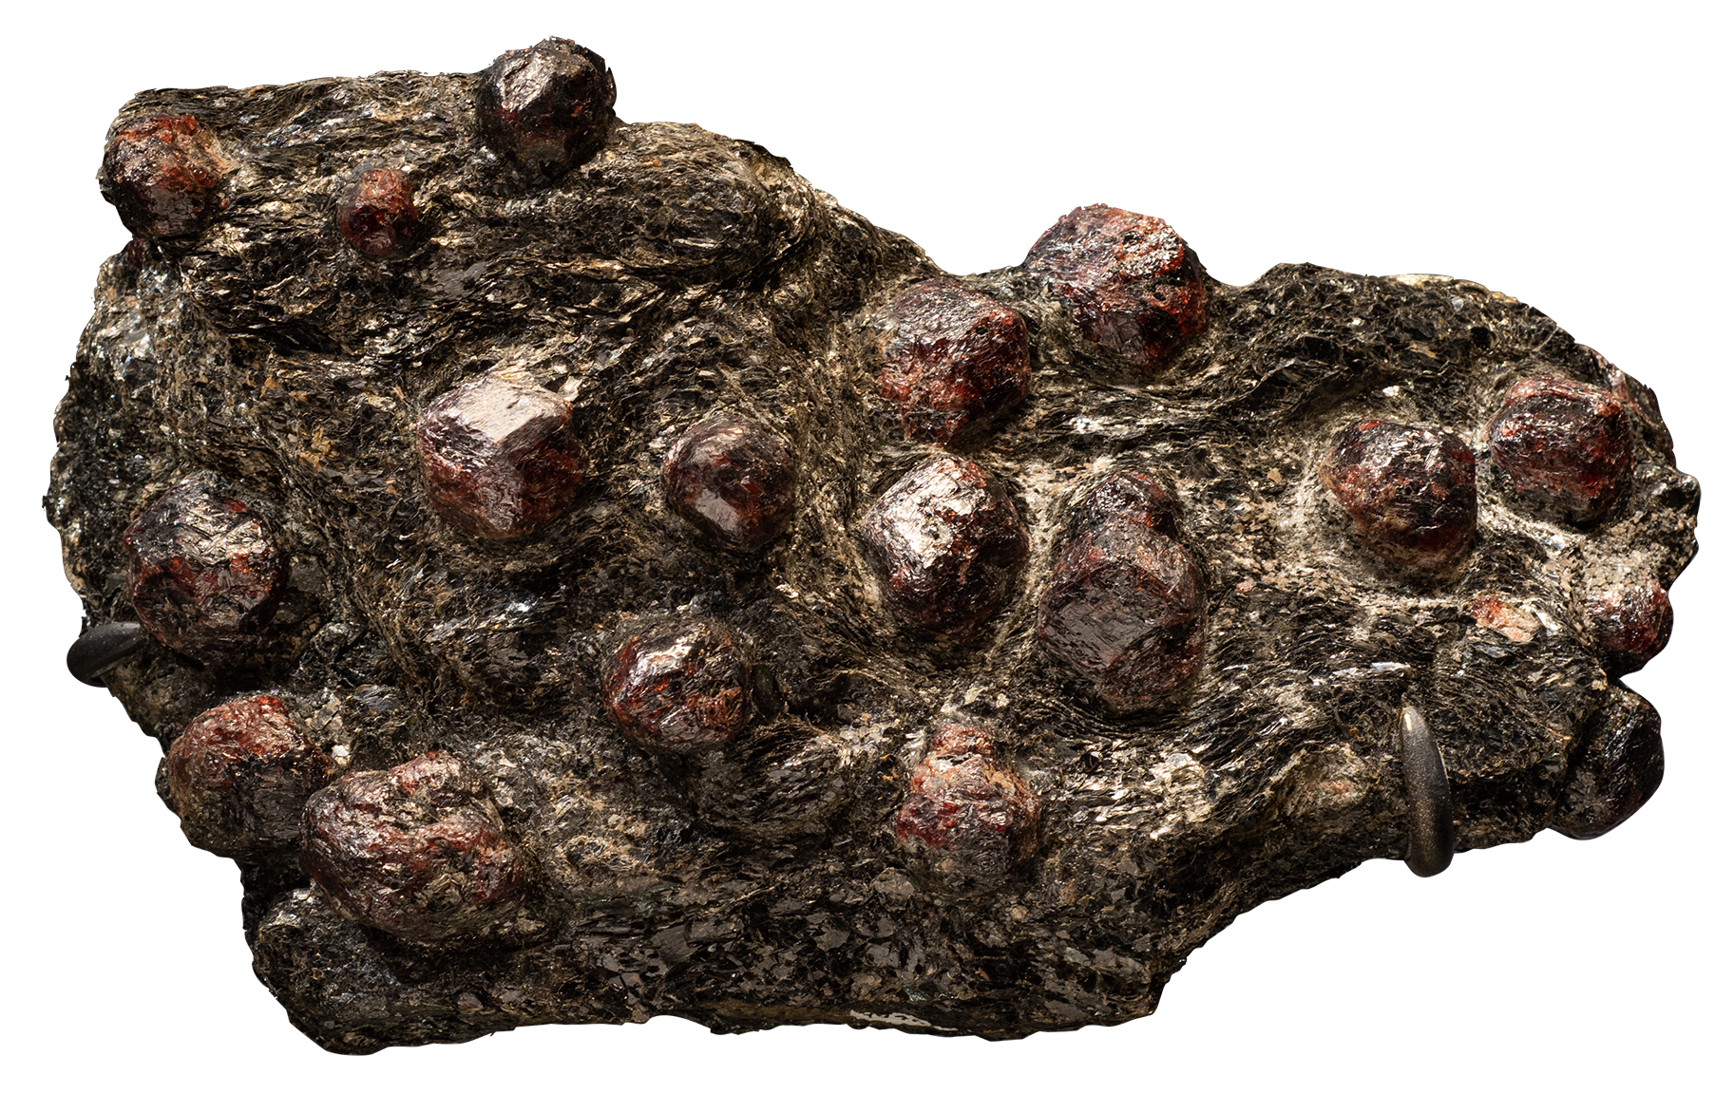
Look closely…
What do you see?

Slide 8
What do you
notice about
its…
Color?
Shape?
Crystal size?

Slide 9
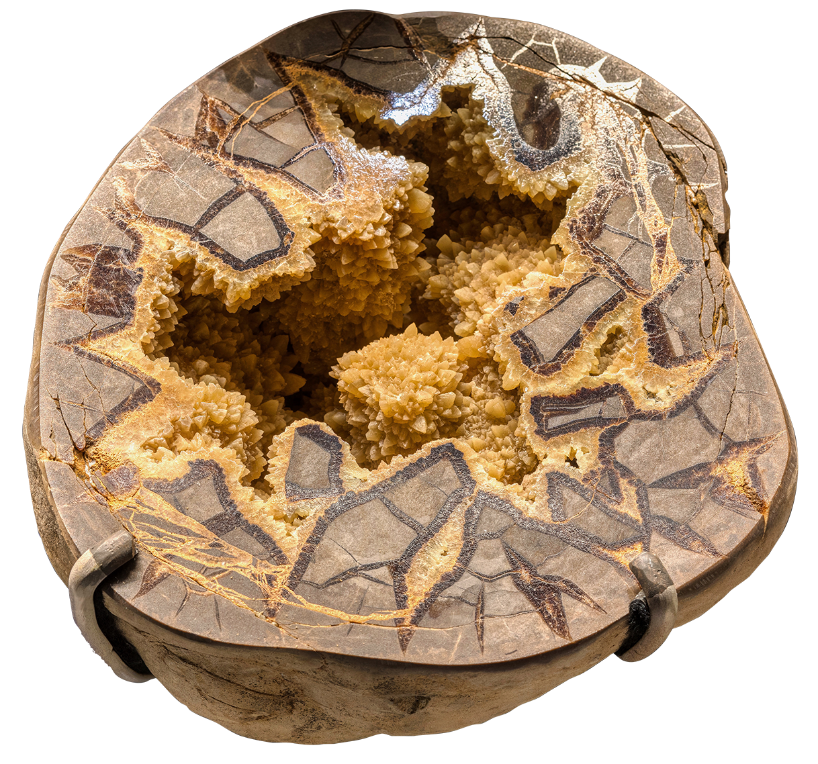
Look closely…
What do you
see?

Slide 10
What do you notice about its…
Color?
Shape?
Crystal size?

Slide 11
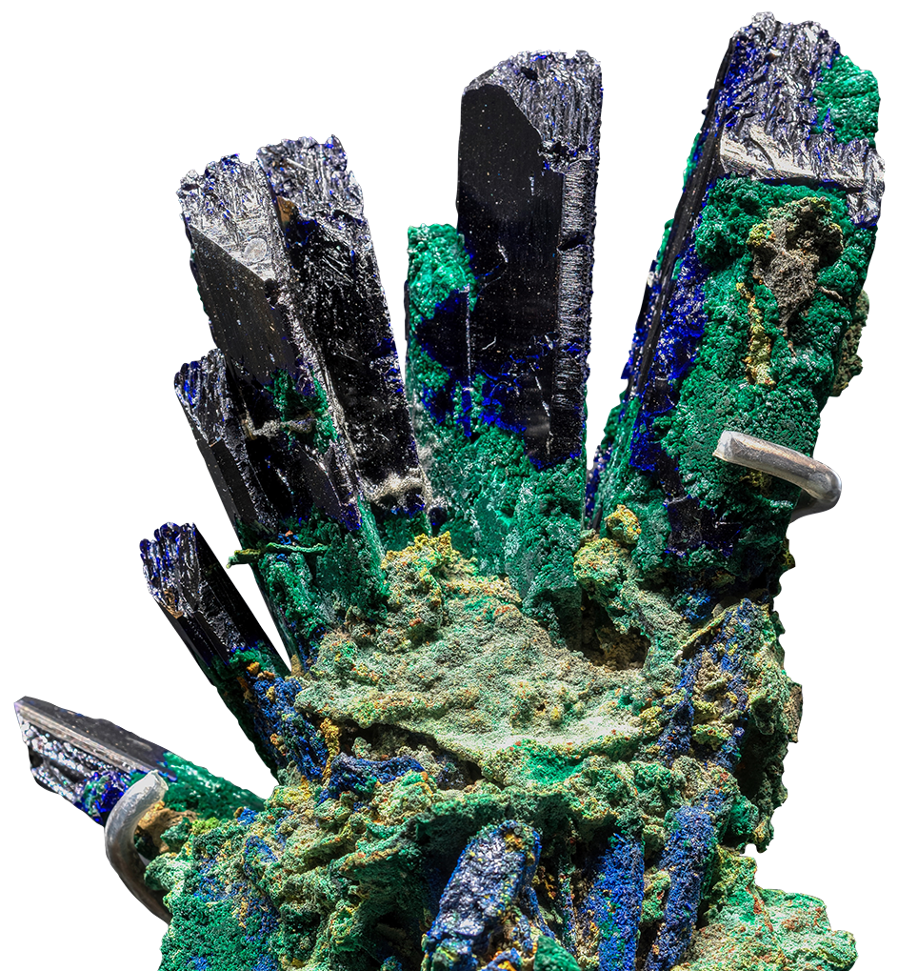
Look closely…
What do you see?

Slide 12
What do you notice about its…
Color?
Shape?
Crystal size?

Slide 13
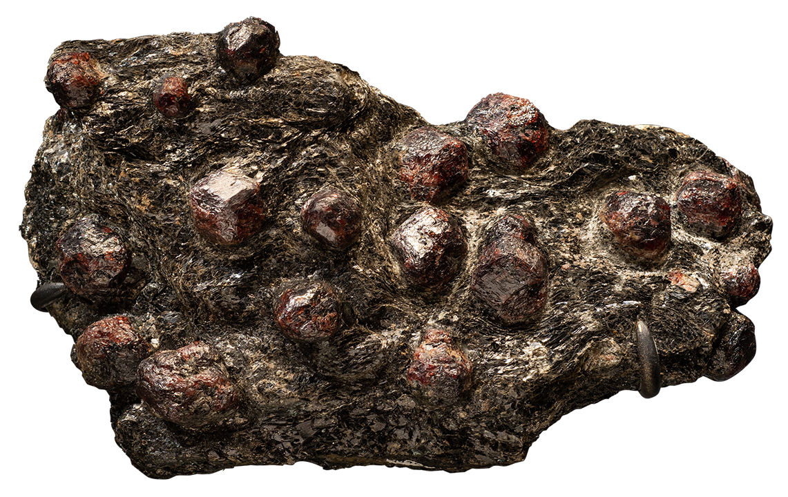
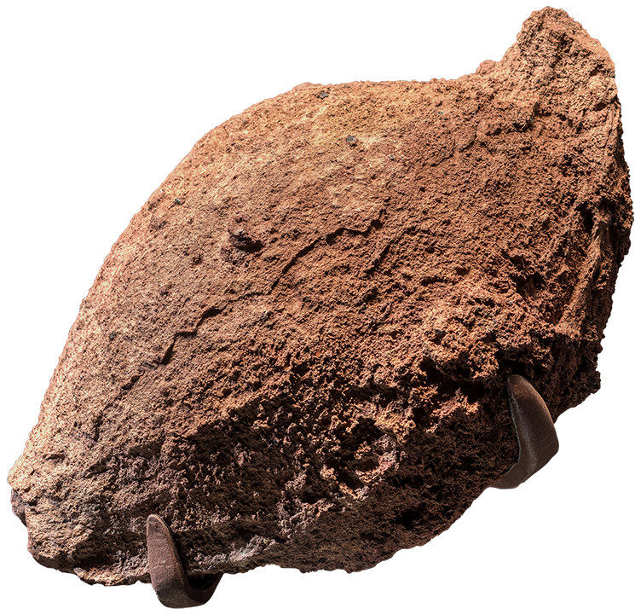
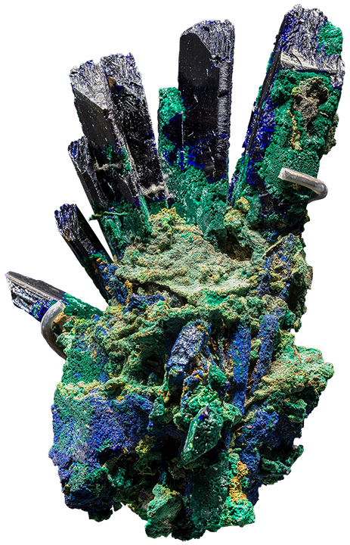
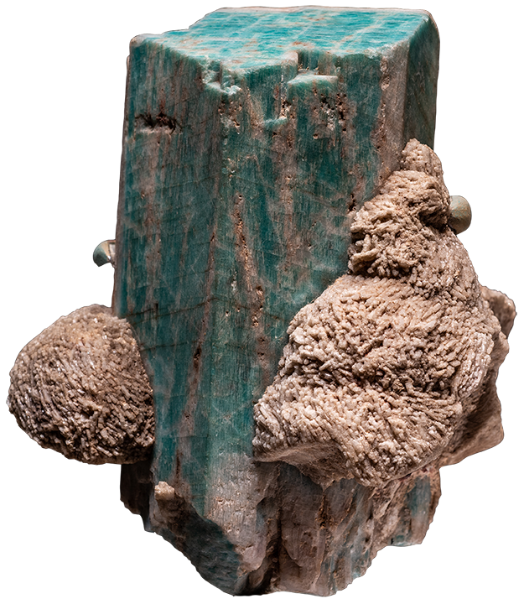
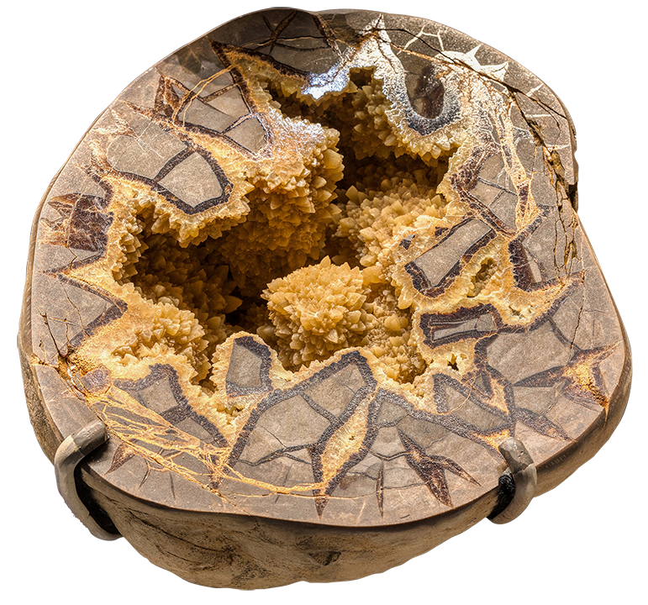
Each of these specimens formed in a different kind of environment.
What questions do you have about them and how they might have formed?
Notes:
Notes for Educator
Questions can be recorded on a class or group chart so that students can revisit the questions after their trip to the Museum and/or use them as prompts for further research.

Slide 14
Part 2
After the Museum Visit
Mignone Halls of Gems and Minerals
GRADES 6–8

Slide 15
Can you match each specimen with the environment in which it formed?
Explain your inference.
Igneous
Pegmatitic
Metamorphic
Hydrothermal
Weathering
A
B
E
C
D
Notes:
Notes for Educator
Answer key and additional background information:
Igneous: C
Specimen: trachybasalt lava bomb
Major minerals: labradorite, pigeonite, forsterite, glass
From: Eifel, Rhineland-Palatinate, Germany
The minerals and texture of an igneous rock are clues to its history, including whether it formed on or near Earth’s surface (extrusive) or solidified deeper in the crust (intrusive). Igneous rocks that form when extruding magma, or lava, solidifies rapidly are fine-grained, with mineral crystals that are difficult to distinguish using only the naked eye. In rocks that solidify from magma deep in Earth’s crust, minerals have time to grow into large, easily recognizable crystals.
This specimen is an extrusive rock.
Pegmatitic: B
Specimen: microcline var. amazonite with albite
From: Crystal Peak, Colorado, USA
Pegmatites are a special kind of igneous rock characterized by large crystals—sometimes of unusual minerals containing rare elements.
This specimen’s minerals are from a simple pegmatite. Simple pegmatites have the same suite of minerals found in igneous rocks they are associated with, and make up the vast majority of all pegmatites. Whereas complex pegmatites are rich in rare elements, and because of that, they have uncommon minerals.
Metamorphic: A
Specimen: almandine in biotite schist
From: New York, New York, USA
Metamorphism occurs when changes in temperature, pressure or fluid availability alter minerals, usually without melting them. Changing conditions can cause minerals to change their structure or simply change size. Different temperatures and pressures exist in different parts of the crust, and metamorphic minerals record these conditions.
This specimen formed when large volumes of rock were buried by mountain building and the thickening of Earth’s crust (regional metamorphism)
Hydrothermal: E
Specimen: calcite and barite, septarian nodule
From: Dalzell, South Dakota, USA
Earth’s interior is constantly moving, causing rocks in the brittle crust to fracture—usually forming cracks but also open cavities. Hot water, common in Earth’s crust, moves through these fractures, dissolving and transporting rock components. When water reaches cooler rocks or some other condition changes, minerals will crystallize along rock walls, growing freely into the open fractures and cavities, and forming mineral veins and crystal-coated pockets.
This specimen formed in a cavity with a curved surface, where crystals grew radially toward the cavity’s center, creating a mineral pocket.
Weathering: D
Specimen: azurite (formed in oxidized zone)
From: Sumeb, Oshikoto, Namibia
When primary sulfide deposits were exposed to weathering processes near Earth’s surface, gases dissolved in rainwater percolated downward through the ore deposit, triggering a series of chemical reactions. This produced distinct zones of minerals: a rusty, metal-poor upper layer just above a colorful oxidized zone, and, even deeper, a zone of enriched metal sulfide deposits.
This specimen formed in the oxidized zone, as water enriched in acids, metals and oxygen descends, it reacts with existing minerals to form colorful oxide, sulfate and carbonate minerals.

