Slide 1
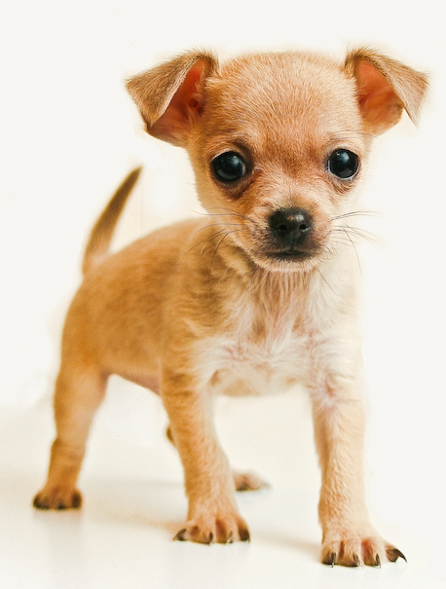
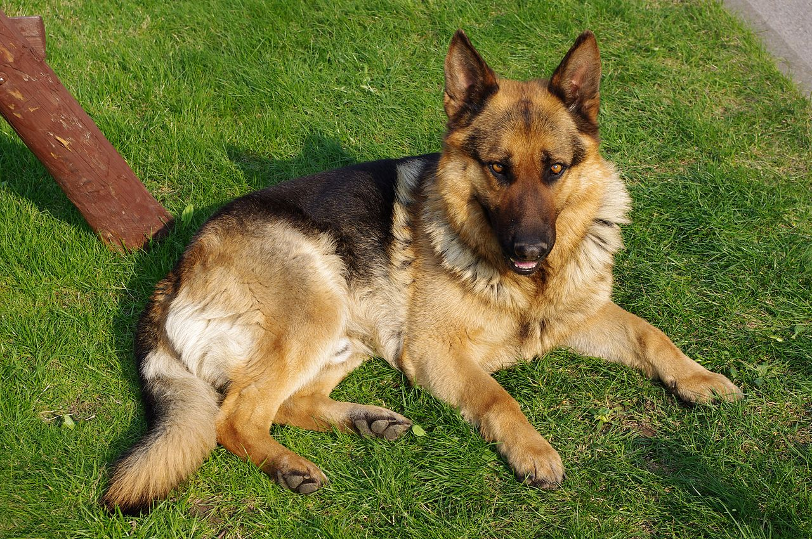
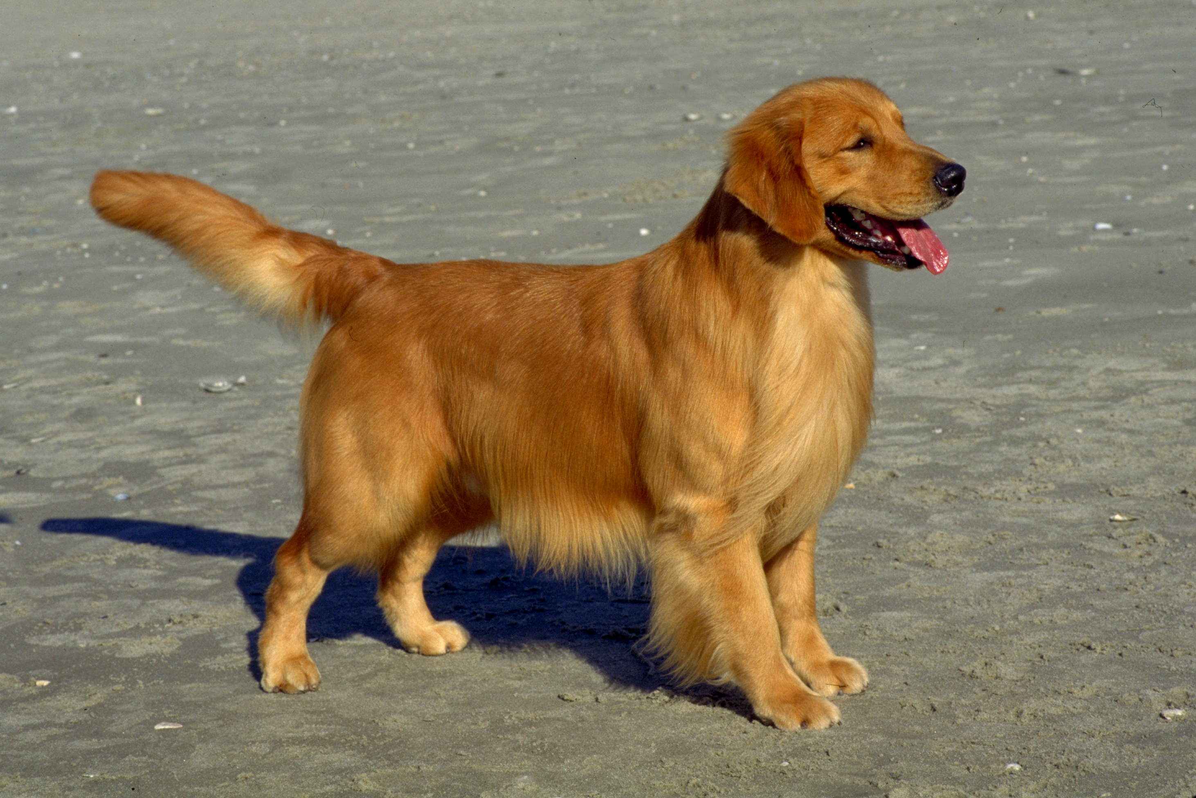
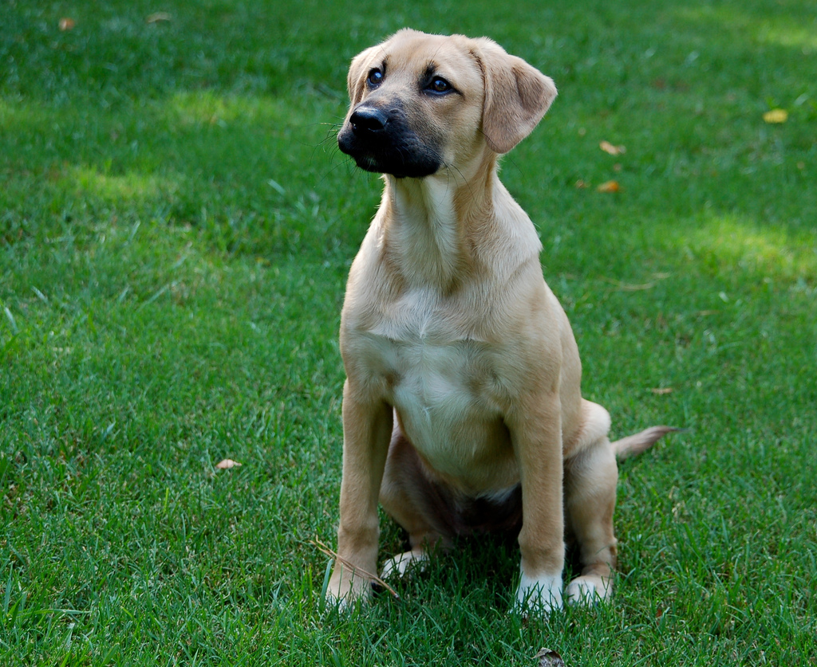
Dogs
Why do different breeds look so different?
Over many centuries, dogs were selectively bred, often by mating close relatives with similar traits, to produce the many diverse dog breeds we see today. .
The Downside of Breeding Close Relatives
This technique allowed breeders to successfully produce many different breeds of dogs but has also led to health problems in purebreds due to inbreeding.
Great Danes Originally bred for their hunting skills and then to be guard dogs in Germany.
Health Problems: • Heart problems • Wobbly walking
• Severe hip pain
Chihuahuas Originally bred in Mexico to be companion dogs.
Health Problems: • Seizures • Low blood sugar
• Eye problems
German Shepherds Bred to herd sheep.
Health Problems: • Severe hip and elbow pain • Heart problems
• Nerve problems
Golden Retrievers Bred to fetch birds shot down by hunters; they have soft mouths and love water – characteristics useful for returning fallen birds undamaged to the shooter.
Health Problems: • Heart problems • Wobbly walking
• Severe hip pain
Mutts Dogs that are a mix of more than one breed have been found to live longer and have fewer health problems than purebred dogs.
Notes:
Scooby Doo: Hanna-Barbera Poductions/Photofest © Hanna-Barbera Poductions
Mutt: Allmutt Blog
German Shepherd: American Kennel Club
Golden Retriever: American Kennel Club

Slide 2
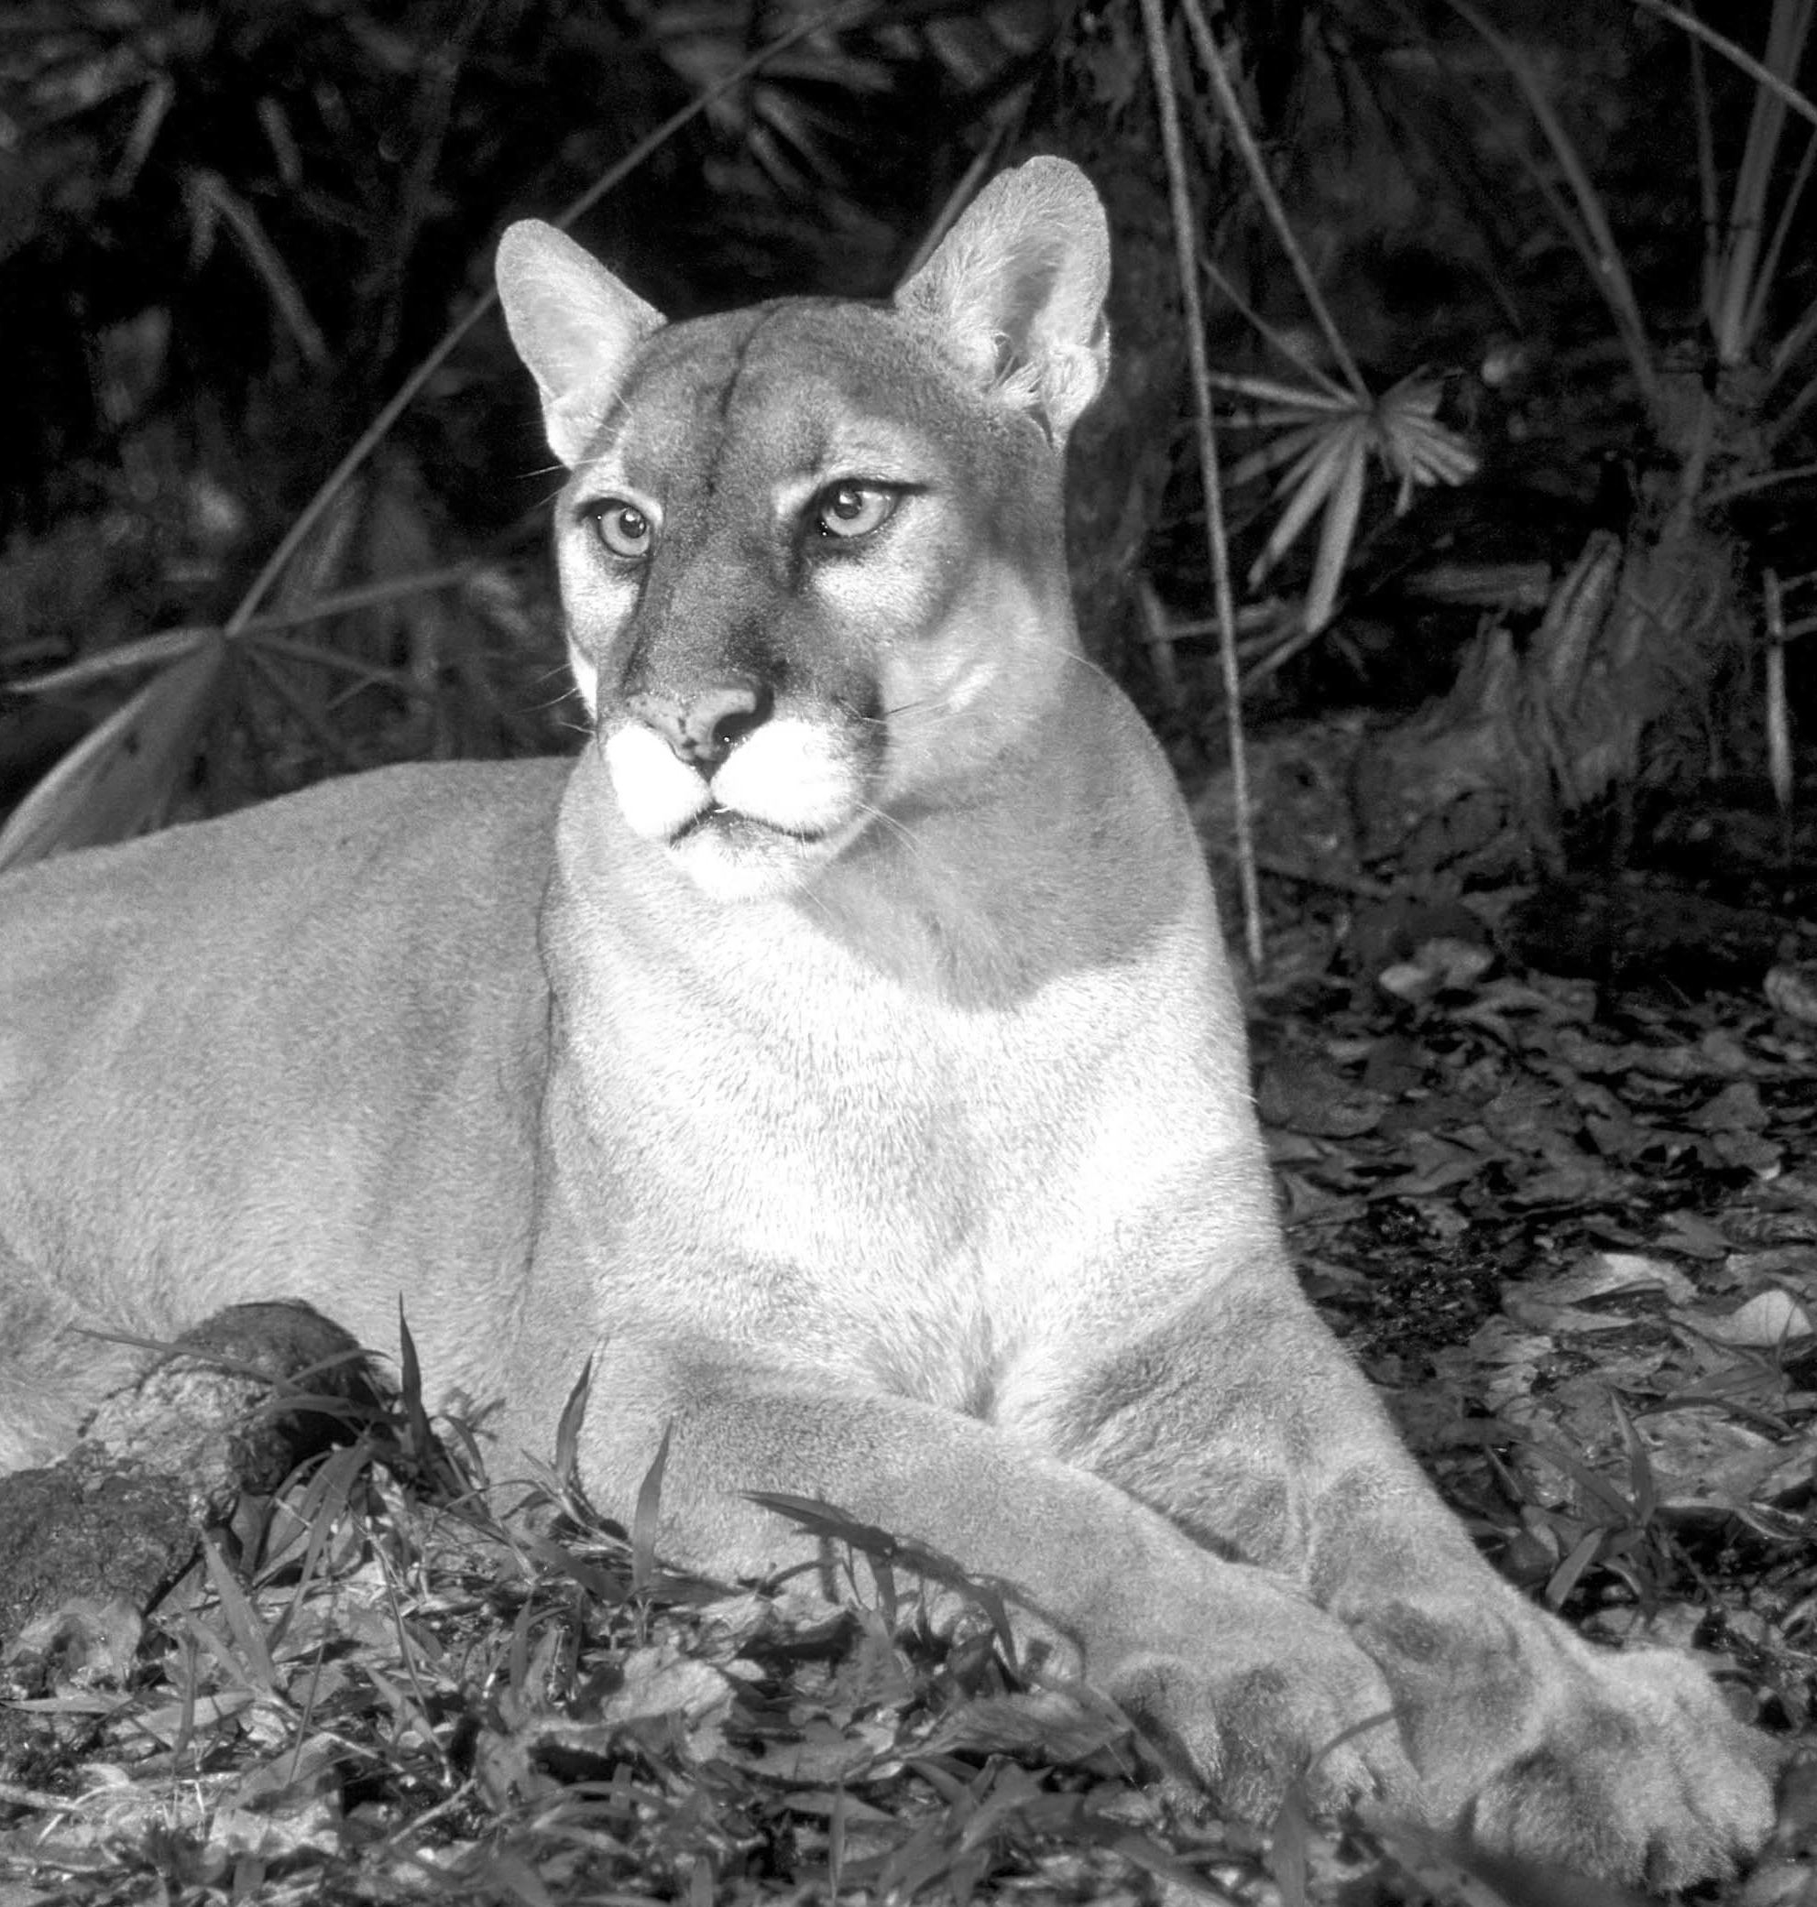
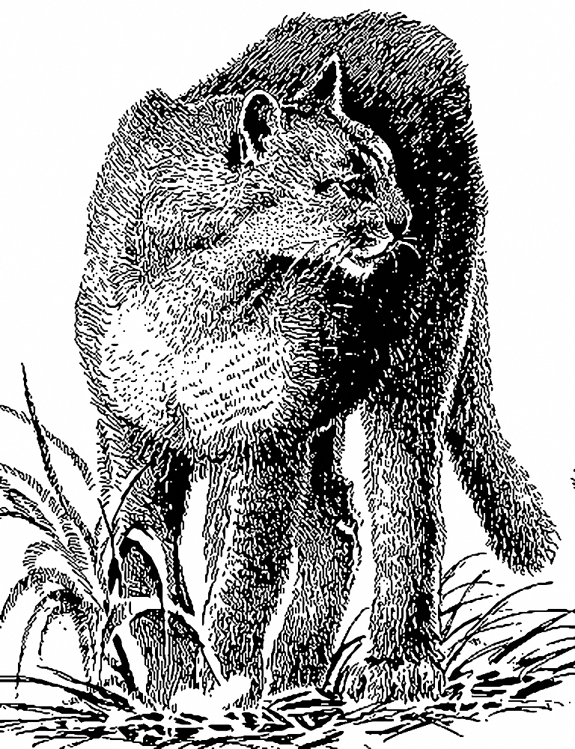
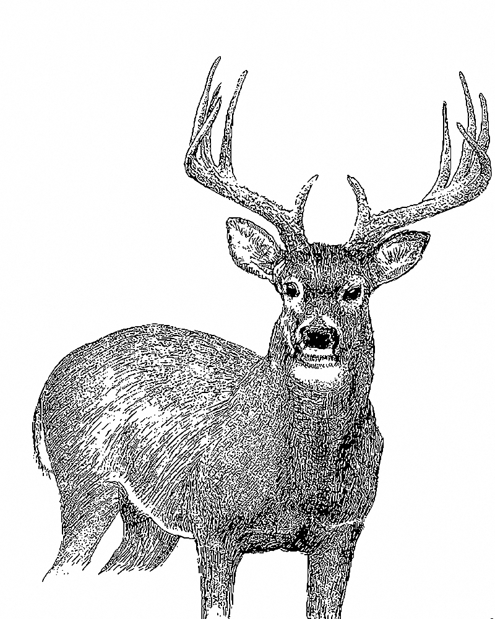
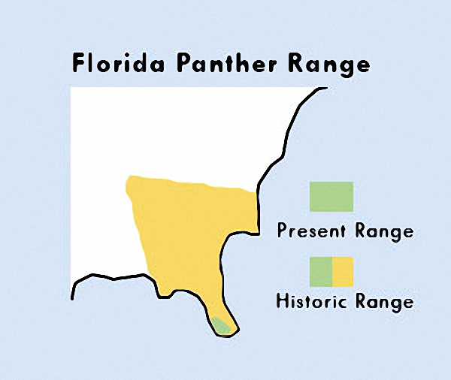
The Florida Panther: Fighting for Survival
Endangered and Inbred
The panther used to be abundant throughout the Southeast United States. Today, due to habitat loss and hunting, only 80-100 panthers survive in Southern Florida. So few Florida panthers remain that close relatives breed, making undesirable traits like heart defects and abnormal sperm common. Panthers born with these defects cannot survive in the wild or if they do, they cannot successfully parent a new generation of panthers.
Attempting to Solve the Problem
Scientists bred few Texas panthers with the Florida panthers. They hope that the addition of new genetic material will help the Florida panther population to become healthier.
Panthers mostly eat white tailed deer, but they also eat raccoons, rabbits, feral hogs, and birds. Keep pets away from them because they will eat them too!
The Florida panther used to be found throughout the Southeast United States including Arkansas, Louisiana, Mississippi, Alabama, Georgia, Florida, and even some of Tennessee and South Carolina. Today, it is only found in the southernmost tip of Florida.
The Florida panther, the state animal of Florida, is part of an animal group sometimes called mountain lions, pumas, panthers, and cougars.
Notes:
Florida Panther(left): US Fish & Wildlife Service Florida Panther Range Map
Florida Panther Range: US Fish & Wildlife Service
White Tailed Deer: US Fish & Wildlife Service
Florida Panther laying: US Fish & Wildlife Service

Slide 3
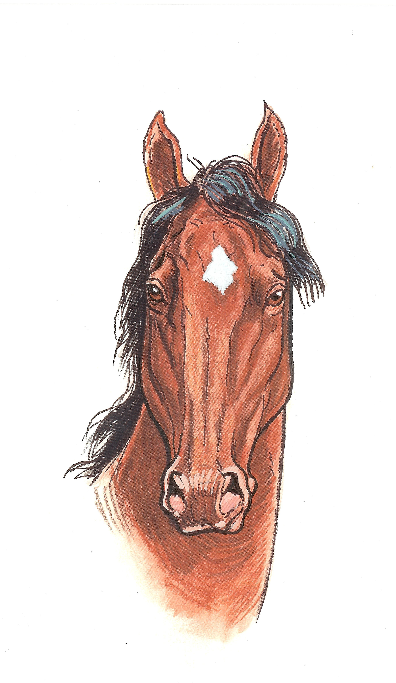
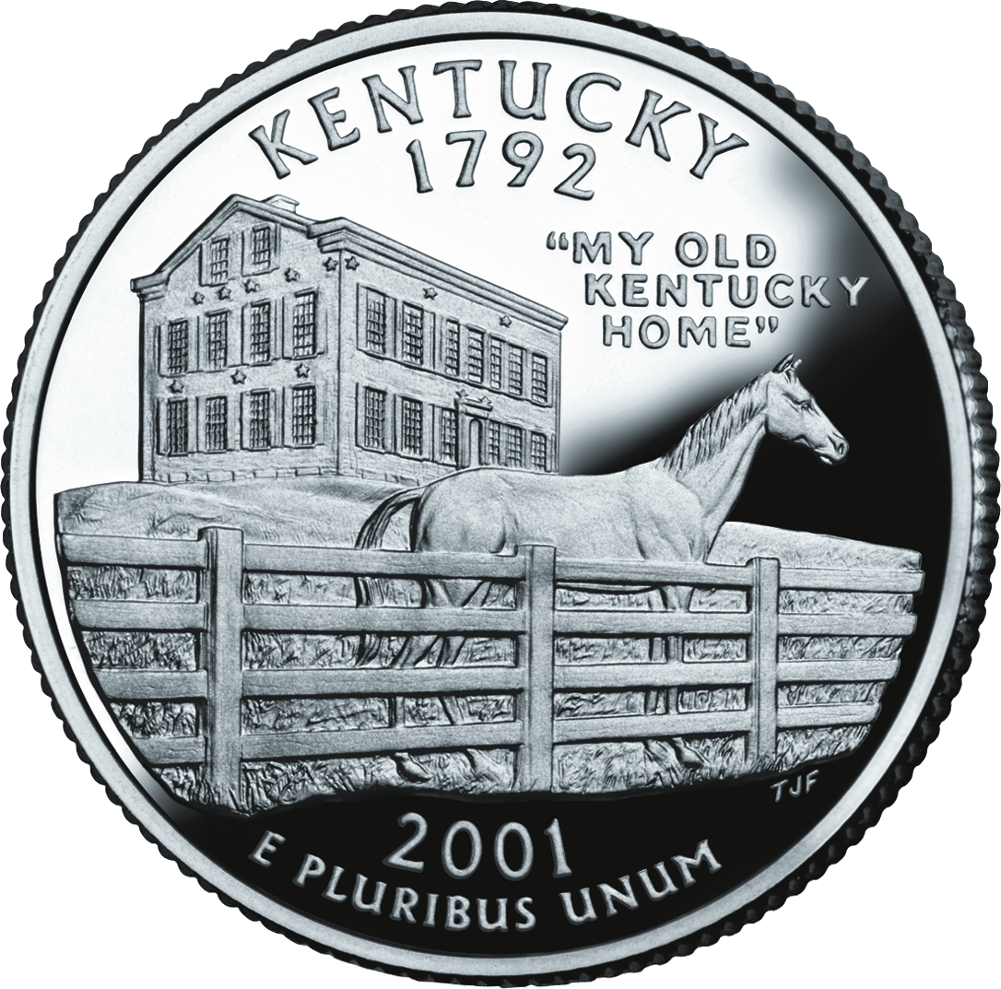
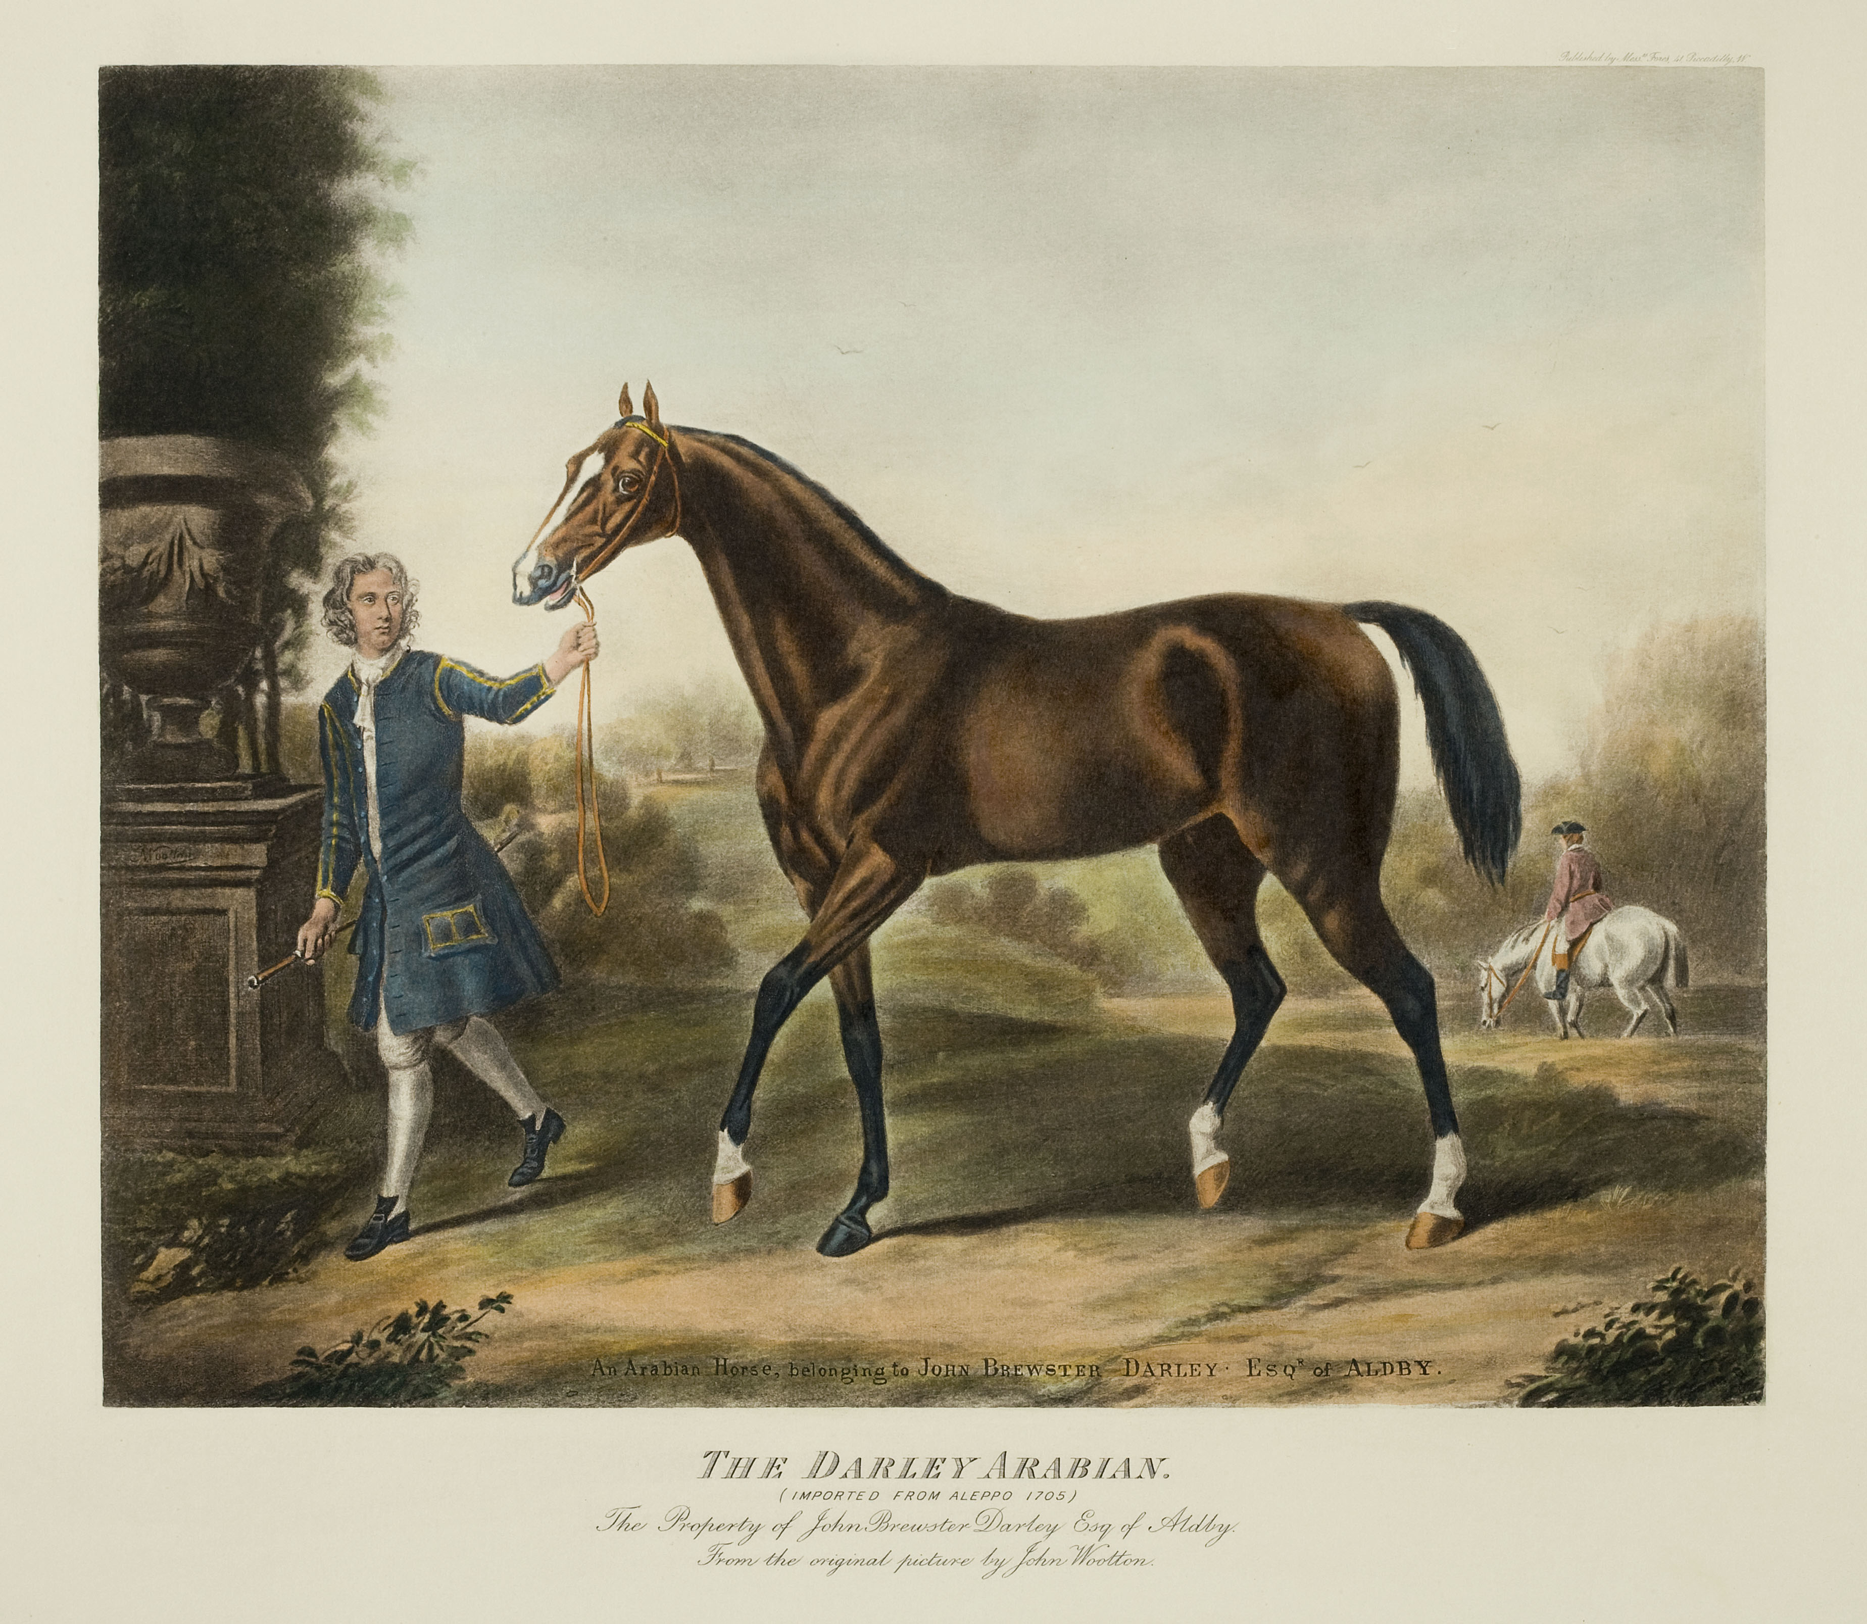
Thoroughbred Horses
History
The Thoroughbred line of racehorses began 300 years ago in England with horses from North Africa and the Middle East. Breeders keep careful records of horse parentage to understand the family history of new breeding horses.
Breeding
Analysis of Thoroughbred family histories and genes shows that all modern racehorses are descended from only 28 horses. In fact, most horses are descended from three horses with only one of those males contributing genes to almost all Thoroughbreds alive today!
Inbreeding Effects
Selectively choosing to mate fast horses has made Thoroughbreds the fastest breed of horses, but it has also made them inbred, which contributes to reproductive issues and skeletal defects that cause bone breaks. Horses that break a bone are usually put down.
The three Triple Crown races, the Kentucky Derby, Preakness Stakes and Belmont Stakes, are the major events for U.S. three-year-old Thoroughbred horses.
A Thoroughbred horse on the Kentucky State quarter, a state known for thoroughbred horse breeding.
Most racehorses today are descended from the Darley Arabian, depicted above.
Notes:
Horse Star Mark: Artwork by Dale Crawford, courtesy of US Geological Survey
Belmont Stakes: The New York Racing Association
Kentucky Coin: US Mint
Darley Arabian Horse: AMNH/C. Chesek

Slide 4
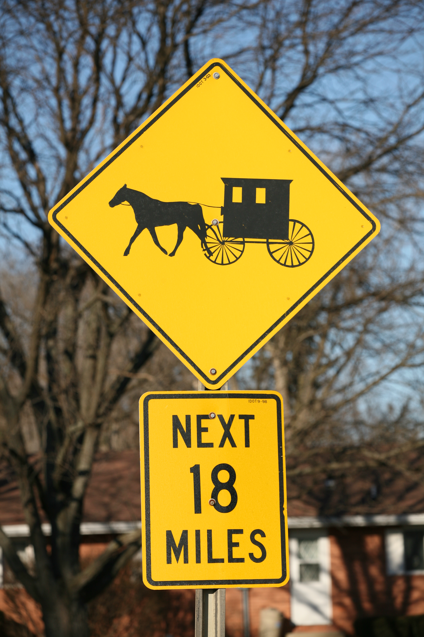
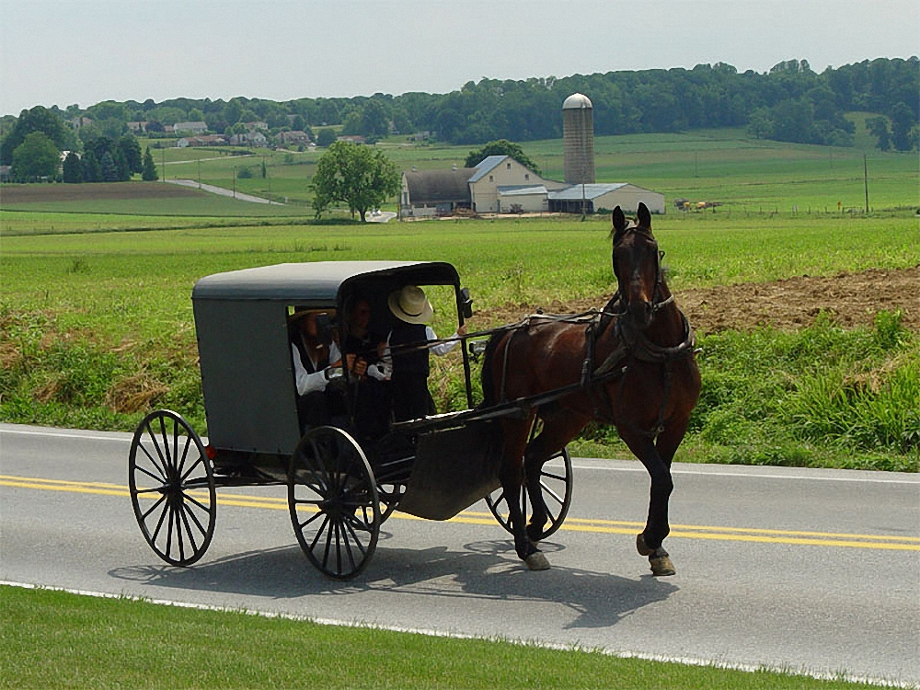
What is it?
People are born with this disease if they inherited an improperly functioning gene from both their parents. Affected babies cannot break down certain protein components, which build up in the body leading to sweet smelling urine, like maple syrup. Left untreated, babies become brain damaged.
Treatment
This disorder is treated by exclusively eating foods that do not contain the proteins which cannot be broken down.
Where is it Common?
A greater proportion of Amish suffer from this disorder than the general population because many of today’s Amish are descendants of a small founding group that carried the gene for this disorder. The smallness of the original founding group means that the gene for this disorder is carried by a higher proportion of Amish than in the general population.
The largest Amish communities are in Ohio, Pennsylvania, and Indiana.
Notes:
Amish Buggy Sign: Daniel Schwen
Lancaster Amish: T. Utente
MMA diagram: Minnesota Department of Health

Slide 5
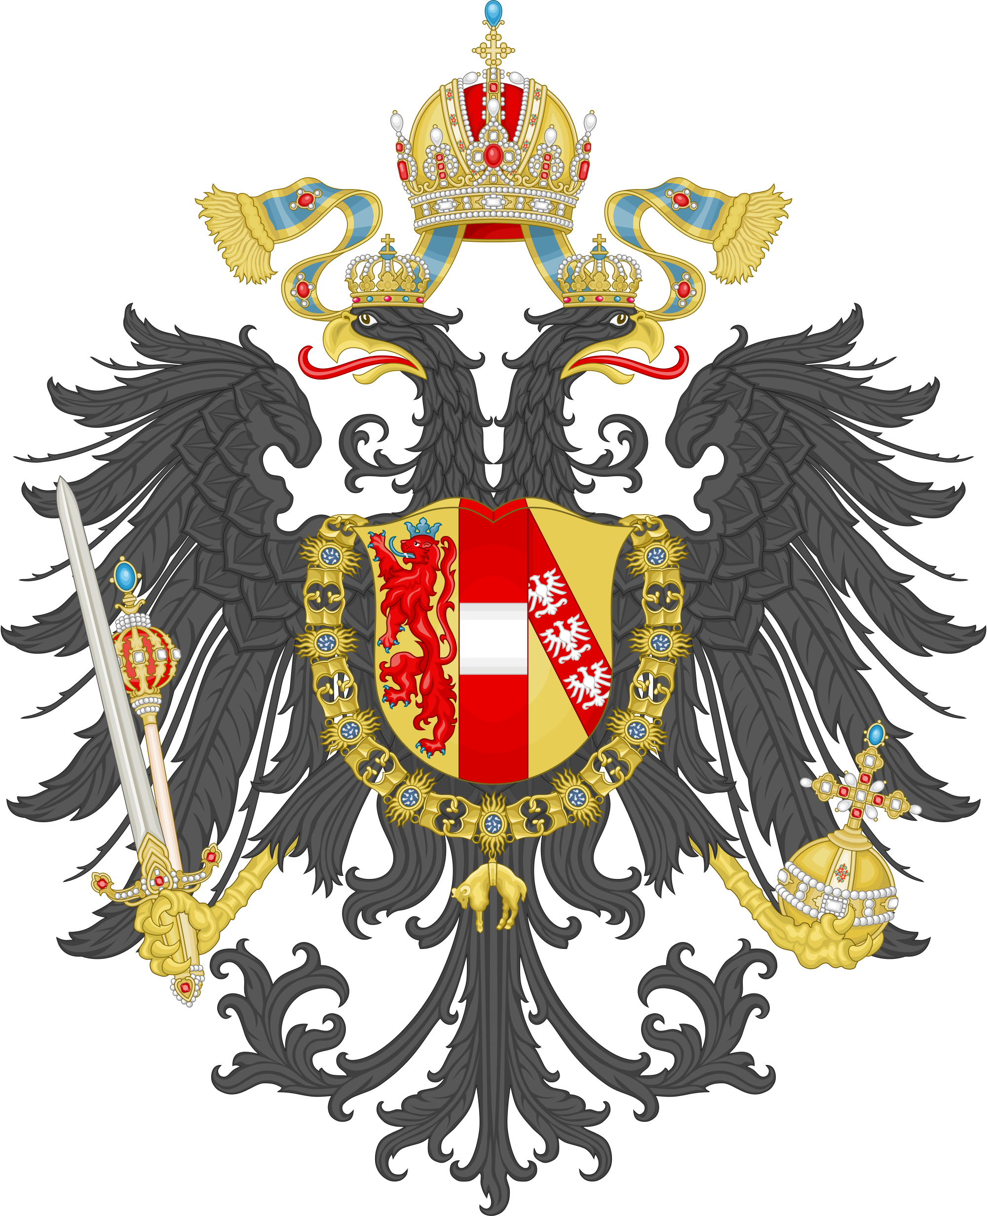
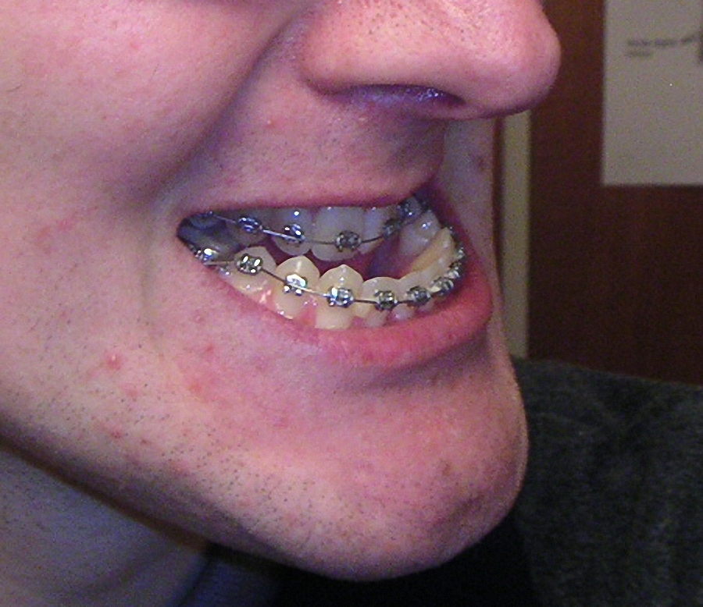
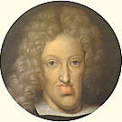
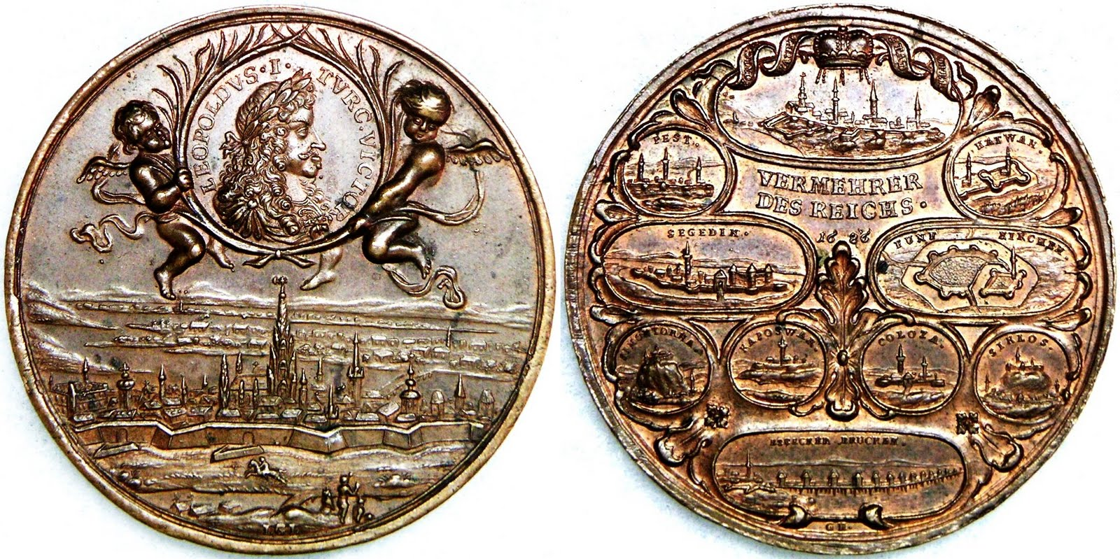
Inbreeding Amongst European Royalty
The House of Habsburg
This European royal family ruled over enormous regions of central and western Europe during the middle ages and into the Renaissance period.
Inbreeding
In order to keep “pure” bloodlines and seal alliances for increased power, the Habsburgs intermarried one another frequently. Marriages between first cousins and uncles and nieces were fairly common.
The Habsburg Jaw
In the mid 1400s, the Habsburg Jaw was first noticed in the royal family. This condition, where the lower jaw grows faster than the upper jaw results in an elongated chin and can worsen with age. The jaw was so common in the Habsburg family that the condition was named after them!
Photo of a person with Habsburg Jaw
Charles II (1661-1700), the last Habsburg King of Spain had the most extreme case of Habsburg Jaw recorded. He was also mentally disabled. An analysis of the previous marriages that led to his birth reveals multiple uncle-niece marriages and first cousin marriages.
This coin of Leopold I (1640-1705), another Habsburg, again shows the characteristic Habsburg Lip. However, some coin collectors do not believe that this coin is accurate.
Notes:
Austrian Crest: Hugo Gerhard Ströhl
Person with Habsburg Jaw: Mikäel Haggström
Leopold I Coin: HKMAL Coins

Slide 6
Image Credits
Scooby Doo: Hanna-Barbera Poductions/Photofest © Hanna-Barbera Productions Mutt: Allmutt Blog German Shepherd, Golden Retriever: American Kennel Club Group of dogs: Chihuahua: By Danielle deLeon (originally posted to Flickr as Degaen) [CC-BY-2.0 (http://creativecommons.org/licenses/by/2.0)], via Wikimedia Commons
All: US Fish & Wildlife Service
Horse Star Mark: Artwork by Dale Crawford, courtesy of US Geological Survey Belmont Stakes: The New York Racing Association Kentucky Coin: US Mint Darley Arabian Horse: AMNH/C. Chesek
Amish Buggy Sign: Daniel Schwen Lancaster Amish: T. Utente MMA diagram: Minnesota Department of Health
Austrian Crest: Hugo Gerhard Ströhl Person with Habsburg Jaw: Mikäel Haggström Leopold I Coin: HKMAL Coins

