Slide 1
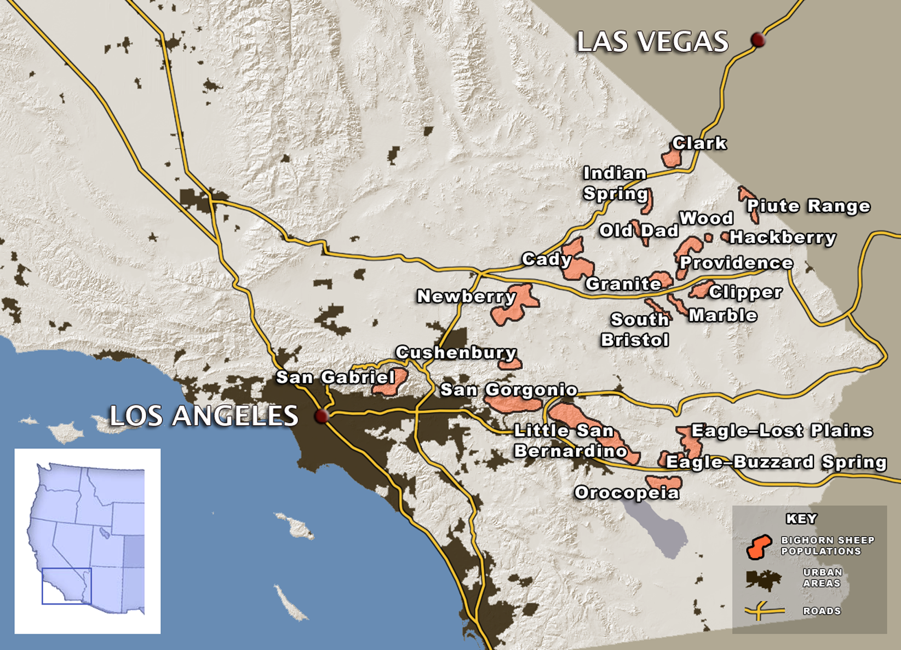
Examining the DNA for evidence of breeding between mountaintop sheep populations.
Notes:
Now we have added the names of the mountaintops where each sheep population is found.

Slide 2
How would a highway running through two sheep populations affect their mating habits?
Notes:
Now we have added the names of the mountaintops where each sheep population is found. Next we are going to focus on one area.

Slide 3
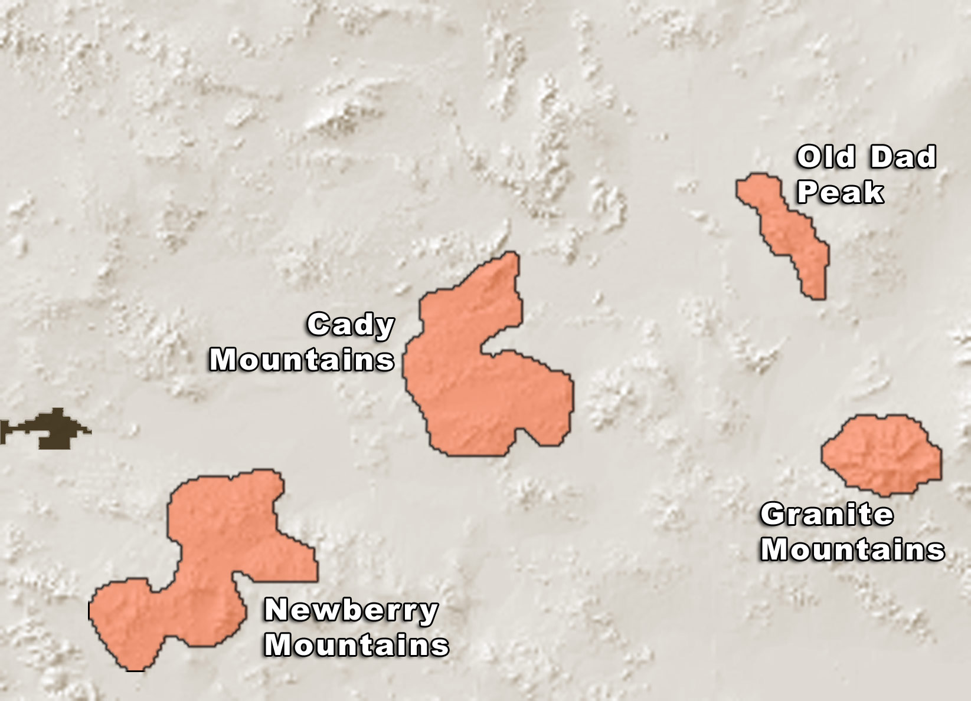
Based only upon geographic distance with which population would you expect Cady mountain sheep to show more signs of mating: Newberry, Old Dad, or Granite sheep? Why?
Notes:
This slide will not have highways, so students should say that old dad and granite should be the closest together because of geographical proximity.

Slide 4
Based only upon geographic distance with which population would you expect Cady mountain sheep to show more signs of mating: Newberry, Old Dad, or Granite sheep? Why?
Answer: Newberry
Why? It is the closest.
Notes:
This slide will not have highways, so students should say that old dad and granite should be the closest together because of geographical proximity.

Slide 5
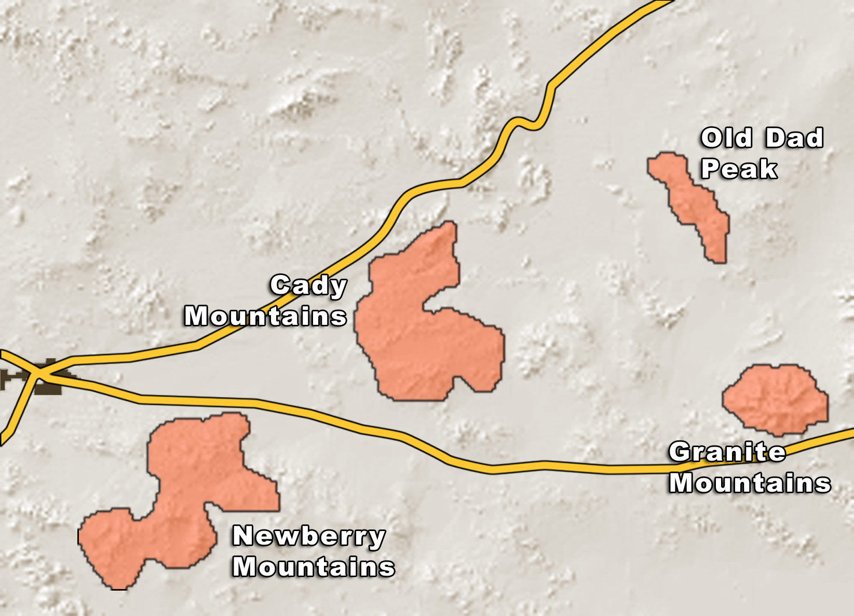
Due to the highways around Cady mountain, which population will Cady bighorn sheep show the least signs of mating, Newberry, Old Dad, or Granite sheep? Why?

Slide 6
Due to the highways around Cady mountain, which population will Cady bighorn sheep show the least signs of mating, Newberry, Old Dad, or Granite sheep? Why?
Answer: Newberry
Why?: It is separated from Cady Mountain by a highway.

Slide 7
Instructions for Analysis
STEP 1:
a. Use a metric ruler to measure the minimum distance in millimeters between mountain tops.
b. Based on these measurements, predict which populations will have the highest level of inter-breeding.
STEP 2:
Then use the genetic data (arrows), draw double-headed arrows to connect populations to signify the documented level of breeding between populations. More arrows show more connection, i.e., more breeding; fewer arrows show less connection, i.e., less breeding.
STEP 3:
a. Answer questions to compare your results from step 1 and step 2.
b. Predict highway location and draw it on map.

Slide 8
STEP 1:
Use a metric ruler to measure the minimum distance in millimeters between mountain tops.
Based on these measurements, predict which populations will have the highest level of inter-breeding.

Slide 9
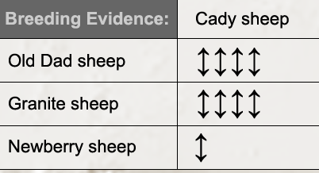
STEP 2: Using the genetic data (arrows), draw double-headed arrows to connect populations to signify the breeding levels between populations.
More arrows show more connection, i.e., more breeding; fewer arrows show less connection, i.e., less breeding.

Slide 10
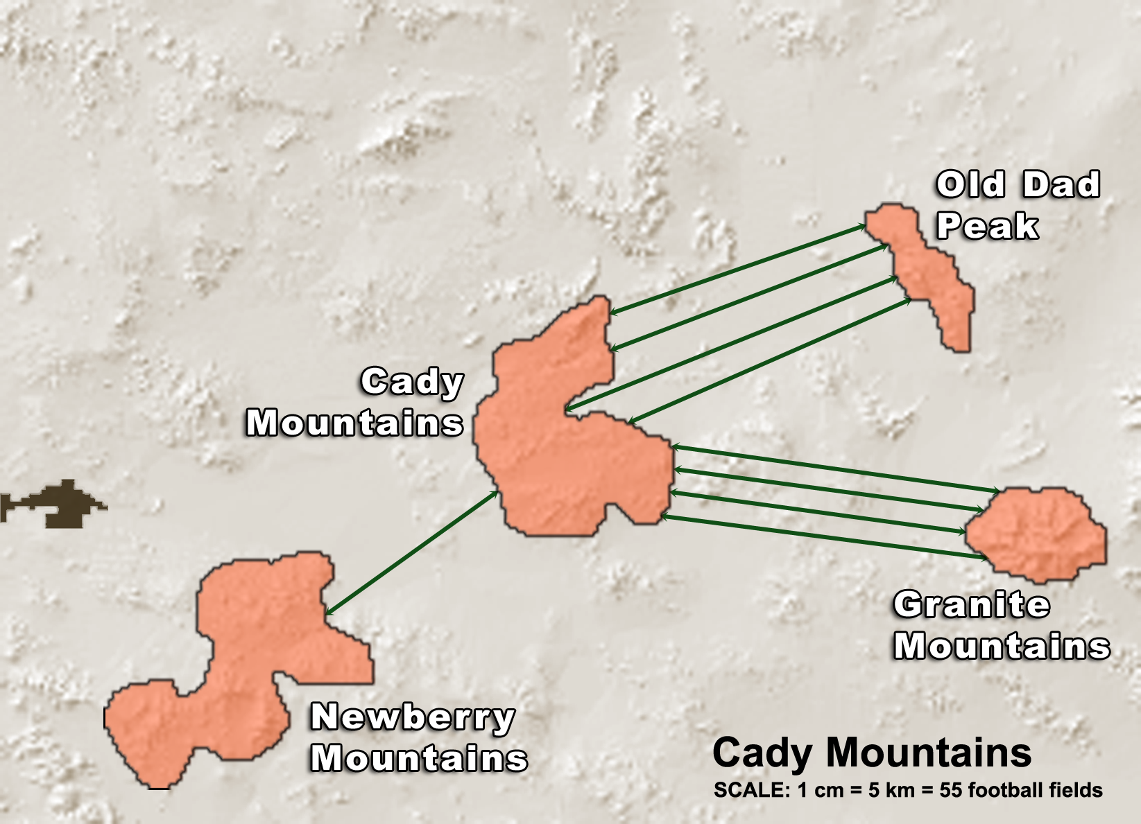
STEP 2: Using the genetic data (arrows), draw double-headed arrows to connect populations to signify the levels of breeding between populations.
More arrows show more connection, i.e., more breeding; fewer arrows show less connection, i.e., less breeding.

Slide 11
STEP 3:
Answer questions to compare your results from step 1 and step 2.
Predict highway location and draw it on map.
Where would you put the highway?

Slide 12
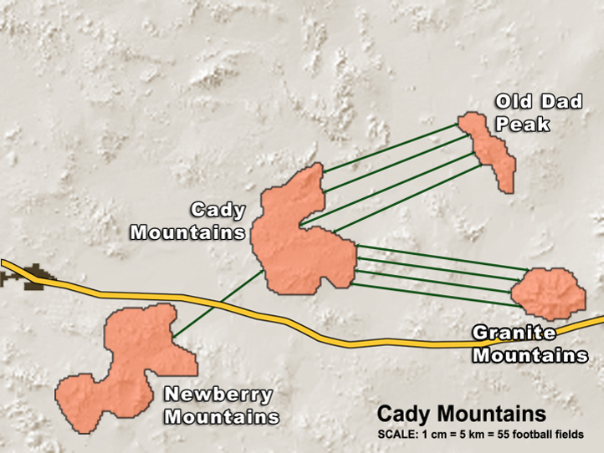
STEP 3:
Answer questions to compare your results from step 1 and step 2.
Predict where the highways are by drawing them on the map.

Slide 13
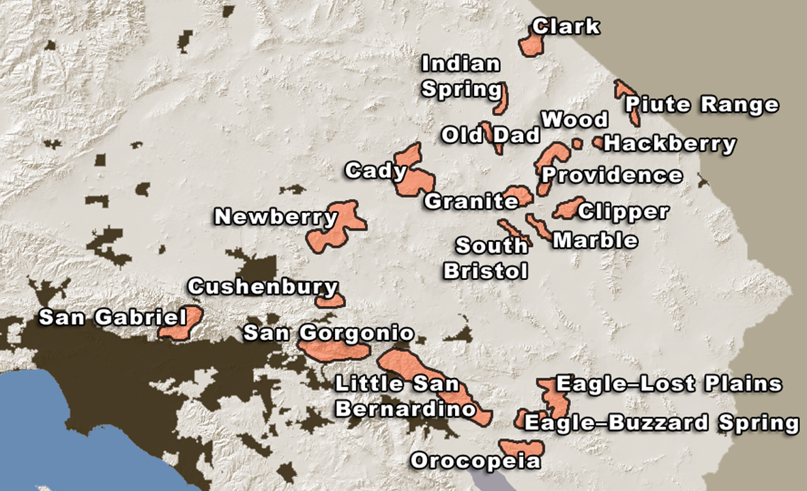
After completing your analysis, transfer your data onto this overview map. Draw lines that signify the genetic data and draw highways based upon those line data.

Slide 14
Highways

